Slide 1
Jira TechTalk
May 20, 2025
Presented by
Rudy Rodriguez - Data & Reporting Analyst
Tim Kelleher - Software Engineer

Slide 2
Current Status
Jira is live!
All new tickets should be created in Jira
Existing TFS requests will be honored
TFS will be shutting down Tuesday, June 10, 2025

Slide 3
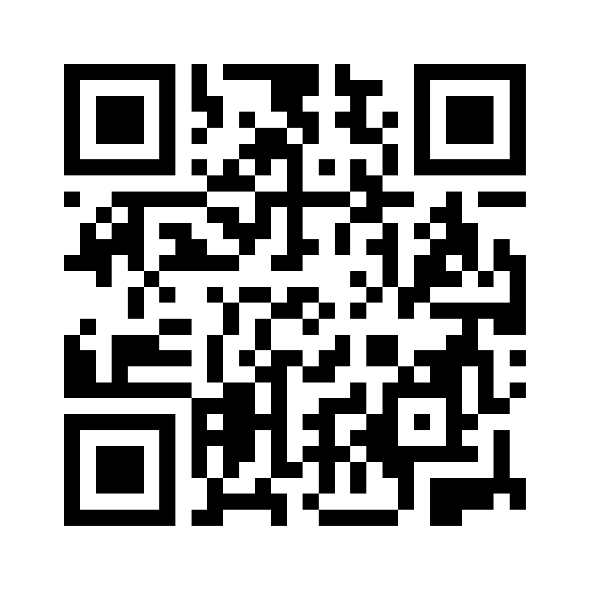
tickets.advancement.ucr.edu
Log in or
create your account:

Slide 4
Domain Collapse
Thanks David Briseno!
Due to the domain collapse, ITS now controls some more of your tech (hardware and software)
You may have to go through ITS for some requests

Slide 5
Scope of Jira
CMT (Jira)
Software/Systems: Raiser’s Edge/Financial Edge, Jira, Karma, Adobe Suite, LinkedIn Sales Navigator, LiveAlumni, Marching Order, CyberSource, Double the Donation, GiveCampus, MailChimp, Salesforce, SharePoint Folders & File Storage
Hardware: Laptops, cell phones, equipment, printers, servers, etc.
Data and Reporting Services: lists, reports, and dashboards of data from Raiser’s Edge/Financial Edge/Salesforce
ITS (BearHelp, ServiceNow)
Software: Slack, Teams, Zoom, PowerBi, Docusign, Adobe Suite, SnagIt, Microsoft Office Suite
Hardware: Laptop, computer, tablet, printer
Network and Infrastructure: DNS, Network Access, Integrations Architect, API Access, Google Cloudskills, Slate Access
Communications: Campus website, Zoom phones, multimedia services, department email/shared mailboxes
Reporting Services: lists, reports, dashboards of data from campus systems

Slide 6
Jira Launch Stats
Jira went live on April 14th
In one month about 500 tickets created
~200 support tickets
~50 data imports
~50 email blasts
~20 data pulls

Slide 7
Recap
Jira Login
Use the QR code to gain access using your NetID
cmtjira@ucr.edu
tickets.advancement.ucr.edu
TFS Sunsetting
Last day is Tuesday, June 10, 2025
Once you have access to Jira, please begin using it

Slide 8
Additional Resources
Submitting a Ticket Tutorial
https://ucrcmt.atlassian.net/wiki/external/NmNkYTZlZTE2NzczNDdlMjgzM2ZmZDZiOTNmNWYzNDk
Video Tutorials
https://ucrcmt.atlassian.net/wiki/external/MTA1MTk1NTNmOTc3NDQ5Yjg3MDllY2VjNzhkYTAxY2M
Office Hours
Meeting scheduled for Tuesday, June 3rd.
Come to us with your Jira questions!

