Slide 1
April 9, 2024
GOOD DAY UA
GET TO KNOW VCUA TEAMS

Slide 2

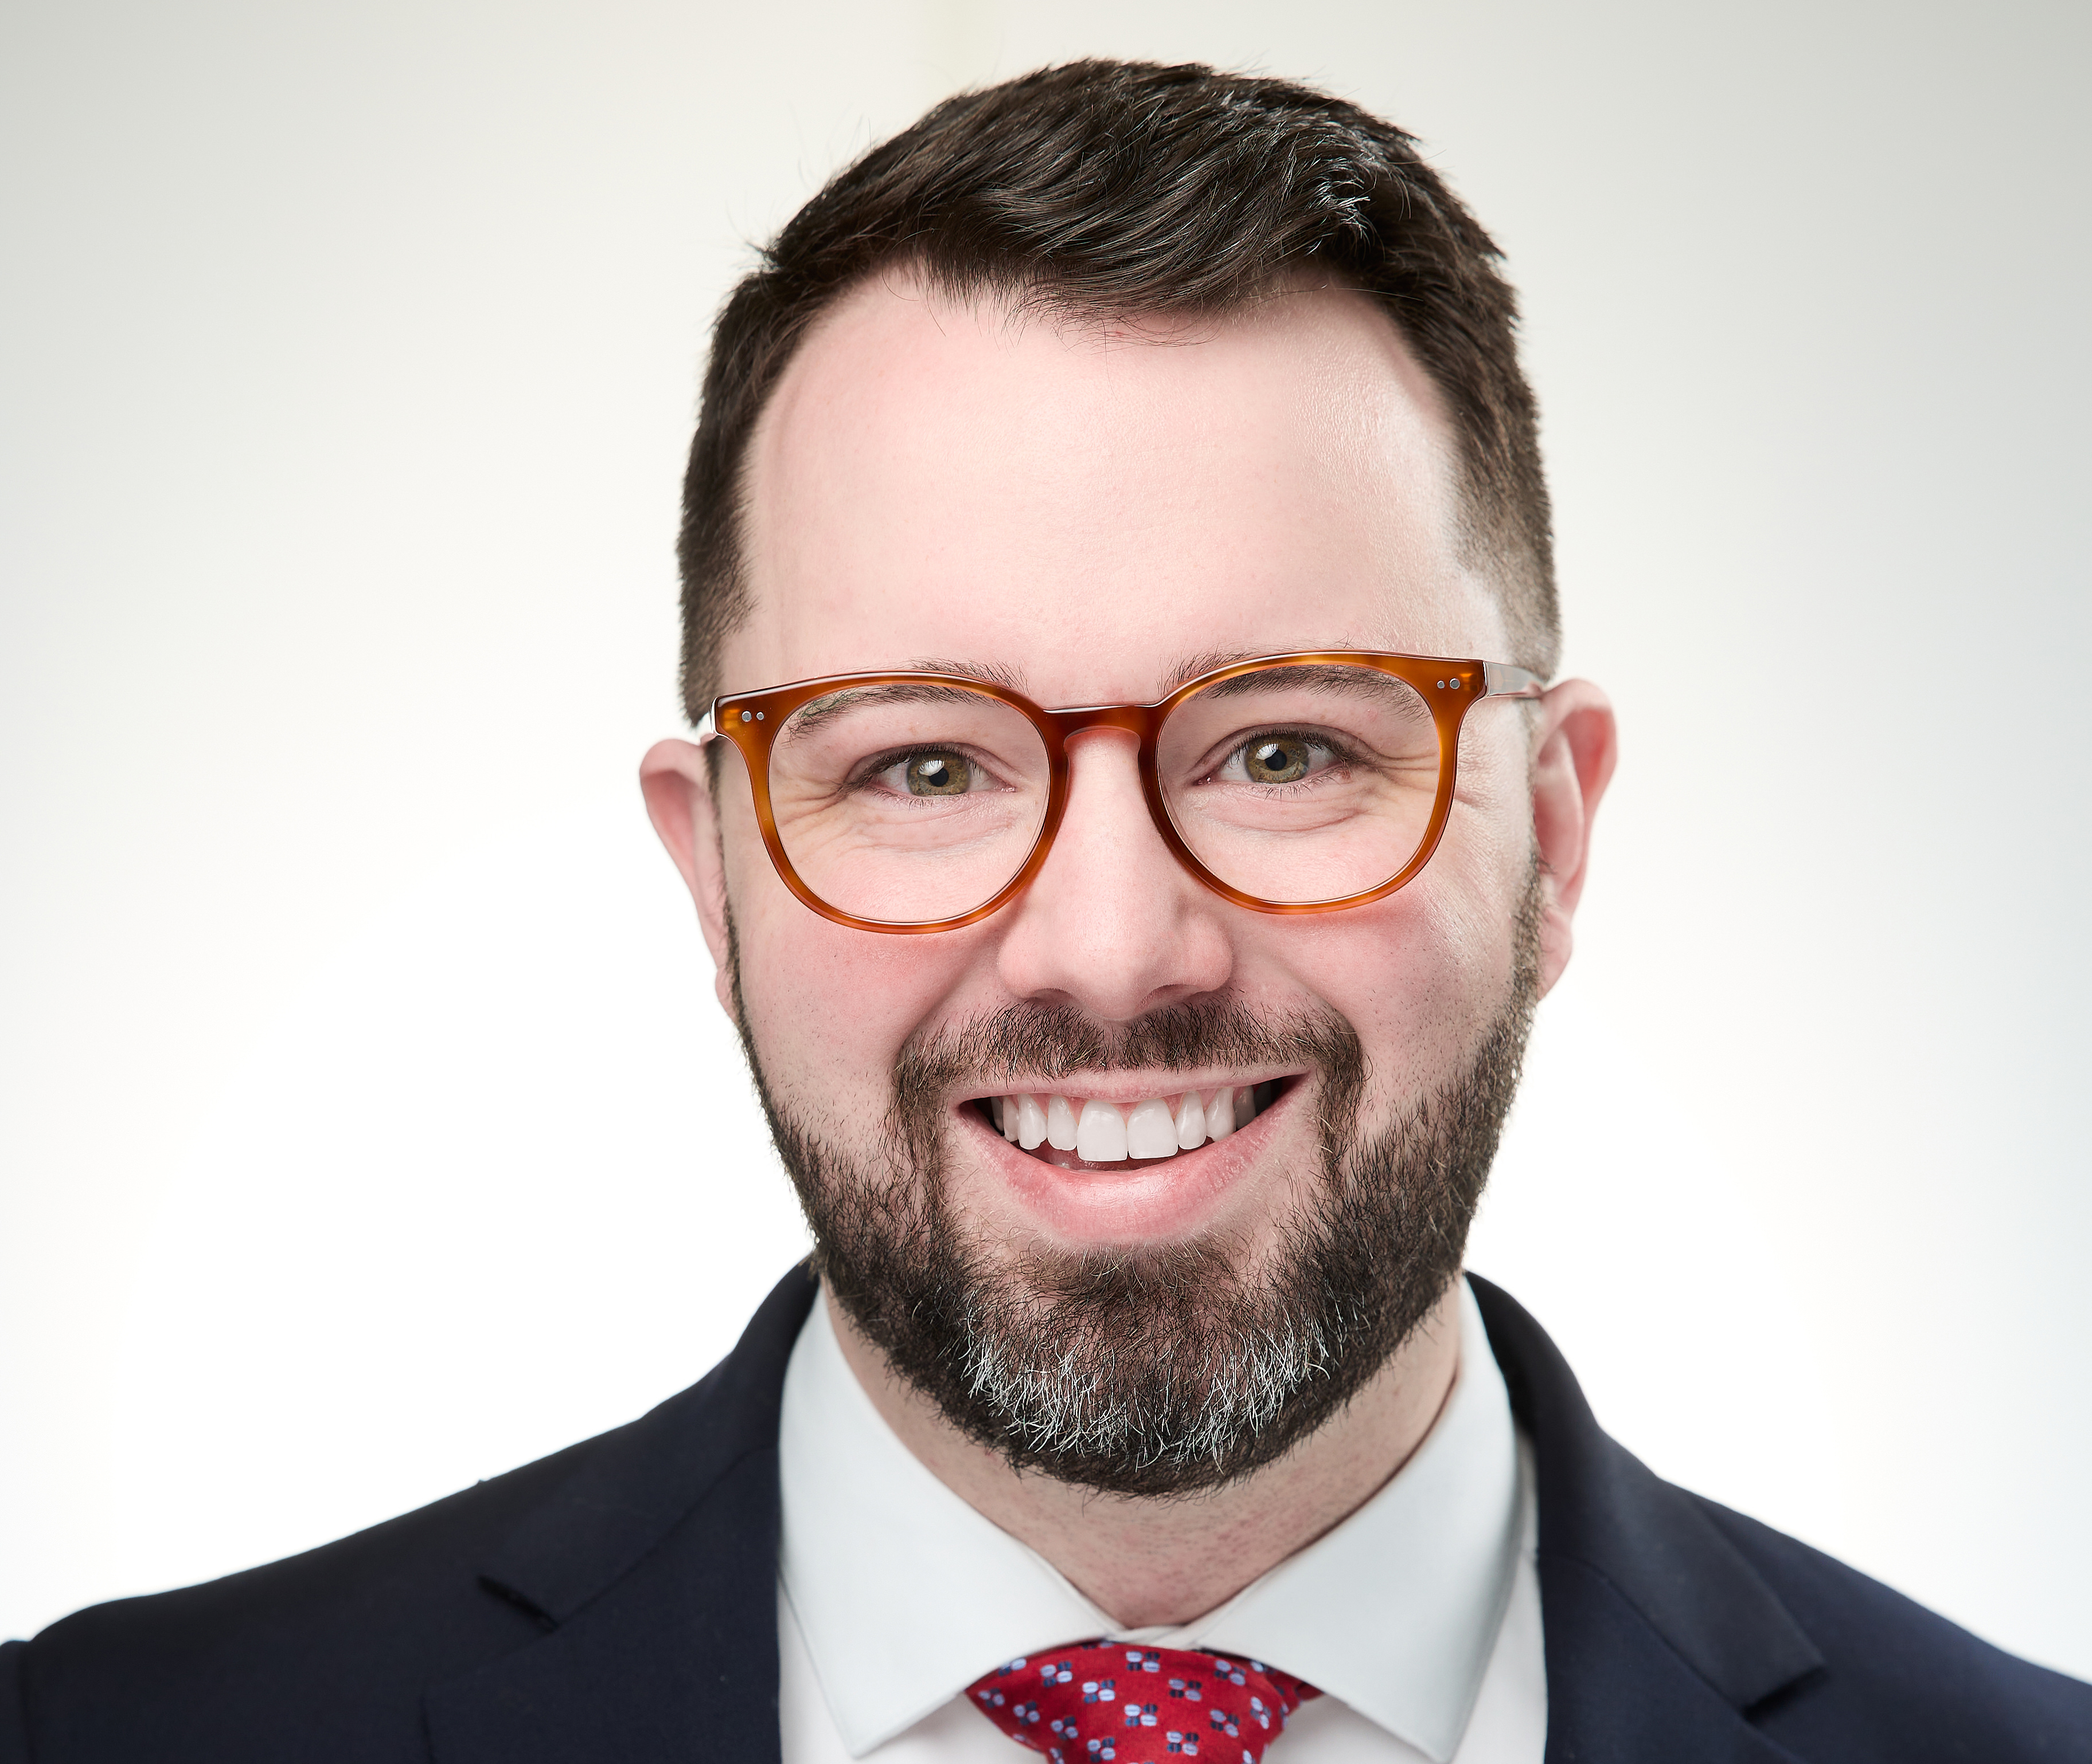
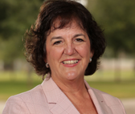
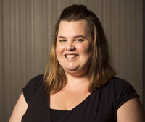
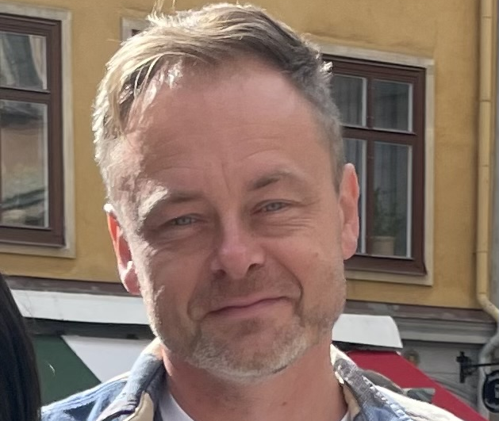
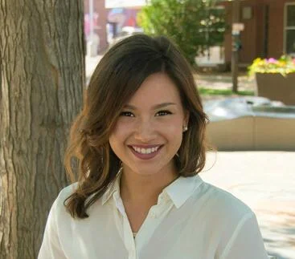
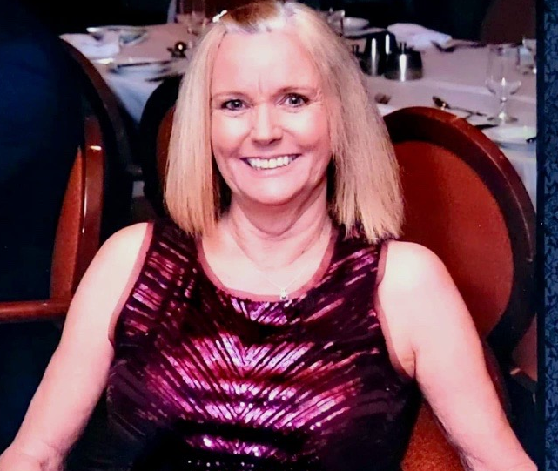
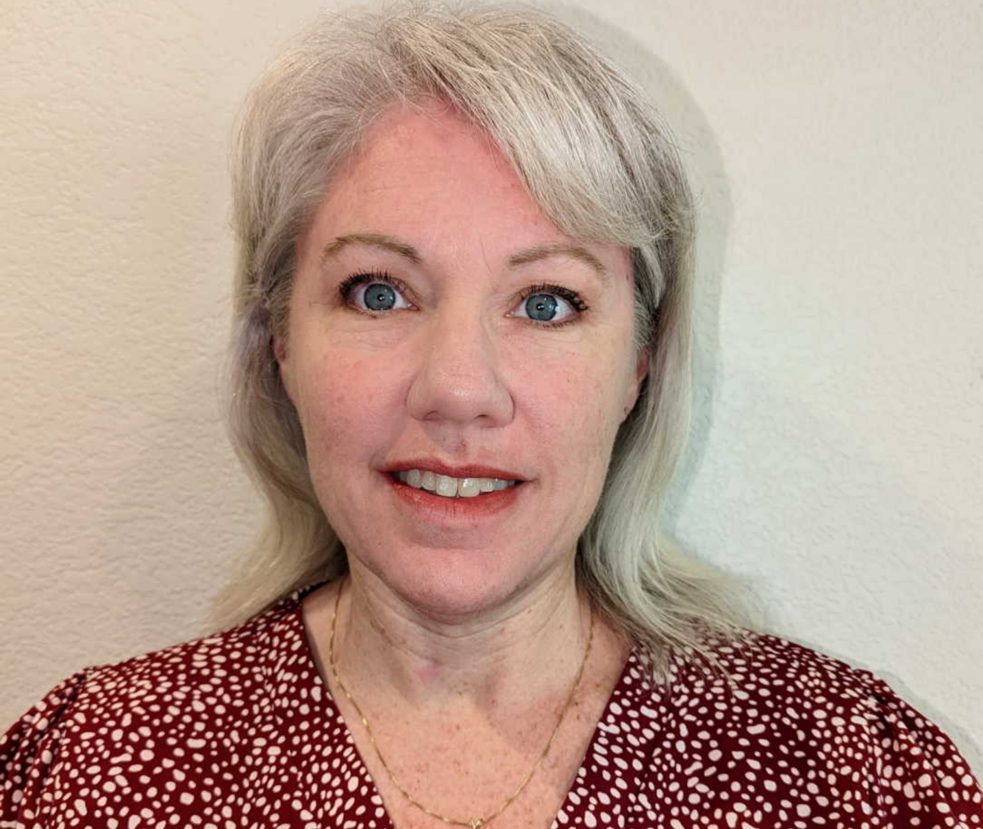
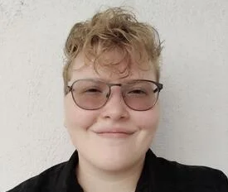
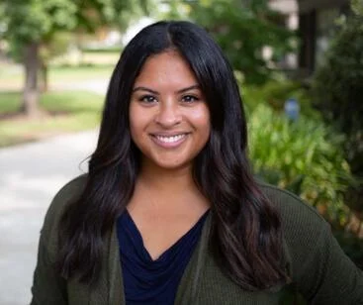
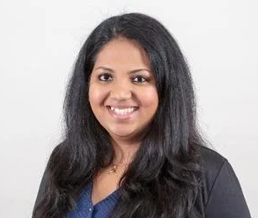
OUR TEAM
Josh Carter
Sharilyn Berry
Heather Morales
Matt Heimdahl
Alexis Szewczuga
Chief of Staff
Executive Director, UCRF Relations
Assistant Director, Prospect Development
Assistant Director, Prospect Research & Data Intelligence
Senior Data & Prospect Research Analyst
LaDonna Ardary
Kimberley Harvie
Ed Hirtzel
Taylor Ring
Mahisha Ketagoda
Strategic Initiatives Liaison
Director of Prospect Development
Prospect Development Associate
Prospect Development Associate
Senior Prospect Research Analyst
Notes:
Heather, LaDonna, Ed, Taylor, Sharilyn, Josh

Slide 3
OUR MISSION
Our team’s mission is to support University Advancement staff, campus leadership, and external stakeholders with strategy and resources to raise private philanthropic support and engagement from our diverse constituents.

Slide 4
OUR VALUES
SERVICE
CURIOSITY
EMPATHY

Slide 5
WHY VCUA

Slide 6
OUR GOAL
Move University Advancement’s priorities forward by driving integrated strategy and operations.

Slide 7
Strategic Alignment (Chief of Staff)
Board Relations
Prospect Development
Governance
Administrative Support
Strategic Board Communications
Identification & Reporting
Portfolio & Moves Management
Campaign Planning
STRATEGIC ALIGNMENT
CORE BUSINESS OBJECTIVES
PROVIDE SUPPORT TO TRUSTEES AND KEY AMBASSADORS
MANAGE TRUSTEE PORTFOLIOS EXPECTATIONS
SERVE AS CHIEF TRUSTEE COMMUNICATORS
INCREASE PROSPECT PIPELINE (INDIVIDUALS AND ORGANIZATIONS)
WORK WITH LEADERSHIP TO ESTABLISH PORTFOLIO STAGE MIGRATION EXPECTATIONS AND METRICS
SERVE AS PORTFOLIO MANAGERS (INSIDE SALES)
PARTNER WITH DEVELOPMENT ON CAMPAIGN STRATEGY

Slide 8
PROSPECT DEVELOPMENT

Slide 9
PROSPECT RESEARCH & DATA INTELLIGENCE
PD’s data & analytics arm
Team Members:
  Matt Heimdahl – Assistant Director
  Mahisha Ketagoda – Senior Analyst
  Alexis Szewczuga – Senior Analyst

Slide 10
TEAM FOCUS AREAS
Prospect Identification
Predictive Modeling
Reporting
Process Improvement
Training

Slide 11
FY24 PD SUCCESSES
Major gifts from prospects previously identified by PD:
  $400K gift from David Betts ‘90 (Nesha & Eveleen)
  $137K estate gift from Edward Hill ‘65 (Brittany & Sandy)
  $26K gift from Dr. Anil Garde (Kathy Kim)
567 new prospects identified for portfolio additions and regional outreach lists
Trainings library
Scorecard -> DO Progress Summary
Affinity Score
Windfall data import

Slide 12
FY2025
OBJECTIVES
Identify external prospects (new Friends) with affinity for UCR’s mission
Create suite of predictive models to target prospecting efforts
Incorporating and improving user experience (UI/UX) in our processes & deliverables
Revamp/streamline our reporting
Readying for Salesforce transition

Slide 13
PROSPECT MANAGEMENT

Slide 14
COVERAGE AREAS
Kimberley Harvie, Director Prospect Development
Senior Leadership, Principal Giving
Trustee Research, Team Development
Heather Morales, Assistant Director Prospect Development
Gift Planning, Regional & Pipeline Development, Student Affairs, Corporate & Foundation Relations and Annual Giving
Briefing Profiles & Due Diligence Research
Ed Hirtzel, PD Associate
CHASS, SPP, Education, Athletics, UNEX and Library
Taylor Ring, PD Associate
CNAS, BCOE, School of Medicine and Business

Slide 15
Monthly Meetings with Fundraising Staff
  Portfolio & Proposal Reviews
  Progress to Goals
  Strategies for Unit Priorities
Portfolio Maintenance
  Assignments, Unassignments, Referrals & Transfers
  Annual Review
  New Hire Portfolio Reviews & Research
  Staff Departure Offboarding Schedule & Review
Moves Management Reviews
  Stage Aging & Moves
Tools & Training
  DO HUB & PD SharePoint
  Video Training & Job Aids
  New Hire Onboarding Weekly Virtual Open House
  How to run Annotated Guest Lists
PROSPECT MANAGEMENT
Prospect Management is the planning, recording, and reporting of significant moments in the relationship between prospective donors and the organization.
Notes:
Talk about collab with other units to refine the referral process

Slide 16
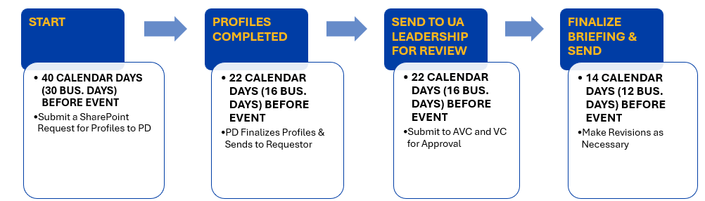
BRIEFING PROFILES
Prospect Development will work with campus stakeholders to provide profiles to be included in event briefings for the Chancellor, Provost, Vice Chancellor UA and occasionally for deans.

Slide 17
Prospect Research
  Provide research on prospects and donors based on the solicitation stage, relationship status with UCR and the purpose of the request
Due Diligence Research
  Named Gifts (Dedicated Space, Named Funds)
  Campus Awards, such as 40 Under 40 Alumni
  UCRAA Board of Directors and UCRF Trustee nominees
Ad Hoc Research as Requested
RESEARCH

Slide 18
UCR FOUNDATION RELATIONS

Slide 19
The Mission of the
UCR Foundation is
to actively promote philanthropy and manage donated resources for the advancement of UCR!
Notes:
I’m going to spend most of my time today putting the BOT into context. The UCR Foundation is 501c3, and like all nonprofits it has a board responsible for decisions. Current transition but this is mission statement.

Slide 20


OFFICERS OF THE UNIVERSITY
BOARD OF
TRUSTEES
OFFICERS OF THE UCR FOUNDATION
Chancellor
Chief Campus Counsel
UCRF Chair
UCRF Ex Officio Trustee
Board of Trustees
Vice Chancellor
Vice Chancellor
Planning
Advancement
UCRF Chair Elect
,
Budget
Administration
&
President
Monique Dozier
UCRF Treasurer
Board of Trustees
Associate Vice
CFAO
UCRF Immediate Past
Chancellor
Development
,
UA Administration
Chair
&
Finance
Board of Trustees
UCRF Executive VP
UCRF Vice President
Annya Lott
Finance & CFAO
Kim McDade
Executive Director
Executive Director
UCRF Corporate
UCRF Associate
Secretary
Sharilyn Berry
Treasurer
Luke Chen
FINANCE
&
EXECUTIVE
Consult
INVESTMENT
COMMITTEE
COMMITTEE
NOMINATIONS
COMMITTEE
BOARD OF TRUSTEES
University roles
AUDIT
Foundation roles
COMMITTEE
October
2023
AD HOC
COMMITTEES
Notes:
This chart gives some sense of how the whole operation fits together. In addition to the volunteer trustees and ex officio members like the Chancellor and the President of the Alumni Association, we have five staff officers. Monique Dozier is president, Annya Lott and Kim McDade are vice presidents, Luke Chen is the Associate Treasurer, and I serve as Corporate Secretary. None of the staff officers have voting privileges.

Slide 21
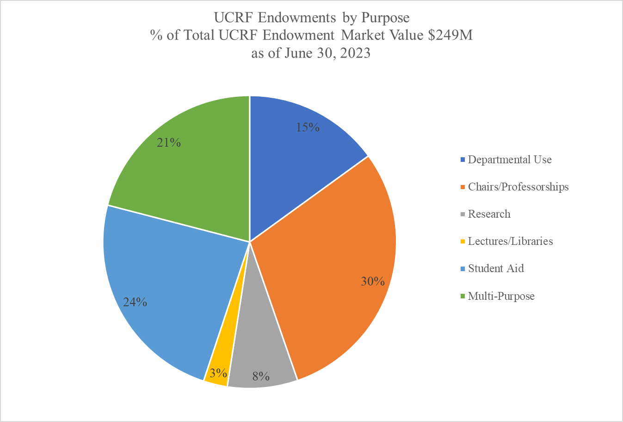

UCRF ENDOWMENT
By investing long term, the endowment provides spending to benefit UCR students, faculty, and programs as specified by the donor, while ensuring ongoing support in perpetuity.
The FY 2023 total endowment payout to campus was $10.5M.
Notes:
One of the main jobs of the BOT is making decisions about the endowment investment, including how we manage the endowment and what percentage of the interest we use each year to support UCR needs.

Slide 22
HOW IS THE ENDOWMENT FUND DISTRIBUTION DETERMINED?
The U.C. Riverside Foundation investment policy specifies the payout rate and averaging period used to calculate the distribution for all endowment funds.
As of fiscal year 2021, the Finance & Investment Committee recommended, and the Board of Trustees approved the increase in our spending policy to 4.5% of the 60-month average pool price per share.
4.0% of the payout is to the fundholder for the endowment purpose.
0.5% of the payout is the administration cost recovery fee. The administration cost recovery fee is used to defray the cost of administering and carrying out the terms of the campus’ endowments and endowment related funds held by the U.C. Riverside Foundation.
Annually in May, the FIC recommends to the Board of Trustees the spending policy level for the upcoming fiscal year. The FIC recommended to maintain the 4.5% spending policy in May 2022 and May 2023.
Notes:
The annual endowment payout is transferred to campus in September each year. The Foundation, working very closely with Kim McDade and Luke Chen,s complete the audit and the financial statements after the fiscal year ends; when completed, the foundation transfer the annual payout to campus. The board has recommended maintaining the 4.5% spending policy, of which 4% is going to support the specified UCR needs and .5% goes to administration costs.

Slide 23
FOUNDATION COMMITTEES
Finance & Investment Committee
  Has fiduciary responsibilities related to the endowment.
  Reviews and endorses investment policies and procedures.
  Amends guidelines, as necessary, pertaining to the investment policy.
Executive Committee
  Made up of all committee chairs, the Chancellor, Chair, Past Chair, Chair Elect, & Treasurer
  Handle business between meetings
  Approve board meeting agendas and annual operating budget
  Establish or disband standing and ad hoc committees
Audit Committee
  Confers with the external audit form to assure that the Foundation’s financial affairs are in order
  Reviews and approves the annual audit
  Reviews the annual IRS 990 tax form
Nominations Committee
  The Committee responsible for making recommendations to the Executive Committee regarding nominating practices and procedures
  With the approval of the Board, adopts criteria for trustee evaluation and evaluates trustees for re-election to successive terms
  Identifies and recruits qualified persons for election as Trustees and volunteer officers
  Prepares and submits slates of candidates for election to the Board and to the various elective offices of the UCRF for approval by the full Board of Trustees
Notes:
The Executive Committee is made up of the chairs of all the commitees, the Chancellor – who is a voting member of the board, the Chair, past chair, and Chair Elect, and the trustee who serves as Treasurer. They handle business between meetings, approve board agendas and the operating budget, and establish or disband standing and ad hoc committees, among other duties.

Slide 24
BOARD OF TRUSTEES EXPECTATIONS
Approved by the UCRF Board of Trustees – February 12, 2020
Philanthropy: Annual & Major Gift expectations
Ambassadors: Make substantive connections to philanthropic and business leaders
Participation: attend two of three annual meetings, serve on a committee, engage with campus in meaningful ways
Eligibility: Must complete annual UCRF Conflict of Interest statement and disclosures
Currently being reviewed by Nominations in partnership with external consultants.
Notes:
The average board member serves four two year terms. After that they must take one year off and they may be invited back to start the cycle over again. They are each expected to give at least $5K a year and

Slide 25
FOUNDATION RELATIONS TEAM ROLE
We serve as primary liaisons between Board of Trustees and university
We draft and compile communications to board (emails, handbooks, rosters, etc.)
We plan and staff meetings for full board and various committees
We handle logistics for nominations process
We collect legally required documentation like Conflict-of-Interest forms
We facilitate board orientation
We monitor trustee giving
We promote adherence to bylaws
We perform other duties as assigned 😊
Notes:
So all of that was to get to this much shorter presentation on what LaDonna Ardary and I do. We serve as primary liaisons between the Board and the university. There are lots of documents that we prepare and disseminate, lots of meetings – both for the full board and for various committees – that we plan and staff (shout out to colleagues Ian Foster, Annya Lott, Kim McDade and Luke Chen who also staff or co-staff committees), we monitor whether the trustees are meeting their various expectations, we make sure the bylaws are being followed and like all of you we perform other duties as assigned. LaDonna is also involved with budgets and purchasing for other parts of the VCUA team. We work with many different offices within University Advancement. For instance, we are working on a project with Prospect Development where they have researched possible professional and personal connections that our trustees might have and development has asked the trustees about how they might help UCR make new connections with these leaders.

Slide 26
COLLABORATE WITH US
If you have a great idea for a social or enrichment activity for the board members
If you know somebody who would be a wonderful trustee
If you are working with a trustee and want to coordinate a visit when they are here for board business
If you are working with a dean or vice chancellor who isn’t sure what is expected of them at the next meeting
If you have any questions at all about anything board related!
Notes:
There are many reasons you might want to contact us – we are in a bit of a transition with our Nominations Committee as they are working with a consultant who is reviewing what our process should look like so I’m a little more vague than I would usually be about what kind of person would make a good trustee, but certainly if you know somebody you think would do well let’s have a conversation. We work with various units to provide enrichment activities for our board members when they are on campus. Many academic leaders are invited to our board meetings so we are often working with the units to make sure the deans and vice chancellors know what to expect. In general if you have any questions about anything related to the board or its members, please reach out to us. Thank you.

Slide 27
QUESTIONS OR COMMENTS?

