Slide 1
We Should Have Seen Today Coming from 300 Years Away:
the lessons learned in the gaps between African-American “firsts” and “seconds”.
Dalyn Montgomery, Director Alumni Marketing Strategy and Analytics

Slide 2
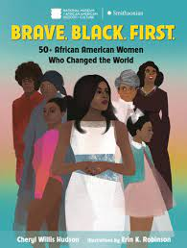
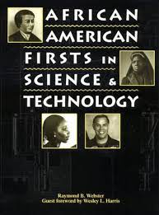
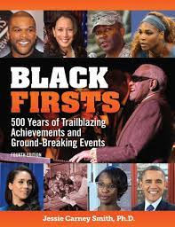
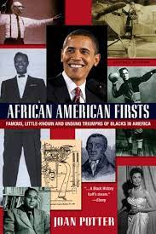
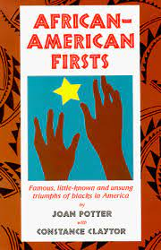
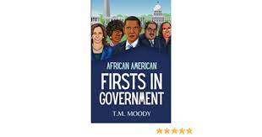
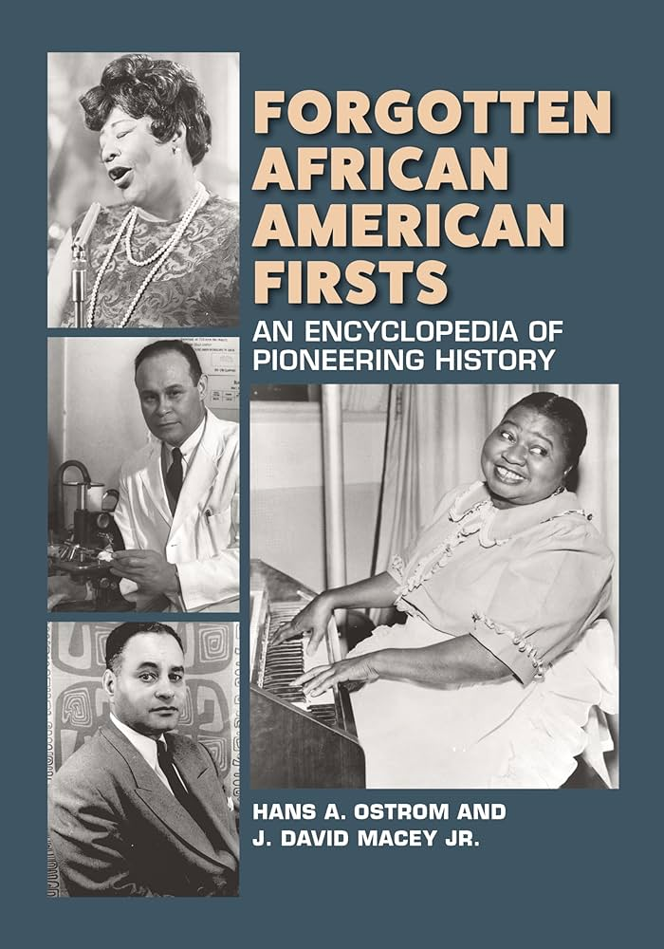

Slide 3
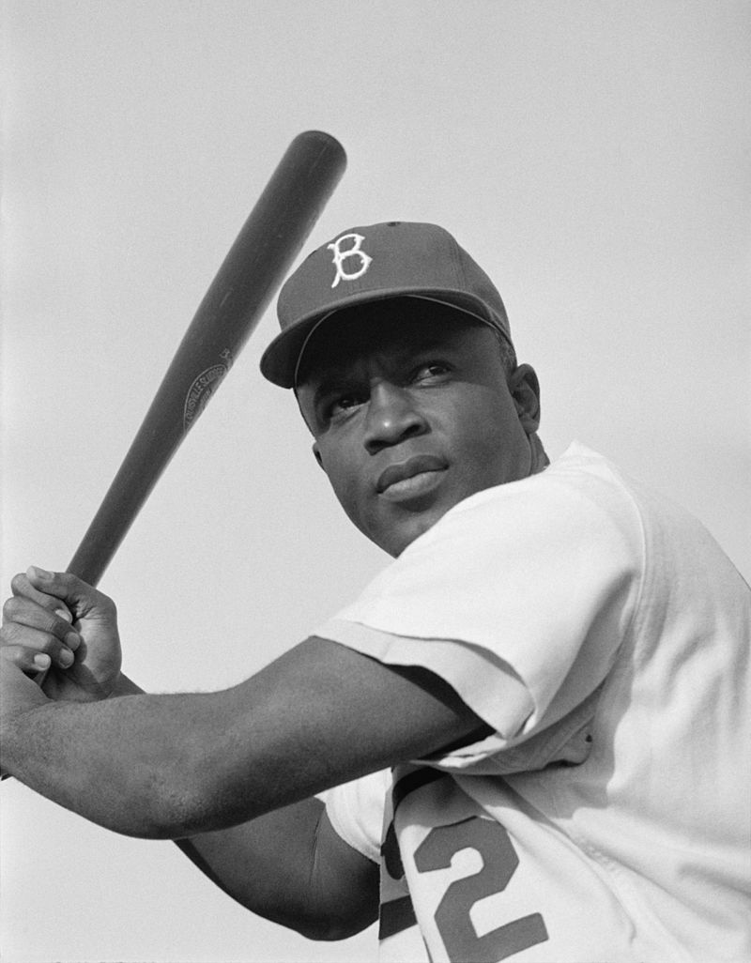
Jackie Robinson
1939 earns varsity letters in football, baseball, basketball, and track at UCLA.
1944 court martialed
1945 Athletic Director at Sam Houston College
April 15th, 1947 takes the field with the Dodgers.

Slide 4
Jackie Robinson
1939 earns varsity letters in football, baseball, basketball, and track at UCLA.
1944 court martialed
1945 Athletic Director at Sam Houston College
April 15th, 1947 takes the field with the Dodgers.
Moses Fleetwood Walker
1881 University of Michigan baseball goes 3-3 and reacts by recruiting Moses Walker, a catcher out of Oberlin College. 1882 Michigan goes 10-3.
1883 Walker signs with the Toledo Blue Stockings and makes Major League (NL) debut May 1, 1884.
Retired from pro baseball in 1889 when the league banned Black players.

Slide 5
Jackie Robinson
1939 earns varsity letters in football, baseball, basketball, and track at UCLA.
1944 court martialed
1945 Athletic Director at Sam Houston College
April 15th, 1947 takes the field with the Dodgers.
What Happened Here?
Moses Fleetwood Walker
1881 University of Michigan baseball goes 3-3 and reacts by recruiting Moses Walker, a catcher out of Oberlin College. 1882 Michigan goes 10-3.
1883 Walker signs with the Toledo Blue Stockings and makes Major League (NL) debut May 1, 1884.
Retired from pro baseball in 1889 when the league banned Black players.
Notes:
History is the space between the two firsts.

Slide 6
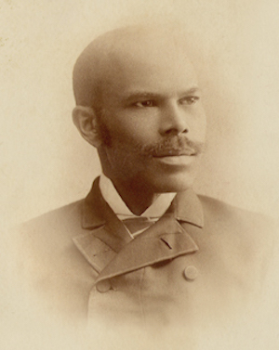
George Washington Fields
1890 graduates from Cornell law. 1st Black law graduate
Notes:
Field’s “first” is disputed.

Slide 7
George Washington Fields
1890 graduates from Cornell law. 1st Black law graduate
Macon Bolling Allen
Passed Maine bar in 1844. 1st Black Lawyer
1845 passes bar in Boston
1848 passes test to become judge
1874 elected probate judge in Charleston SC
187? Moves to D.C.
Notes:
Field’s “first” is disputed.

Slide 8
George Washington Fields
1890 graduates from Cornell law. 1st Black law graduate
Macon Bolling Allen
Passed Maine bar in 1844. 1st Black Lawyer
1845 passes bar in Boston
1848 passes test to become judge
1874 elected probate judge in Charleston SC
187? Moves to D.C.
And Here?
Notes:
Field’s “first” is disputed.

Slide 9
1794- John Chavis Accepted into Washington & Lee College

Slide 10
1794- John Chavis Accepted into Washington & Lee College
1826- Washington & Lee owns 73 slaves/1923 refuses to play against schools with black athletes/1966 admits Dennis Haston (transfers out after 1 year)/1968 admit Walter Blake and Carl Wothers- both eventually graduate.

Slide 11
1794- John Chavis Accepted into Washington & Lee College
1826- Washington & Lee owns 73 slaves/1923 refuses to play against schools with black athletes/1966 admits Dennis Haston (transfers out after 1 year)/1968 admit Walter Blake and Carl Wothers- both eventually graduate.
172 years

Slide 12
1794- John Chavis Accepted into Washington & Lee College
1826- Washington & Lee owns 73 slaves/1923 refuses to play against schools with black athletes/1966 admits Dennis Haston (transfers out after 1 year)/1968 admit Walter Blake and Carl Wothers- both eventually graduate.
172 years
29 years
1823- Lucious Twilight graduates from Middlebury (He was “passing”). 1845 Middlebury knowingly admits Martin Freeman who graduates salutorian.

Slide 13
1794- John Chavis Accepted into Washington & Lee College
1826- Washington & Lee owns 73 slaves/1923 refuses to play against schools with black athletes/1966 admits Dennis Haston (transfers out after 1 year)/1968 admit Walter Blake and Carl Wothers- both eventually graduate.
172 years
29 years
1823- Lucious Twilight graduates from Middlebury (He was “passing”). 1845 Middlebury knowingly admits Martin Freeman who graduates salutorian.
120 years
1965- Middlebury admits more than 1 Black person for first time.

Slide 14
1794- John Chavis Accepted into Washington & Lee College
1826- Washington & Lee owns 73 slaves/1923 refuses to play against schools with black athletes/1966 admits Dennis Haston (transfers out after 1 year)/1968 admit Walter Blake and Carl Wothers- both eventually graduate.
172 years
29 years
1823- Lucious Twilight graduates from Middlebury (He was “passing”). 1845 Knowingly admits Martin Freeman who graduates salutorian.
120 years
1965- Middlebury admits more than 1 Black person for first time.
1833- Oberlin founded, open to Black people and women.
10 years
1844- George Vashon graduates/later founds Howard.
1862- Mary Jane Patterson graduates.
29 years
1904- Kentucky outlaws interracial education
1921- 3 women at 3 different schools earn a PhD (U Penn, Chicago, Radcliffe)
1933- Princeton admits Bruce Wright on scholarship/rescind offer when they learn he is Black. 1947- Princeton graduates 3 Black students.
1950- UVA admits Greg Swanson via court order- he drops out due to harassment
1952- Brown v. Board
1961- UGA admits 2 black students. Riots ensue and UGA suspends the 2 students.
1978- Regents v Bakke
26 years

Slide 15
1770- Crispus Attucks dies in Boston Massacre
1778- 1st Rhode Island/Black regiment
1948- Executive Order 9981 desegregates Military

Slide 16
1770- Crispus Attucks dies in Boston Massacre
1778- 1st Rhode Island/Black regiment
1870- West Point admits James Webster then expel him in 1874 for faking his own beating (he was found tied up, unconscious, covered in razor slashes).
1877- Henry Flipper graduates West Point
He is later court martialed out of the Army.
1887 John Alexander graduates West point, becomes 1st Black officer in US Army to hold regular command position.
1948- Executive Order 9981 desegregates Military
17 years
179 years

Slide 17
1770- Crispus Attucks dies in Boston Massacre
1778- 1st Rhode Island/Black regiment
1870- West Point admits James Webster then expel him in 1874 for faking his own beating (he was found tied up, unconscious, covered in razor slashes).
1872- Naval Academy admits Henry Conyers and then drive him out in less than a year.
1877- Henry Flipper graduates West Point
He is later court martialed out of the Army.
1932- Benjamin Davis accepted to West Point, never assigned roommate.
1887 John Alexander graduates West point
1948- Executive Order 9981 desegregates Military
1949- Wesley Brown graduates Naval Academy
17 years
179 years
77 years

Slide 18
1818- Philadelphia founds African Fire Association. White people complain and it closes within the year.

Slide 19
68 years
1818- Philadelphia founds African Fire Association. White people complain and it closes within the year.
1886- Isaac Jacobs is hired by Phila Fire Dept. he lasts 4 years.

Slide 20
68 years
1818- Philadelphia founds African Fire Association. White people complain and it closes within the year.
1824- Savannah organizes Fire dept./all Black people.
1858- Richmond Fire Dept. founded includes Black people (slaves).
1864- Richmond authorizes hire of one Black man.
1886- Isaac Jacobs is hired by Phila Fire Dept. he lasts 4 years.
1845- Savannah starts white Fire Dept.
1950- Richmond hires “1^{st”} ten Black firefighters
21 years
86 years

Slide 21
68 years
1818- Philadelphia founds African Fire Association. White people complain and it closes within the year.
1824- Savannah organizes Fire dept./all Black people.
1858- Richmond Fire Dept. founded includes Black people (slaves).
1864- Richmond authorizes hire of one Black man.
186?- San Antonio has 2 Black volunteer companies.
1886- Black company asks for funding (white company was funded) and is then forcibly disbanded.
1886- Isaac Jacobs is hired by Phila Fire Dept. he lasts 4 years.
1845- Savannah starts white Fire Dept.
1950- Richmond hires “1^{st”} ten Black firefighters
1967- San Antonio hires “1^{st”} Black Firefighter
21 years
86 years
81 years

Slide 22
1783- James Derham Dr. in New Orleans and Philadelphia

Slide 23
1783- James Derham Dr. in New Orleans and Philadelphia
64 years
1847- James McCune MD from U Glasgow. David Peck MD Rush Med Coll.

Slide 24
1783- James Derham Dr. in New Orleans and Philadelphia
1847- AMA forms to decide who is/is not a medical doctor.
64 years
1847- James McCune MD from U Glasgow. David Peck MD Rush Med Coll.

Slide 25
1783- James Derham Dr. in New Orleans and Philadelphia
1847- AMA forms to decide who is/is not a medical doctor
1870- AMA formally votes to not accept any Black doctors.
1913- ACS founded as an alternative to AMA and includes 1 Black doctor, Daniel Williams
1945- American College of Surgeons rejects Black membership.
64 years
1847- James McCune MD from U Glasgow. David Peck MD Rush Med Coll.
1888- AMA accepts local chapter’s lists and may (unverified) have “defacto” accredited local Black doctors.
1934- Louis Wright accepted to ACS
1964- AMA formally says it does not support discrimination (no enforcement mechanism).
21 years
181 years

Slide 26
Human social history is not linear yet we teach history along a timeline
1600
1700
1800
1900
2000

Slide 27
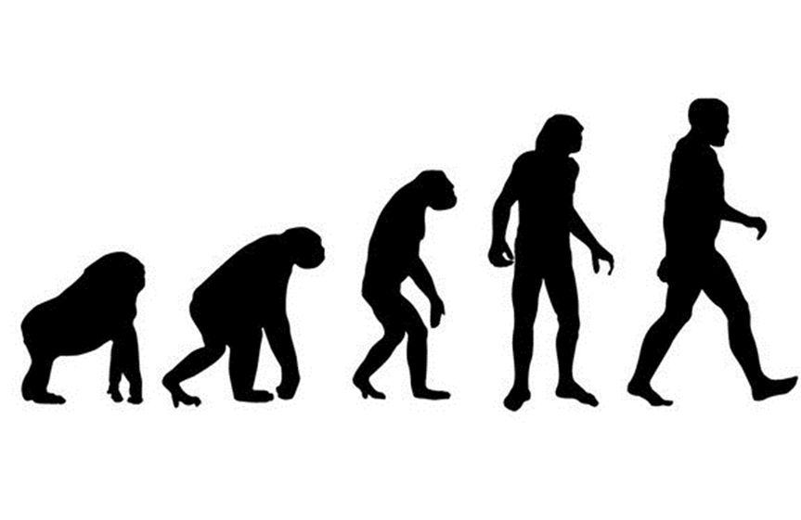
The idea of linear social history creates the illusion that progress is inevitable and natural. It is not.
1600
1700
1800
1900
2000
Notes:
Progress itself is a relative and fluid thing.

Slide 28
Regression is as possible as progression.
+
1700
1800
1900
2000
2100
-
If we choose a metric to measure history, such as standard of living or political autonomy, then history moves up and down, or sideways, as time progresses.
Notes:
Classicists understand this reviewing Greece, Rome, the fall of Rome, the dark ages and the renaissance. Empires rise and fall.

Slide 29
White well being held at zero
+
1700
1800
1900
2000
2100
-
Black well being plotted in relation to white well being
Notes:
Classicists understand this reviewing Greece, Rome, the fall of Rome, the dark ages and the renaissance. Empires rise and fall.

Slide 30
What pressures move the line?
White standard of Living
+
End reconstruction
Civil Rights Act
Obama
revolution
13th amend
End WWI
End WWII
Regents v Bakke
Trump
1776
1865
1876
1918
1945
1964
1978
2008
2016
1700
1800
1900
2000
2100
-
Black Standard of Living
Notes:
Classicists understand this reviewing Greece, Rome, the fall of Rome, the dark ages and the renaissance. Empires rise and fall.

Slide 31
“1sts” are outliers
White standard of Living
+
End reconstruction
Civil Rights Act
Obama
revolution
13th amend
End WWI
End WWII
Regents v Bakke
Trump
1776
1865
1876
1918
1945
1964
1978
2008
2016
1700
1800
1900
2000
2100
-
Black Standard of Living
Notes:
Classicists understand this reviewing Greece, Rome, the fall of Rome, the dark ages and the renaissance. Empires rise and fall.

Slide 32
Education
+
Regents v Bakke
John Chavis
1978
Walter Blake/Carl Wothers
1700
1800
1900
2000
2100
-
Notes:
Classicists understand this reviewing Greece, Rome, the fall of Rome, the dark ages and the renaissance. Empires rise and fall.

Slide 33
Military
+
Crispus Attucks
James Webster West Point
Wesley Brown Naval Academy
1700
1800
1900
2000
2100
-
Notes:
Classicists understand this reviewing Greece, Rome, the fall of Rome, the dark ages and the renaissance. Empires rise and fall.

Slide 34
Government
+
Barack Obama, President
Hiram Revels Senator Mississippi
Edward Brooke III
1700
1800
1900
2000
2100
-
Notes:
Classicists understand this reviewing Greece, Rome, the fall of Rome, the dark ages and the renaissance. Empires rise and fall.

Slide 35
Arkansas 1957
Notes:
How many stories are in this picture? Statistically, are our students most likely to be an outlier or part of the crowd? How would things be different if this crowd was taught differently? What was being a “first” like for this girl?
Little rock nine 1957. 3 years after brown v board.

Slide 36
White reaction to Black outliers
Focusing on the lone achiever re-enforces the myth of meritocracy and obscures the bigger truth of white obstruction
Notes:
How many stories are in this picture? Statistically, are our students most likely to be an outlier or part of the crowd? How would things be different if this crowd was taught differently? What was being a “first” like for this girl?
Little rock nine 1957. 3 years after brown v board.

Slide 37
White reaction to Black outliers
angry
Focusing on the lone achiever re-enforces the myth of meritocracy and obscures the bigger truth of white obstruction
Notes:
How many stories are in this picture? Statistically, are our students most likely to be an outlier or part of the crowd? How would things be different if this crowd was taught differently?

Slide 38
White reaction to Black outliers
Too old to be a student
angry
Focusing on the lone achiever re-enforces the myth of meritocracy and obscures the bigger truth of white obstruction
Notes:
How many stories are in this picture? Statistically, are our students most likely to be an outlier or part of the crowd? How would things be different if this crowd was taught differently?

Slide 39
White reaction to Black outliers
National Guard
Too old to be a student
angry
Focusing on the lone achiever re-enforces the myth of meritocracy and obscures the bigger truth of white obstruction
Notes:
How many stories are in this picture? Statistically, are our students most likely to be an outlier or part of the crowd? How would things be different if this crowd was taught differently? Why are these extra people opposed? Why is the military there? Who ordered them there and why?

Slide 40
White reaction to Black outliers
National Guard
Too old to be a student
angry
Where in this picture, is the most practical or applicable lesson?
Is context created by itself or is it created by determined actors?
Notes:
How many stories are in this picture? Statistically, are our students most likely to be an outlier or part of the crowd? How would things be different if this crowd was taught differently? Why are these extra people opposed? Why is the military there? Who ordered them there and why?

Slide 41
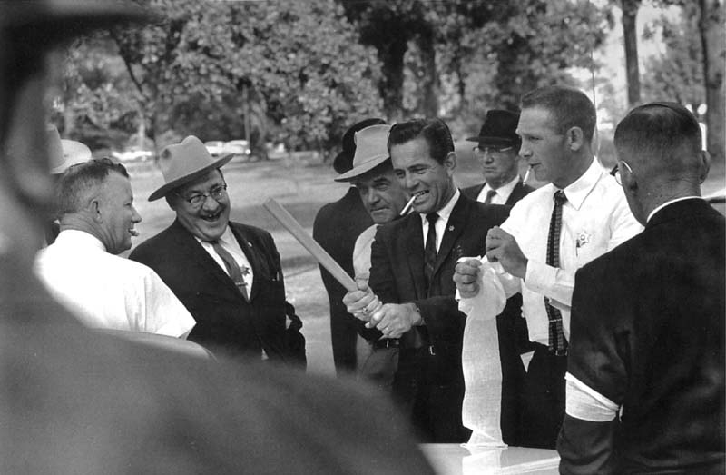
White reaction to Black outliers
Sheriff
Sheriff
Sheriff
James Meredith integrates Ol’ Miss in 1962, eight years after
Brown v. Board of Ed
Notes:
How many stories are in this picture? Statistically, are our students most likely to be an outlier or part of the crowd? How would things be different if this crowd was taught differently?

Slide 42
White reaction to Black outliers
Sheriff
Sheriff
Sheriff
Ax handle
James Meredith integrates Ol’ Miss in 1962, eight years after
Brown v. Board of Ed
Notes:
How many stories are in this picture? Statistically, are our students most likely to be an outlier or part of the crowd? How would things be different if this crowd was taught differently?

Slide 43
White reaction to Black outliers
Sheriff
Sheriff
Sheriff
Arm bands to make it easier to identify each other once you have started, and are participating in, a riot.
Ax handle
James Meredith integrates Ol’ Miss in 1962, eight years after
Brown v. Board of Ed
Notes:
How many stories are in this picture? Statistically, are our students most likely to be an outlier or part of the crowd? How would things be different if this crowd was taught differently?

Slide 44
White reaction to Black outliers
Sheriff
Sheriff
Sheriff
Arm bands to make it easier to identify each other once you have started, and are participating in, a riot.
Ax handle
James Meredith integrates Ol’ Miss in 1962, eight years after
Brown v. Board of Ed
Is context created by itself or is it created by determined actors?
Notes:
How many stories are in this picture? Statistically, are our students most likely to be an outlier or part of the crowd? How would things be different if this crowd was taught differently?

Slide 45
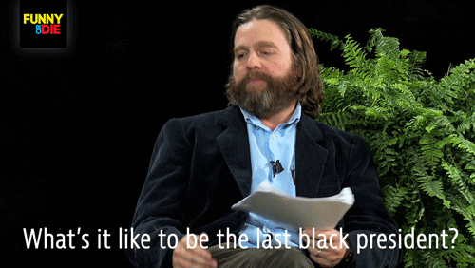
2014

Slide 46
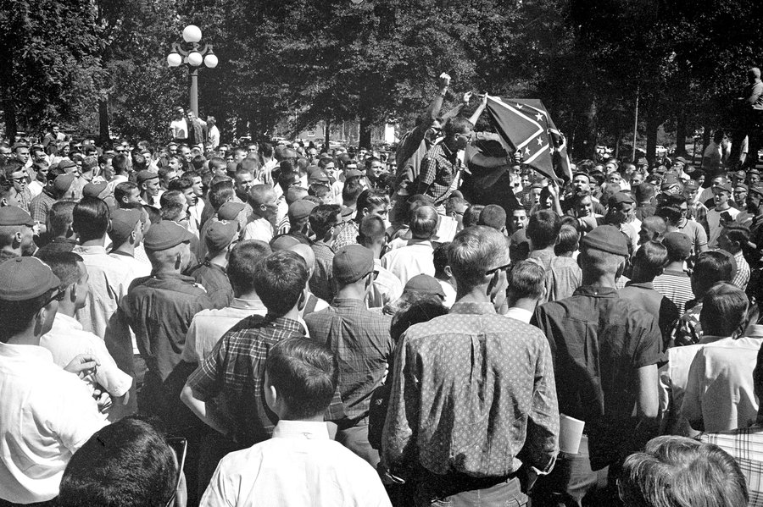
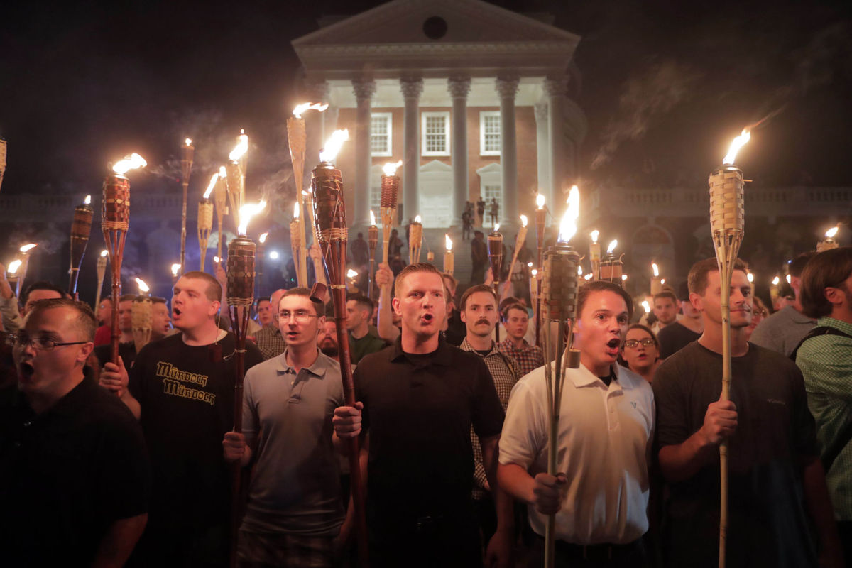
It isn’t just a parallel, it is a regular, repeated, predictable, pattern
If we teach 1,000 history students, who will they most likely be once they leave the classroom-the outlier or the context?
Notes:
What is the most common sense, or likely, reason for the gaps between firsts and second/thirds. Is the real obstacle to sustained black progress, simply white resistance? If this is the case, what should we be teaching white people?

Slide 47
There has existed since the founding, a racialized social order, that is so deeply entrenched that in nearly every instance, geography, and time period where that order is challenged, there is a violent, orchestrated, and intentional reaction to enforce the status quo (white suprememcy), even when resources are plentiful or not being directly challenged.

Slide 48
The gaps in attainment between Black and white are unnatural and only sustainable through intentional external pressures or obstruction.
and for more than 300 years that context has reacted in a consistent and predictable manner.
Notes:
Firsts in social change may be most useful in that they illustrate that change is not natural and inherently progressive. Change is made, worked, forced, engineered, often times this hard work is necessitated by the intentional obstruction or resistance by other equally motivated actors.
Sustained change only happens once both “sides” reach a new status quo either through acceptance, reconciliation, or pacification. Simply outmaneuvering or leveraging the “other” simply sets up future confrontation… or seconds and thirds.

