Slide 1
University Advancement
Administrative Services
November 20, 2023

Slide 2
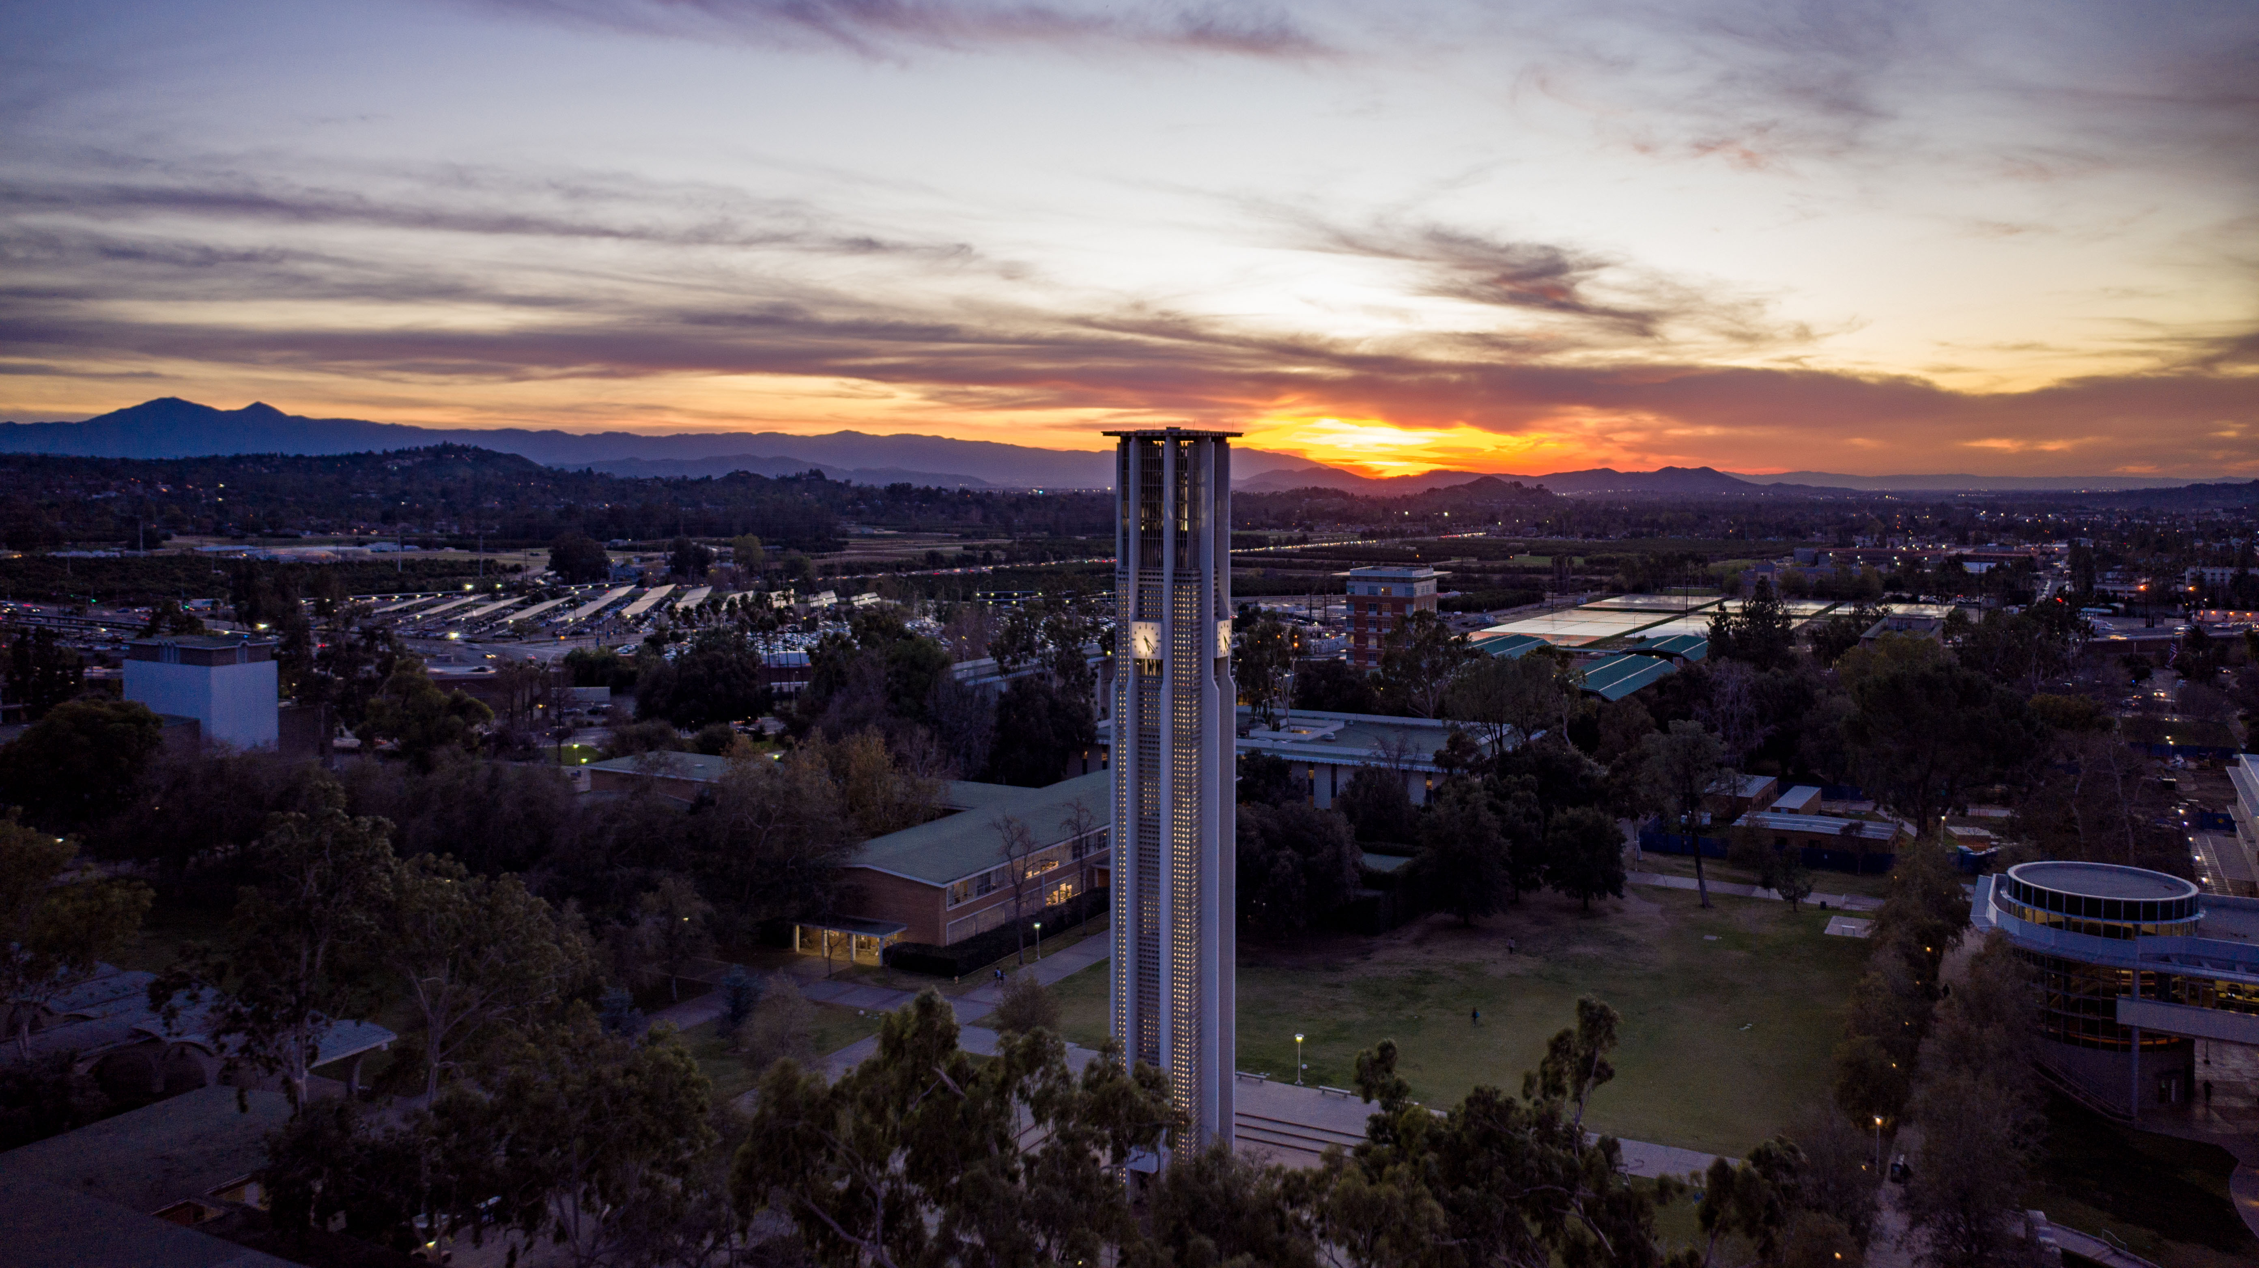

Kim McDade
Chief Financial and Administrative Officer
Introduction

Slide 3

Administrative Services
Provides strategic planning, resource management, and administrative support to the programmatic activities of the University Advancement organization.
Manages the infrastructure that enables UA’s front-line work.
Initiates and participates in the development of appropriate policies and processes that enhance the campus-wide efforts related to obtaining, acknowledging, recording and managing private support received for the UCR campus.
Coordinates and manages the financial and investment activities of the UC Riverside Foundation to ensure consistency with the fiduciary responsibilities of this separately incorporated tax-exempt, non-profit, public benefit corporation..

Slide 4
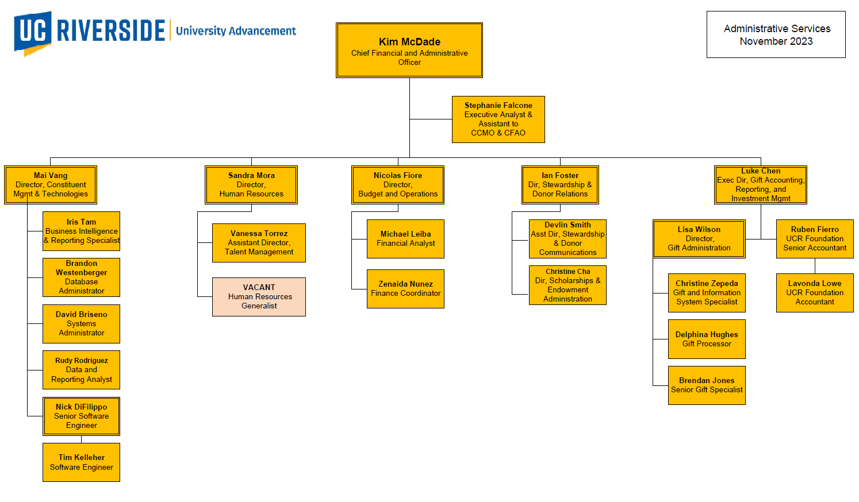

Slide 5
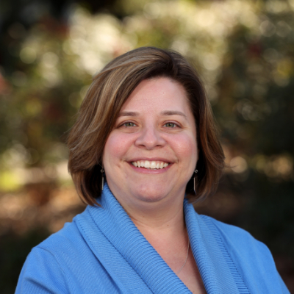
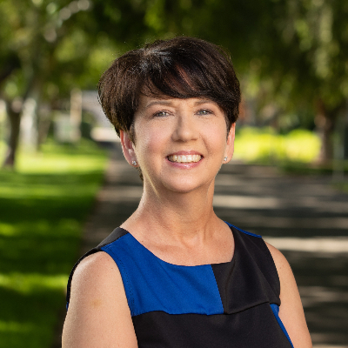
Chief Financial & Administrative Office
Kim McDade
Chief Financial & Administrative Officer
Stephanie Falcone
Executive Analyst & Assistant

Slide 6

Budget and Operations
Nicolas Fiore
Director, Budget and Operations

Slide 7
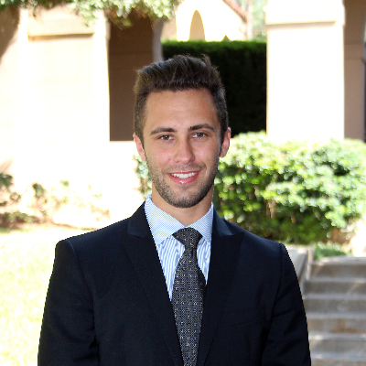
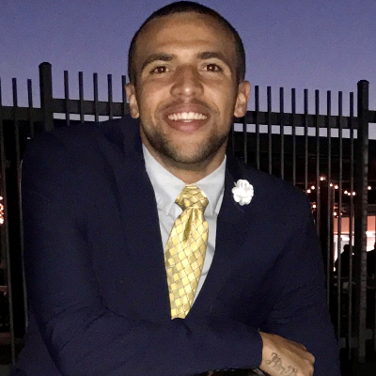
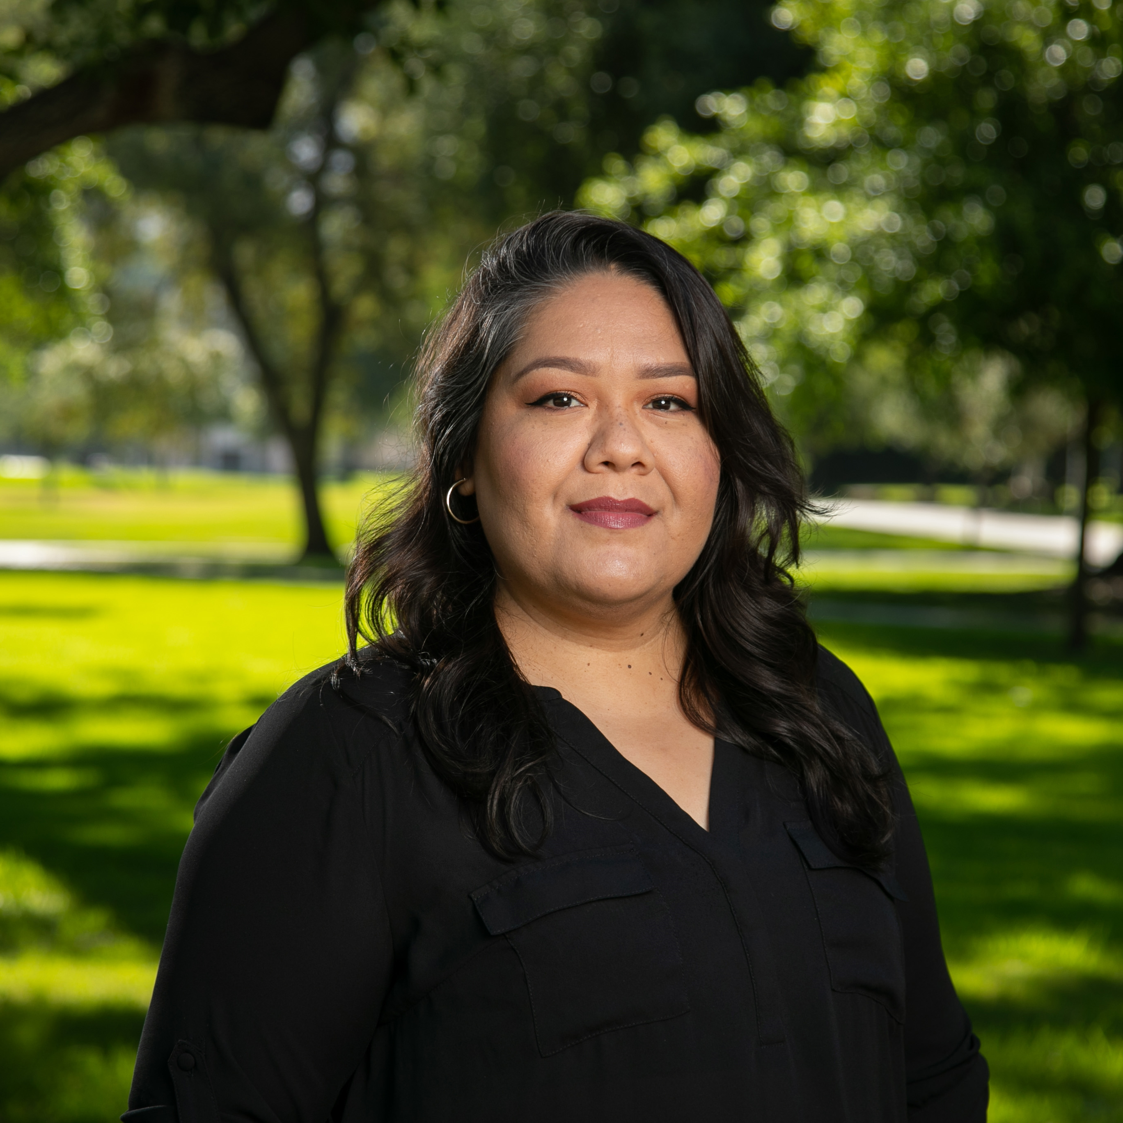
Budget and Operations Team
Nicolas Fiore, Director
Nicolas.Fiore@ucr.edu
Michael Leiba, Financial Analyst
Michael.Leiba@ucr.edu
Zenaida Nunez, Finance Coordinator
Zenaida.Nunez@ucr.edu

Slide 8
Budget and Operations Support
Annual budget preparation
Budget analysis, reporting, and reconciliation
Financial policy compliance
Audit preparation and guidance
Travel and entertainment review/approval/processing
Staff planning and salary/benefit projections
Key performance indicators
Space management
Campus applications systems access (Concur, Oracle, etc.)

Slide 9
Budget and Operations Facts
10
54
52
121
Department Budgets Managed
Activities Managed
Funds Managed
Flex Fields Managed

Slide 10
Budget and Operations Impact23 Highlights
4
Legacy Systems for Financial and Payroll Data Retired
UCRFStotals and SuperDope are now Looker
1
Legacy System for Purchase Orders (PO) Retired
eBuy is now Oracle Financial
2
Legacy System for Budget Establishment Retired
UCRFS is now Oracle Budget
5
Legacy System for Awards Retired
PAMIS eCAF is now Kuali
3
Legacy Systems for Travel and Reimbursements Retired
iTravel and ePay* are now Concur
6
FAUs are now COAs
Chart of Accounts
*Some functions of ePay remain active.
Notes:
ePay more

Slide 11
Budget and Operations Impact23 Resources
News and Updates
Concur Basics
Training
Card Payment Matrix

Slide 12
Constituent Management & Technology (CMT)
Mai Vang
Director, CMT

Slide 13
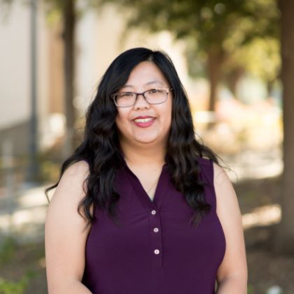

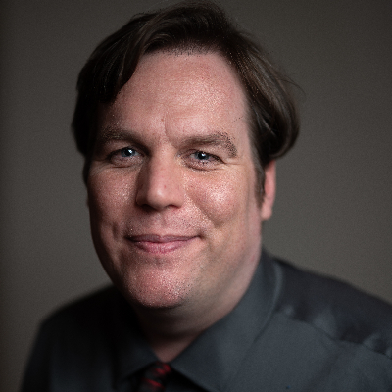
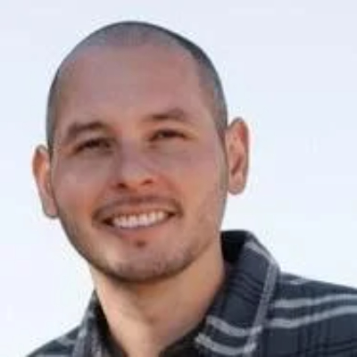
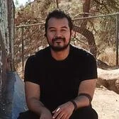

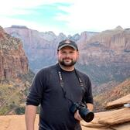
Mai Vang,
Director of CMT
Iris Tam,
Business Intelligence & Reporting Specialist
Brandon Westenberger, Database Administrator
Rudy Rodriguez,
Data & Reporting Analyst
David Briseno,
Systems Administrator
Nick DiFilippo,
Sr. Software Engineer
Tim Kelleher,
Software Engineer
Our Team

Slide 14
Purpose
The Office of Constituent Management & Technologies (CMT) is responsible for all aspects of University Advancement’s technological systems including the Advancement database, The Raiser’s Edge®; programming, reporting and data analysis; systems maintenance and upgrades, training, help desk, and other computer and cell phone support services.

Slide 15
Systems and Technologies CMT Administers
01
Blackbaud - Raiser's Edge/Financial Edge
University Advancement's database
04
Kamino
Internal application built by CMT software engineers to support data exchange, manage various jobs, and help UA scale.
02
Team Foundation Server (TFS)
CMT's ticketing and project management tool
05
MailChimp
Mass email tool used to segment and send out email campaigns to various constituents throughout UA.
03
Karma
Custom self-service forms tool that allows for event form registration, reminder emails, RSVP/Invite only registration, collection of registration fees, tax receipts, product sales, membership sales, workflows/approval process, and requests for database edits/bio updates.
06
Technology Support/Help Desk
Technology support, maintenance, and upgrade management for UA devices and equipment.
Notes:
Works with other departments to onboard new systems and tools (e.g., ThankView, ThruText). Receive data requests such as importing data into RE in bulk, reports to be built in PowerBi, and grabbing alumni and parent data into RE/NXT as well.

Slide 16



Ways to Contact Us
Email
advancementservices@ucr.edu
TFS
Submit a ticket to get support from our team.
Slack
Send us a quick message on Slack.

Slide 17
Foundation Accounting
Luke Chen
Executive Director, Gift Accounting, Reporting & Investment Mgmt

Slide 18
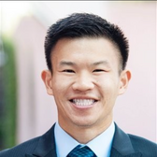
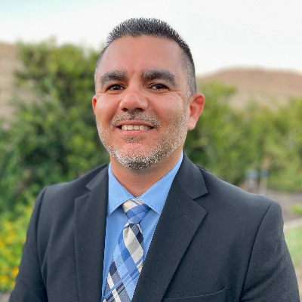
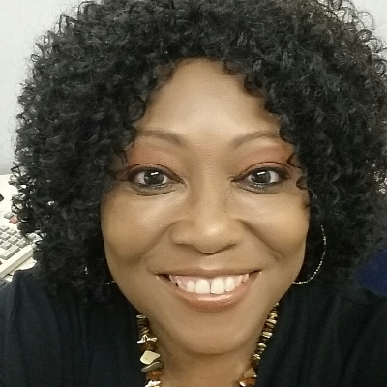
Welcome to the Foundation Accounting Department
Luke Chen
Executive Director
Luke.chen002@ucr.edu
Ruben Fierro
Senior Accountant
Ruben.fierro@ucr.edu
Lavonda Lowe
Accountant
Lavonda.lowe@ucr.edu

Slide 19
Facts about UCRF Accounting
FYE 2023
137,000
322
33
22
Journal lines processed in Financial Edge
Reconciliations
New endowment funds and endowment intent funds created
Current funds created
$249.9M
$10.5M
Total endowment value FYE 2023
Total payout distribution FYE 2023
Notes:
Endowment value:
98.8% of our endowment is invested with the General Endowment Pool (GEP), managed by UC Investments.
The remaining 1.2% of endowment assets are invested in Private Equity and cash.
Payout Distribution:
The payout distribution amount was based on a 4.5% spending rate of the endowment fund's average unit value approved by the Foundation's Board of Trustees.
This value is calculated using the closing unit market value on the last day of each of the 60 contiguous months.
Per campus policy, a cost recovery fee of .5% is assessed annually on the endowments funds to offset the costs of administering the endowments, and the campus gets a total net payout of 4%.

Slide 20

What Do We Do?
Financial Analysis and Reporting
  Financial Statements
  Audit Preparation
  Balance Sheet Reconciliations
  Journal Entries
Tax Filings
Fund Management and Reporting
Endowment Accounting and Reporting
Investment Accounting and Reporting
Pledges Management and Reporting
Prepare materials for Board of Trustees
Notes:
Financial Analysis and Reporting
Financial Statements
Audit Preparation
An audit is an examination of an organization's financial statements and related notes by someone independent of that organization.
The Purpose of the audit is to form an opinion on whether the information presented in our financial statements accurately reflects the financial position of the organization.
We work with the auditors to provide them information to help understand the Foundation and ensure the accuracy of our statements, and answer any questions they have
Balance Sheet Reconciliations: the purpose of Reconciliations is to ensure accuracy and validity of accounts in our general ledger. We compare the transactions and activity in a given account to supporting documentation and resolve any discrepancies that may be discovered.
Bank Accounts
Investment Funds and brokerage accounts
Trusts
Pledges Receivable
Journal Entries
Cash Receipts and Gift Fees
Endowments (allocations, G/L's, transfers, purchases/sales, dividends, etc.)
Stocks/securities
Disbursements to campus
Pledges
Trust entries
Current fund income
Various transfers
Tax Filings
Various Federal and state filings

Slide 21
Gift Fund Types
Funds Functioning as Endowments
Current Funds
Endowment
Deferred Gift Funds
Funds that may be expended immediately and completely, in accordance with donor or UCR-imposed restrictions.
An endowment is created when a donor states a desire that the University use only the payout from the gift or bequest corpus. The principal of a true endowment is held in perpetuity. These funds permit planning far into the future.
Deferred gifts include (but are not limited to) charitable trusts, charitable gift annuities, and life estate gifts. These are gift funds that must “mature” before becoming available to UCR. They typically provide for a lifetime income stream to the donor and mature at his/her death.
(FFE)
Funds in this category can be either unrestricted or designated for specific purposes, like building projects, where money can earn a return before being used for its ultimate purpose, such as the School of Business Building Fund.
Notes:
Current Funds are resources that are expendable in the near term in accordance with donor or UCR imposed restrictions.
The Current Funds group include two basic subgroups: Unrestricted and Restricted.
Unrestricted Current Funds includes all funds for which a donor or other external agency has not specified an expense purpose.
Restricted Current Funds are available for financing operations but are limited by donors or other external agencies to specific purposes, such as to a program, department, or school.

Slide 22
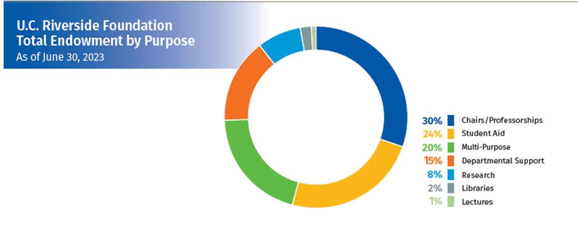
Endowments
Endowment Pool Allocations/Investment Reporting
The process in which Accounting allocates realized and unrealized gains and losses, fund manager fees, taxes, interest, and dividends from all our investments proportionately based on the number of shares allocated to the fund.
Endowment Structure
Endowment pool is using the “Unitized Method” to record the Fair Market Value (FMV) for each endowment fund. Investments into the pool purchase Units based on a Market Value per Unit (MVU), calculated periodically.
Endowment Funds by Purpose
Notes:
30% to chairs/professorships
24% to student aid
20% Multi-Purpose
15% Departmental Support
8% for research
2% for libraries
1% for lectures

Slide 23
Trust Funds
Charitable Remainder Unitrust (CRUT)
An irrevocable, tax-exempt charitable trust in which the donor transfers assets to the trust and the principal is invested.
The trust provides a payment to the donor or other individual beneficiaries either during their lifetimes or for a specific term of years. The donor and UCRF determine the payout rate aligning to the donor's needs.
Upon the death of the last living individual beneficiary or upon the expiration of the term of years, the remainder of the trust assets must be distributed to one or more charitable organizations.
The trustee has a fiduciary responsibility to administer the trust with the care, skill, and conduct that a reasonably prudent person would in order to carry out the terms of the trust.
As of June 30, 2023, UCRF has 3 CRUTs:
Trust #1 Ultimate Purpose:
To be applied for current-use support of the Stem Cell Excellence Fund.
Trust #2 Ultimate Purpose:
To be applied as current-use support of students in the Biomedical Program.
Trust #3 Ultimate Purpose:
15% to add to the Holstein Family Endowed Chair in Religious Studies.
85% to establish a named Endowed Scholarship Fund.
Notes:
One popular deferred gift fund type is a Charitable Remainder Unitrust (CRUT), which appeals to donors who want diversification of investments and reduce current income taxes.
If there are any donors interested in CRUTs, a great resource would be Sandy, our Senior Director of Gift planning.

Slide 24
Gift Administration
Lisa Wilson
Director, Gift Administration

Slide 25
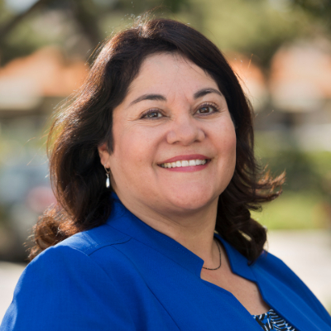
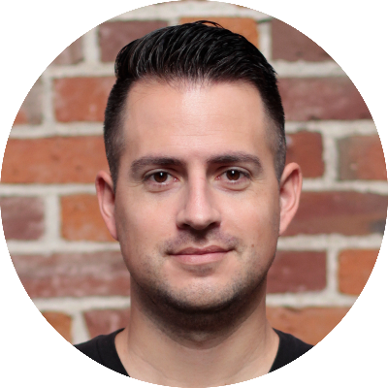
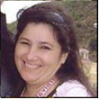
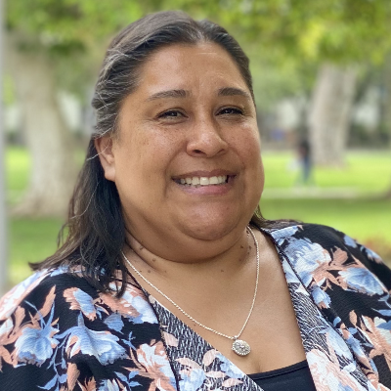
Gift Administration
Our Team
Lisa Wilson
Director,
Gift Administration
Brendan Jones
Senior Gift Specialist
Delphina Hughes
Gift Processor
Christine Zepeda
Gift & Information System Specialist

Slide 26
Gift Processing
Process gifts to the UCR Foundation and UC Regents
Types of Gifts:
Checks, Cash, Credit Cards, Gifts-in-Kind, Stocks, ACH's, Cryptocurrency,
Pledges, Payroll Deductions, Deferred Gifts, Private Grants

Slide 27
Gift Attributes
Soft credits
Tributes
Anonymous
Quid pro quo
Bequests
Link to opportunities
Assign solicitor credit
Link to payments to pledges
IRA gifts
DAF gifts
etc.

Slide 28
Other Functions
Biographical updates - via update forms and routine queries
  Reporting-
    Daily Gift Report
    Monthly Gift Summary Reports
    Monthly Unit Fundraising Reports
    VSE Survey
    Reconciliation reports
    Ad hoc reports
  Pledge reminders
  Pledge write-offs
  Provide guidance to the campus regarding IRS rules and regulations, and CASE Standards, VCUA Online Gift Acceptance System, general gift practices
  Provide assistance to donors
..

Slide 29
Human Resources &
Talent Management
Sandra Mora
Director, Human Resources
Vanessa Torrez
Assistant Director, Talent Management

Slide 30
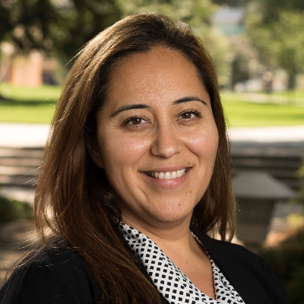
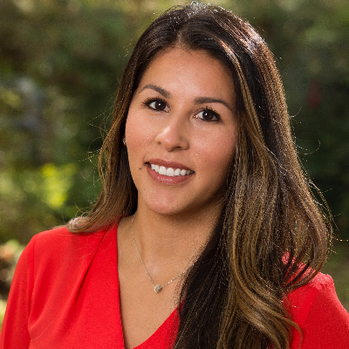
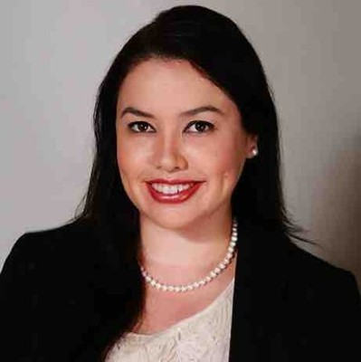
Human Resources & Talent Management
Sandra Mora
Director of Human Resources
Vanessa Torrez
Assistant Director,
Talent Management
Sandra Rodriguez
Talent Acquisition Analyst

Slide 31




HR

Slide 32








What is human resources?
Policy
Employee
Relations
Employment Law
Workforce Planning
Staff Engagement
Development
Staff Engagement
Training
Recruitment

Slide 33
Talent Management
Our commitment to UA
To supply University Advancement with top-level talent and ensure we have talent in critical current and future positions. We provide a smooth recruiting and hiring process with a high-level candidate experience.
Through our partnership with hiring managers, we want to make UA a top workplace and incorporate a distinguished vetting process, driving high-level placements.
Our strategic talent management cycle involves filling positions and suggesting an approach to effectively manage our human capital in a planned and intentional way through avenues such as employee engagement and talent development.

Slide 34
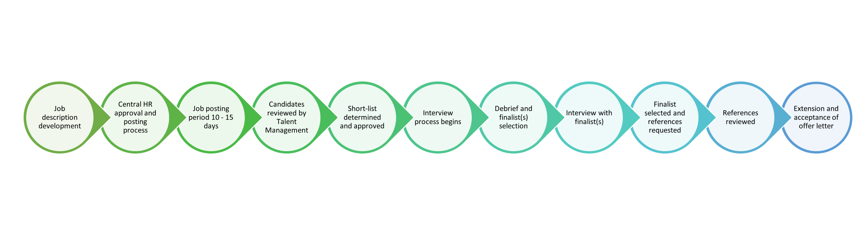
The recruitment timeline

Slide 35
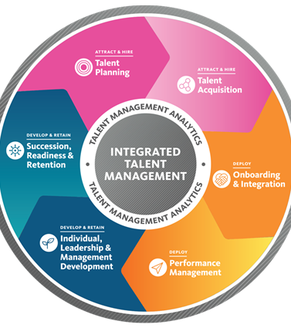
Strategic Talent Management Cycle
Talent Planning
Leadership, Org Charts, Succession Plan & Mapping
Talent Acquisition
Recruitment: Marketing and Branding, Supervisor Resources, Assessments & Pipeline Building
Onboarding & Integration
Itineraries, Meet and Greets, Tours & Scotty-up Program.
Performance Management
Supervisor Trainings & All-Staff Trainings.
Develop and Retain
Culture, Employee Engagement, DEI, Tech Trainings, Lunch and Learns.
Notes:
We engaged a national search firm specializing in development recruitments to help with the sourcing of candidates for the senior positions in the schools and colleges.
With the University Advancement team built out and supported, the focus shifted beyond sourcing/acquisition/onboarding to retention/professional development of current staff.
Support professional development through conference attendance/presentations and other learning opportunities.

Slide 36
Stewardship &
Donor Relations
Ian Foster
Director, Stewardship & Donor Relations

Slide 37
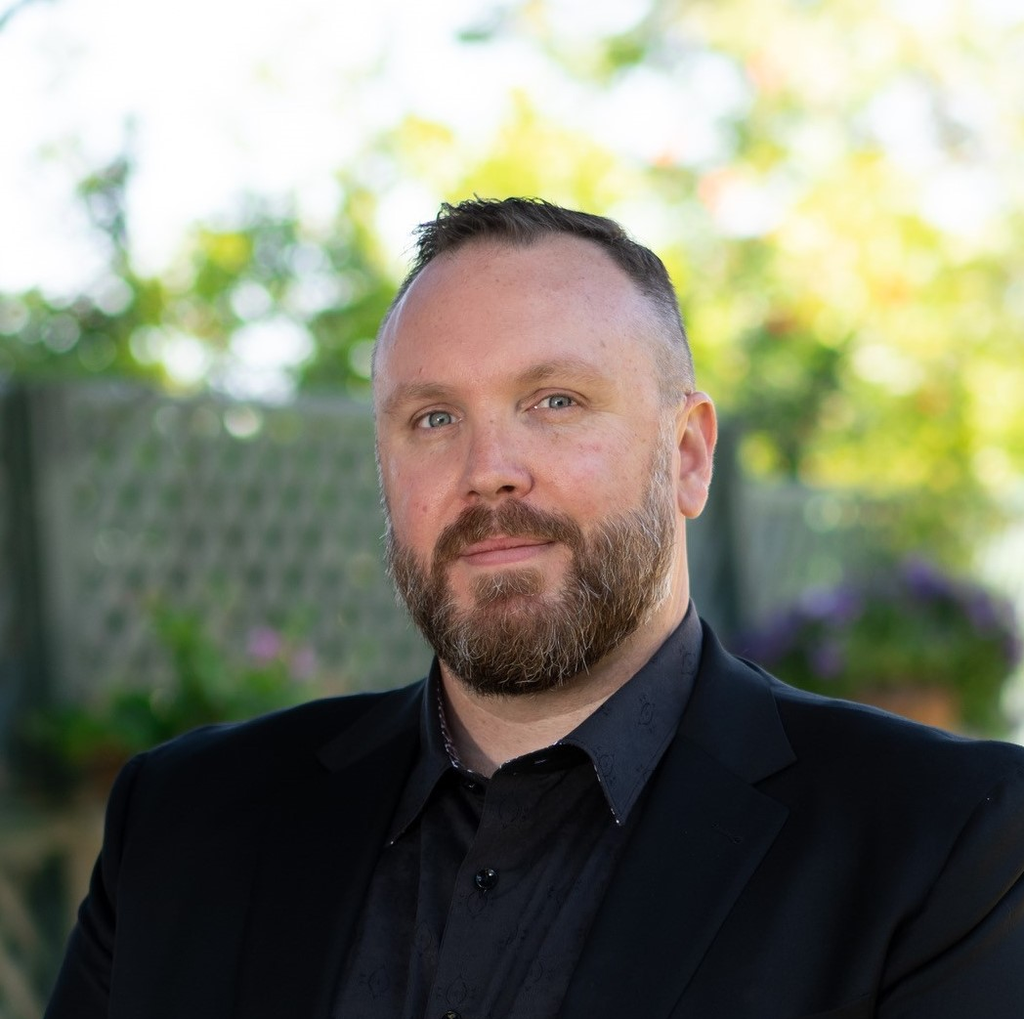
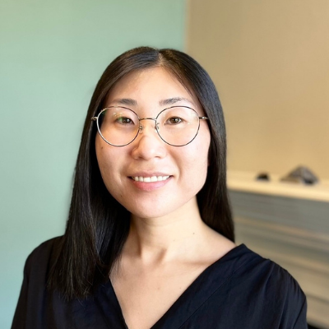
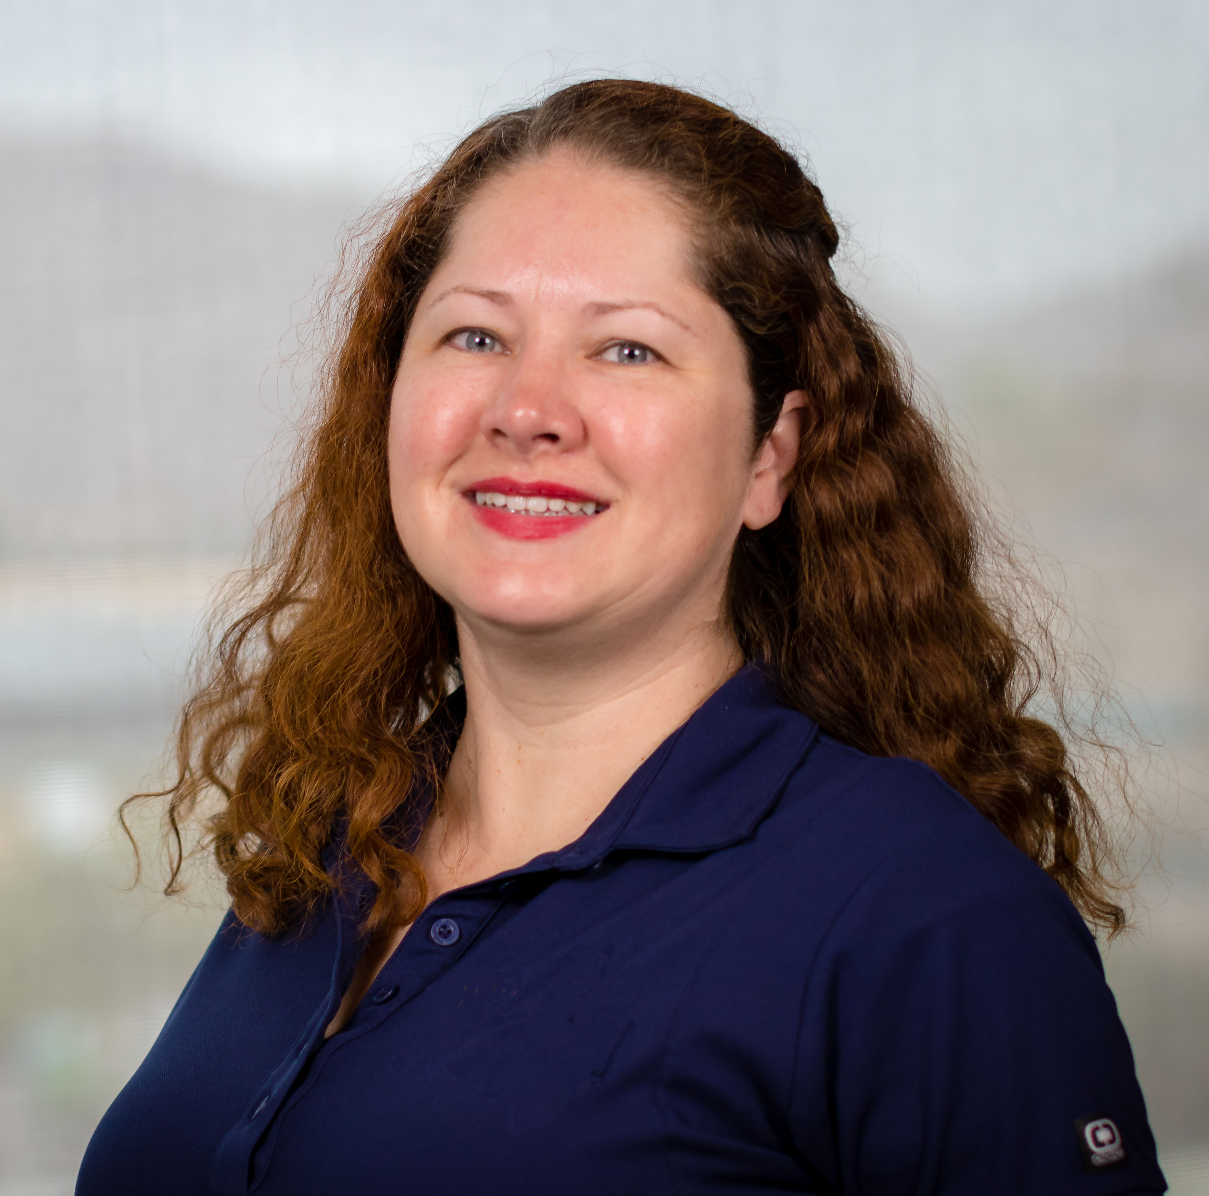
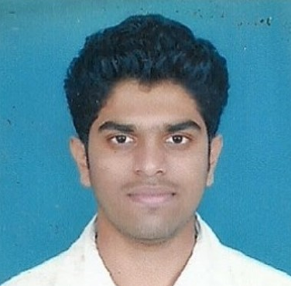
Stewardship & Donor Relations
Our Team
Ian Foster
Director
Stewardship & Donor Relations
Christine Cha
Director
Scholarships & Endowment Administration
Devlin Smith
Assistant Director
Stewardship & Donor Communications
Aditya Srinivas Karamangala Amar
Student Assistant

Slide 38

Fund Administration
Gift agreements, approvals, reporting, and more...
•
Gift agreement guidance, review and approval
•
Annual endowment reporting
Campuswide endowed fund impact collection
Endowed fund impact stories
Consolidation of UCRF and Regents GEP performance
Individual fund performance
•
Oversight of endowed chair approval process and annual chair reports
•
Oversight of campuswide unspent donor funds
•
Oversight and training for fund usage

Slide 39

Stewardship Communications
Telling stories and thanking donors...
•
Senior leadership gift acknowledgement (gifts of $50K+)
•
Staff/faculty donor annual appreciation
•
Tribute/memorial gift notifications
•
Donor birthday card program
(chancellor cards and central cards/emails)
•
Major donor milestones and life events
(anniversaries, condolences, promotions, etc.)
•
High impact fund highlight stories
•
Oversight of campus ThankView account
•
Scholarship profile donor mailings

Slide 40
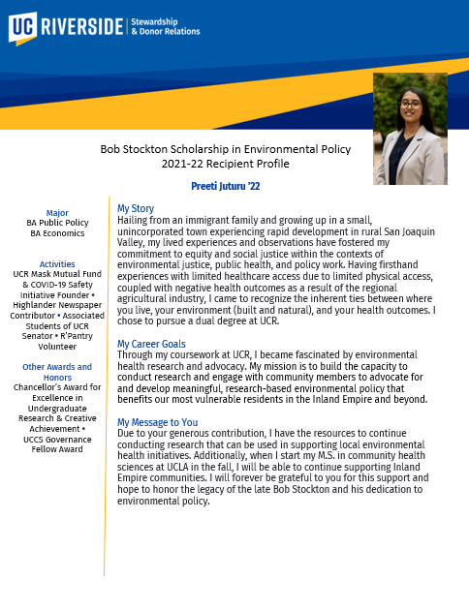
Scholarships & Fellowships
Awarding, and profiles, and tracking, OH MY!
•
Award tracking (endowed and current-use)
•
Administration of student recipient profiles for donors
•
Administration of ScholarshipUniverse
•
Administration of Alumni Engagement scholarship program

Slide 41

Societies and Namings
But wait! There's more...
•
Giving Societies
Oversight of:
  Bell Tower Society - consecutive giving program
  Tartan Society (currently Chancellor’s Associates) - annual giving program
  Highlander Society - major giving society
Provides support in collaboration with Gift Planning
1907 Society (currently Watkins Society) – planned giving program
•
Oversight of Capital Naming Program and Philanthropic Signage
Development of naming opportunities in collaboration with Units
Oversight of approval process
Oversight of campus philanthropic signage program

Slide 42

