Slide 1


Get To Know Your
VSP Vision Benefits
University of California, Riverside
September 2025
Notes:
Generic Script:
Hi. I’m X and I want to thank you for taking the time to learn more about your benefit offering through VSP Vision Care! With VSP, our goal is to help you see well and be well for a lifetime of good vision. Let’s take a look at the great vision benefits available to you.

Slide 2




Great Eye Care with a Hefty Side of Savings
Vision Care
is Essential
Savings that Really Stack Up
Thousands of
In-Network
Choices
Founded by
Doctors
Focused on You
Notes:
Generic Script:
How does VSP help you prioritize your health and your budget?
First, vision care is essential - signs of over 270 health conditions can be detected during an eye exam so it’s important it’s on your wellness checklist.​
You get savings that really stack up – great everyday savings on eyecare and eyewear, plus loads of extras so you can save all year long.​
You can choose high quality care from our huge network of private practice and retail chain locations. Plus, you can shop online on Eyeconic®.​
Founded by doctors focused on you. Your well-being is at the core of everything we do.​

Slide 3
Vision Care is Essential
Did you know an eye exam
is the only
non-invasive way to view blood vessels in your body?
Signs of
more than
270 health conditions can be detected during an
eye exam*
Your eye doctor can be the first to detect certain conditions, like diabetes*
*Full Picture of Eye Health, American Optometric Association, 2020
Notes:
Generic Script:
On the last slide we mentioned that vision care is essential. Why is that?
It’s the only non-invasive way to view your blood vessels.
That’s how your eye doctor can detect over 270 health conditions during an eye exam.
And in some cases, like diabetes, an eye doctor can be the first to detect certain conditions, like diabetes.
Even if you don’t wear glasses now, your vision can change from year to year.
Vision care is an easy way to keep you and your family healthy so make sure it’s on your wellness checklist.

Slide 4
Your VSP Plan Snapshot – Actives Plan
Frequency
Copays
Allowances
Exam: Every Calendar Year
Frame: Every Other Calendar Year
Lenses: Every Calendar Year
$10 WellVision Exam®
$25 Glasses
Up to $60 Contact Lens Exam
$160 Frame
$160 Contacts
(instead of glasses)
*Check out the Member Benefit Summary for details. Savings based on state and national averages for eye exams and most commonly purchased brands. This number represents average savings for a VSP member at an in-network provider. Your actual savings will vary depending on the eyewear you choose, your plan and the eye doctor you visit.
Notes:
Generic Script:
So now we know why vision care is so important. Let’s take a look at how as a not-for-profit company, VSP makes it affordable for you. With your benefit you get great everyday savings on eyecare and eyewear. So, what kind of savings does that add up to?
VSP members save an annual average of $471
Check your Member Benefit Summary for details.

Slide 5
Your VSP Plan Snapshot: Lens Enhancements
Lenses
Lens Enhancements
Fully covered single vision, lined bifocal, lined trifocal lenses, and impact resistant lenses for children
Fully covered standard progressives, light-reactive lenses and impact-resistant lenses
Average savings of 20-25% on other lens enhancements
*Check out the Member Benefit Summary for details. Savings based on state and national averages for eye exams and most commonly purchased brands. This number represents average savings for a VSP member at an in-network provider. Your actual savings will vary depending on the eyewear you choose, your plan and the eye doctor you visit.
Notes:
Generic Script:
You can opt for lens enhancements like anti-glare to reduce blue light impact or progressive lenses so you can see near or far. Check out your Member Benefit Summary for details.

Slide 6
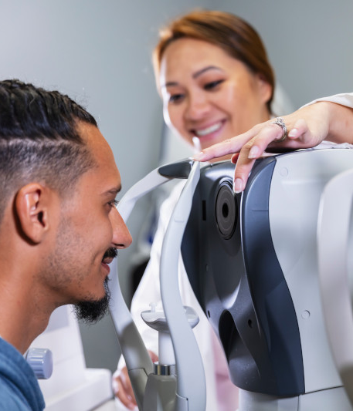
Retinal Screening
Digital imaging is key to early detection and intervention
Images of the inside of the eye
Baseline documentation of a healthy eye
Screen for potential disease(s)
Can be compared year after year to monitor even the most subtle changes in the eyes
No more than $20 copay
$0 copay for members with diabetes
Classification: Confidential
Notes:
SLIDE INSTRUCTIONS: If applicable, check if your client has this and/or free benefits for diabetic patients.
Generic Script:
Retinal screening is a quick scan that shows images of the inside of the eye. It can be used to:
Detect disease
As a baseline of a healthy eye
Compare year after year to detect even subtle changes
With your VSP coverage you get a retinal screening each year for no more than $39.​ And members with diabetes receive a retinal screening fully-covered each year.​

Slide 7

Essential Medical Eye Care
Fully covered retinal screening for members
with diabetes.
Exams and services to treat immediate issues like pink eye and sudden changes in vision.
Treatment options to monitor ongoing conditions such as dry eye, diabetic eye disease, glaucoma, and more.
$20 per exam for additional exams and services.
“My husband burned his eyes welding, and without this benefit we would have had to pay out of pocket or waited days to get prior authorization from his health insurance.”
Notes:
Generic Script:
With Essential Medical Eye Care, here’s what’s covered:
Fully covered retinal screening for members with diabetes who do not have diabetic eye disease
Exams and services to treat immediate issues like pink eye and sudden changes in vision
Treatment options to monitor ongoing conditions such as dry eye, diabetic eye disease, glaucoma, and more
This coverage is supplementary and in most cases your health insurance will be billed first. You may be able to coordinate with your VSP benefits in order to help reduce out-of-pocket costs. If your VSP doctor doesn’t participate with your medical insurance plan, VSP has you covered with only the cost of your copay.

Slide 8

Savings Beyond Benefits
50%
Save 50% on additional pairs of glasses and sunglasses at Visionworks®
$250
Average savings at Eyeconic®, plus free shipping and returns
Plus, VSP members get access to Exclusive Member Extras
$20
Extra $20 on Featured Frame Brands
60%
Save up to 60% on hearing aids with TruHearing®*
$1,200
Save up to $1,200 on Lasik
$300
Get up to $300 in contact lens rebates
Offers vary based on state and benefit plan. Brands and offers subject to change.
*VSP is providing information to its members but does not offer or provide any discount hearing program. VSP makes no endorsement, representations or warranties regarding any products or services offered by TruHearing, a third-party vendor. TruHearing is not insurance and not subject to state insurance regulations. For additional information, please visit vsp.com/offers/special-offers/hearing-aids/truhearing. For questions, contact TruHearing directly. Not available directly from VSP in the states of Washington and California.
Notes:
Generic Script:
You’ve seen the everyday savings is built your VSP Plan. Now let’s take a look at ways you can stack your savings.
How about an extra $20 to save on featured frame brands?
50% off additional pairs of glasses and sunglasses at Visionworks
Prefer to shop online? VSP members save an average of $250 at Eyeconic – plus free shipping and returns.
Plus, VSP members have access to Exclusive Member Extras like 60% off a pair of hearing aids from TruHearing and so much more.

Slide 9



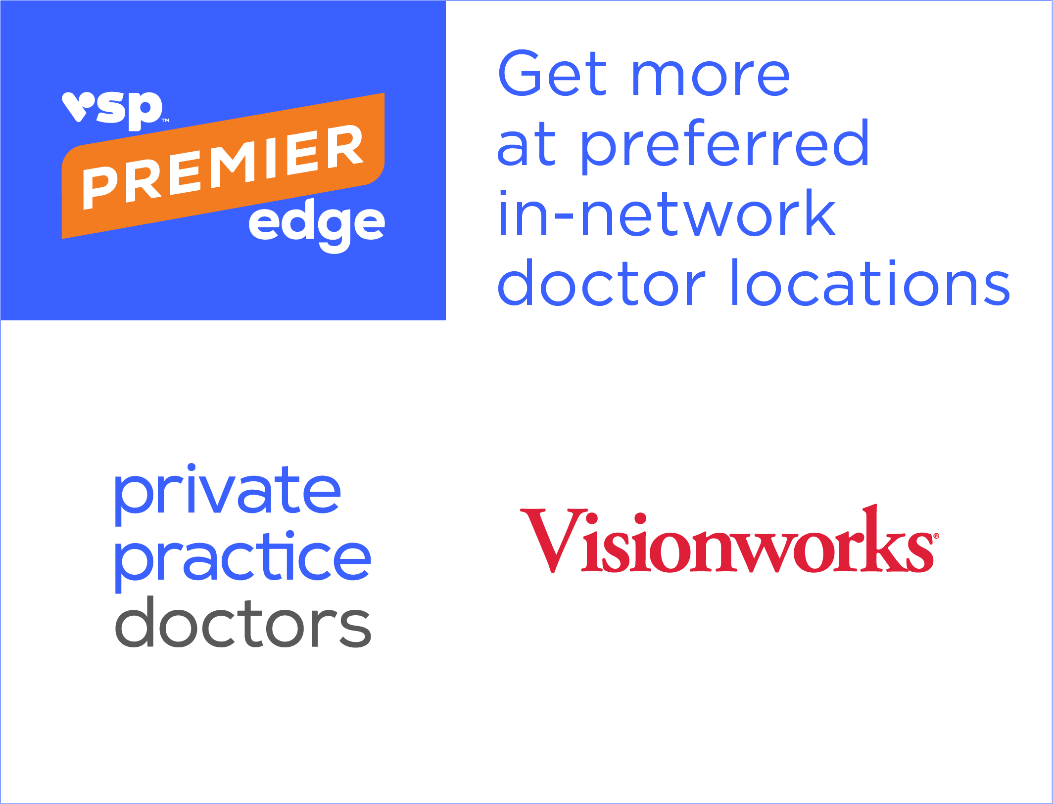






The Choice is Yours
It’s easy to choose the care that’s right for you.
Your benefits go further when you visit a
VSP Premier EdgeTM
location, including private practice doctors
and Visionworks®!
Private Practice locations
Retail
locations
Online at Eyeconic®
Participating Retail Chains like these ̶
and more
Notes:
Generic Script:
VSP was founded by doctors. That's why we make it so easy to find one that's right for you. With thousands of private practice doctors and over 700 Visionworks retail locations nationwide, getting the most out of your benefits is easy at a VSP Premier Edge location. Your benefits go further when you visit a Premier Edge location, with access to exclusive rebates and offers such as: Premier Edge promise - a worry-free eyewear guarantee. exclusive offers and savings, and advanced exam technology including digital retinal imaging and more. And if you prefer to shop online, you can choose from a variety of well-known name brands and contact lenses. Choose from over 70 eyewear brands and over 1600 styles. Eyeconic is a VSP-owned company, and the only website that seamlessly connects VSP vision benefits to a members’ account. By applying your vision benefits, you see savings in real time.

Slide 10
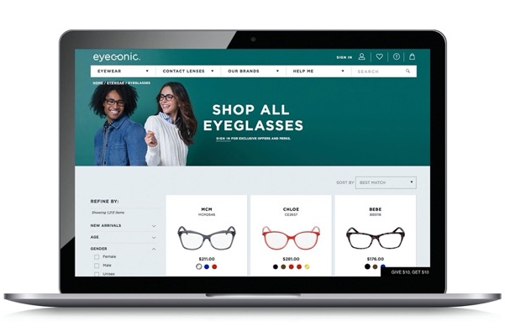
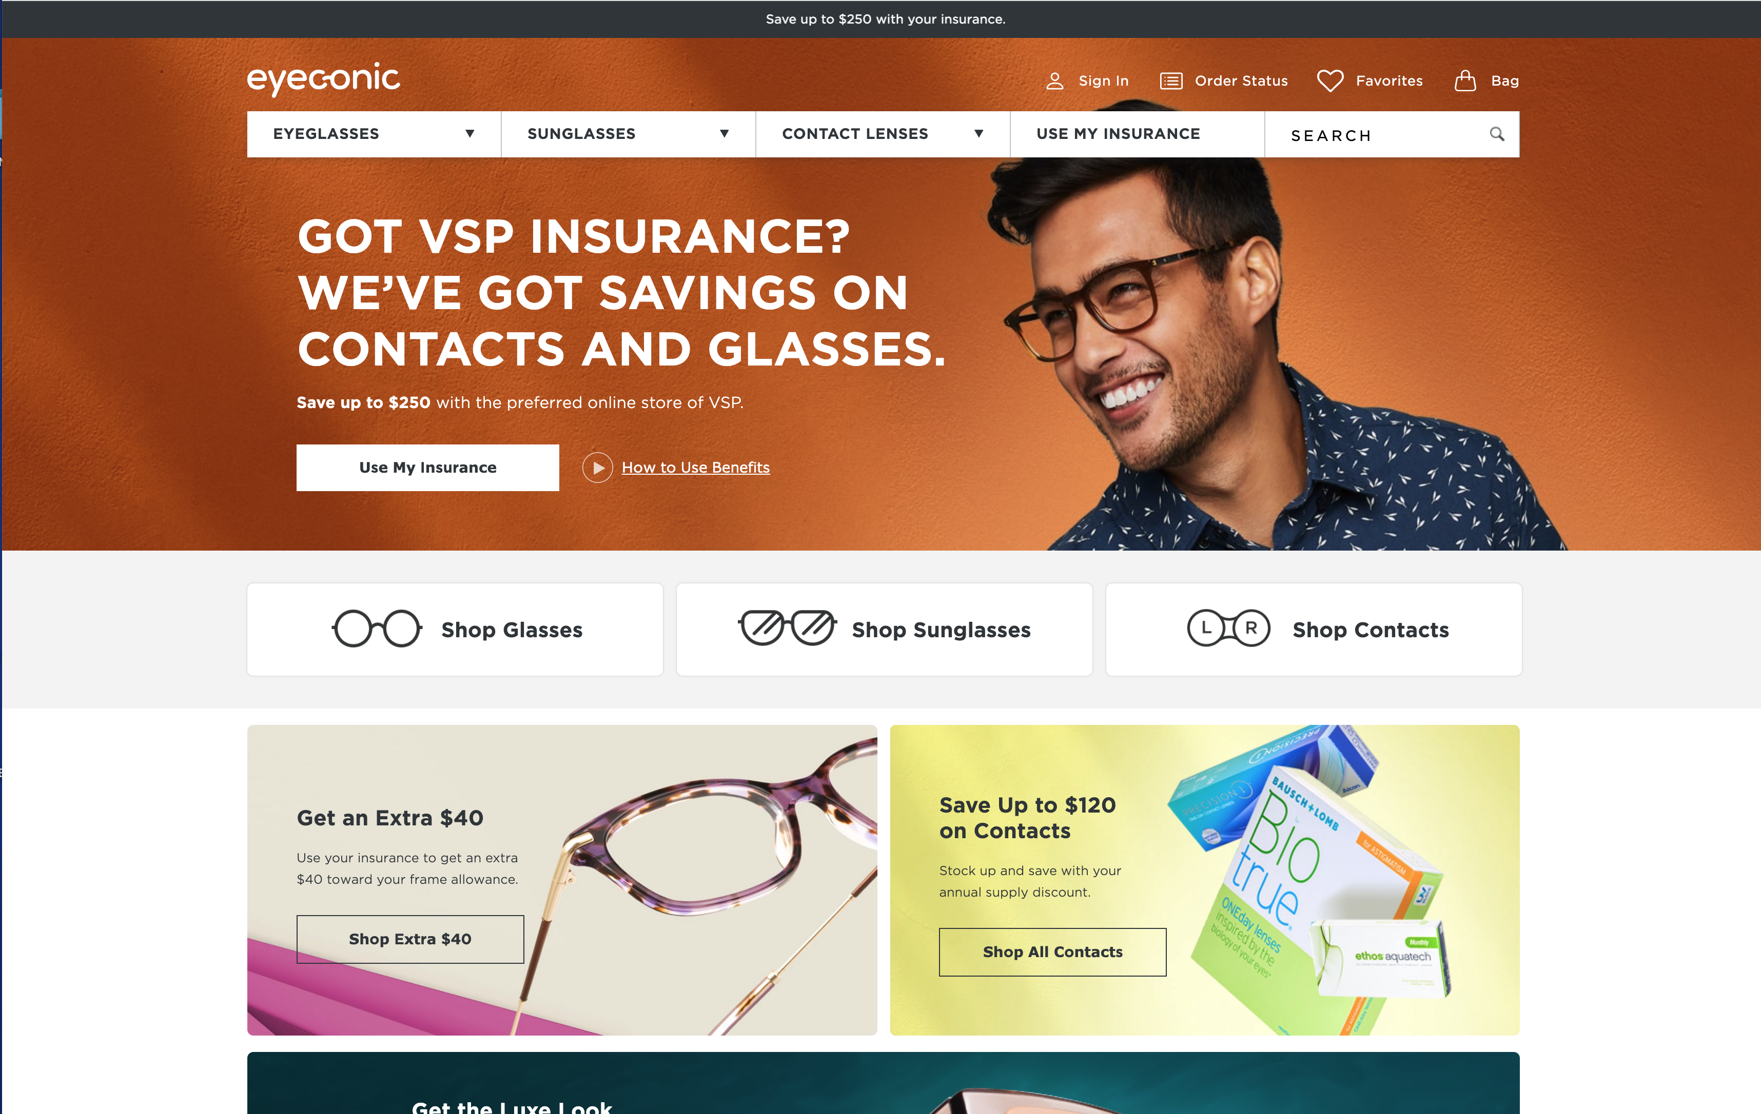
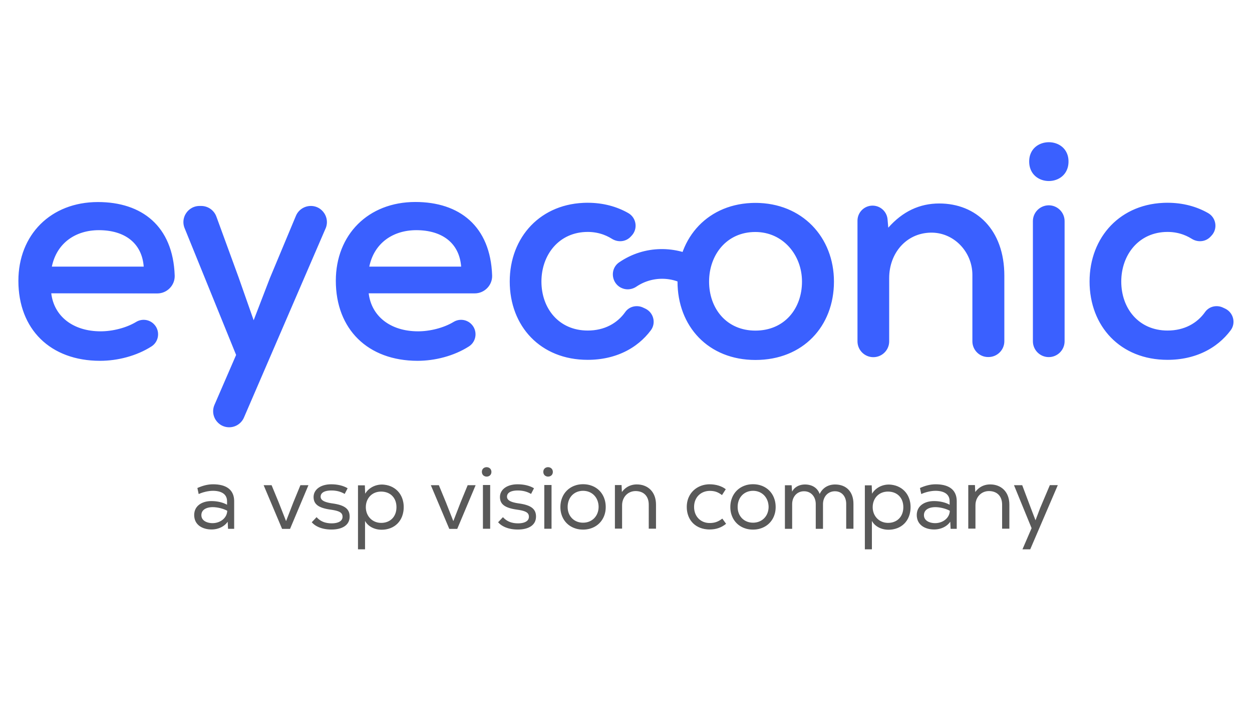
Eyewear Shopping Online at Eyeconic
Eyeconic is the VSP online eyewear store that seamlessly connects your VSP vision benefits to
your account. You’ll get:
A huge selection of contact lenses and designer frames 24/7 – and the Virtual Try-On Tool.
Free shipping and returns.
20% off any out-of-pocket expenses on eyewear
after your frame allowance is applied.
Specialty sizes that fit your needs.
Find your product, customize your order and we do the rest. Start saving today at eyeconic.com® today.
Notes:
Generic Script:
As a VSP-owned company, Eyeconic is the only website that seamlessly connects VSP vision benefits to a members’ account. By applying your vision benefits, you see savings in real time. Save time and money on quality eyewear with a few easy clicks.
1. Connect your vision insurance
2. Select your product
3. Upload your prescription or provide your doctors contact information and we’ll take care of the rest.
Eyeconic offers a variety of well-known name brands and contact lenses. Choose from over 70 eyewear brands and over 1600 styles.

Slide 11
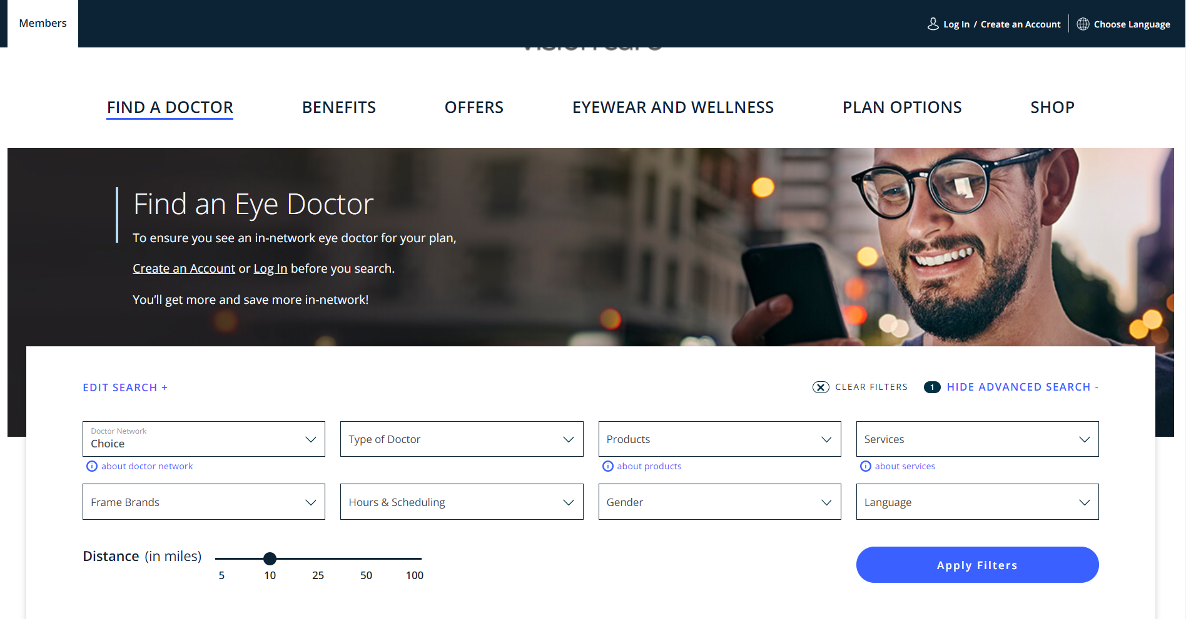
The Right Doctor for You
Using the Find a Doctor
tool on vsp.com is easy
      Visit vsp.com/eye-doctor
      (or navigate from vsp.com home page)
      Enter the preferences that are
      meaningful to you like:
        Location
        Gender
        Language
        Frame brands
        Specialty
        Services
        Hours & Scheduling
A sliding distance bar makes finding a match nearby easy. You can even opt to view locations on a map.
Notes:
Generic Script:
We understand that choosing a doctor is a personal decision, so we’ve made it easy to find the right care for you.
Simply navigate to Find a Doctor on vsp.com
Enter the preferences that are meaningful to you
You can even use the slider to search by distance and view your choice on a map so it’s easy to see how quickly you can get to each location

Slide 12

Using Your Benefit is Easy
Once you’ve enrolled…
Visit vsp.com or download the VSP Vision Care App from the Apple App or Google Play Stores and get instant access to your benefit coverage.
Find a VSP in-network doctor by visiting vsp.com or calling 866.240.8344.
Simply tell your eye doctor’s office that you have VSP–and we’ll take care of the rest!
Notes:
Generic Script:
We also get you’re busy, so we put everything you need in one place – your personalized dashboard on vsp.com.
Before your doctor visit, view your benefit and check out special offers
After you can view your claim and even download your Vision Savings Statement to see how much you saved
You can even take a diabetes risk assessment
And it ’s easy to toggle back and forth between family members with the “switch member” feature next to your name

Slide 13

Thank you!
VSP helps you see well and be well with
the coverage and quality care you deserve.
Visit vsp.com or call 866.240.8344.
©2024 Vision Service Plan. All rights reserved.
VSP, Eyeconic, Eyeconic.com, and WellVision Exam are registered trademarks, and VSP Premier Edge is a trademark of Vision Service Plan.
Classification: Confidential
Notes:
Generic Script:
VSP helps you see well and be well with the coverage and quality care you deserve. Visit vsp.com today to see how VSP helps you prioritize your health and your budget.

