Slide 1
Temporary Layoff Benefits Procedures
UCR Benefits Information

Slide 2
Initial Employee Consultation
Temporary Layoff Dates
Determine temporary layoff period (dates)
Employee benefits (medical, dental and vision coverage) are eligible for continuation while on leave at the current premium for four months
Benefits Premium Continuation
Discuss the process for continuing benefits while on leave
Share the current Benefit Summary in UCPath and review employee premiums
Recommend that employees continue Life Insurance and Accidental Death & Dismemberment coverage in case anything occurs during the layoff period
If employees cancels coverage during temporary layoff, insurance ends and the employee is no longer able to file a claim

Slide 3
Benefits Continuation and Payment
Employee benefits are continued during the temporary layoff when the employee pays the premium
Up to three months* of coverage is available where employees pay the employee portion only
However, in efforts to offer relief during the global pandemic, an exception was made allowing to continue the UC contribution to the cost of coverage for four months following temporary layoff
Leave Administrators should access the UCPath Center portal and view and share the employee’s Benefits Summary page and plan rates for the employee portion
Print and issue the employee Benefits Election

Slide 4
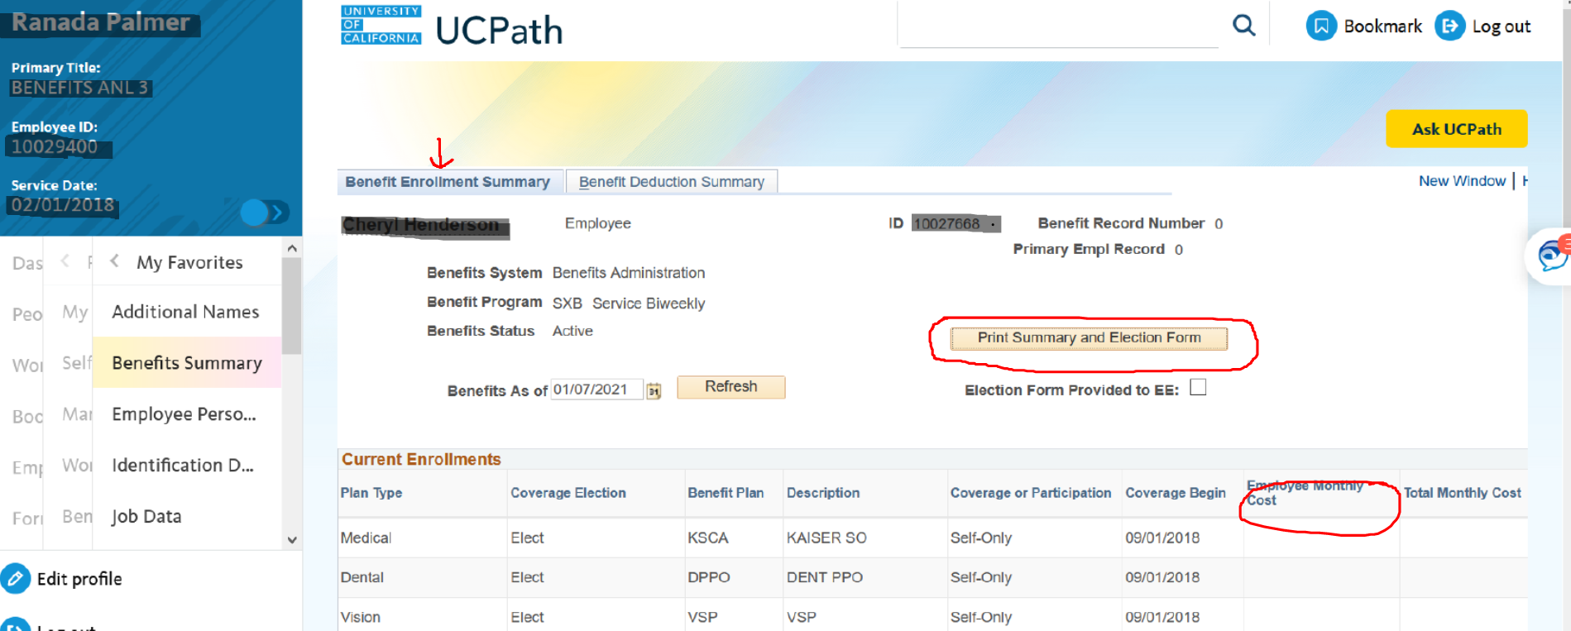
UCPath Center Benefits Summary Page Review

Slide 5
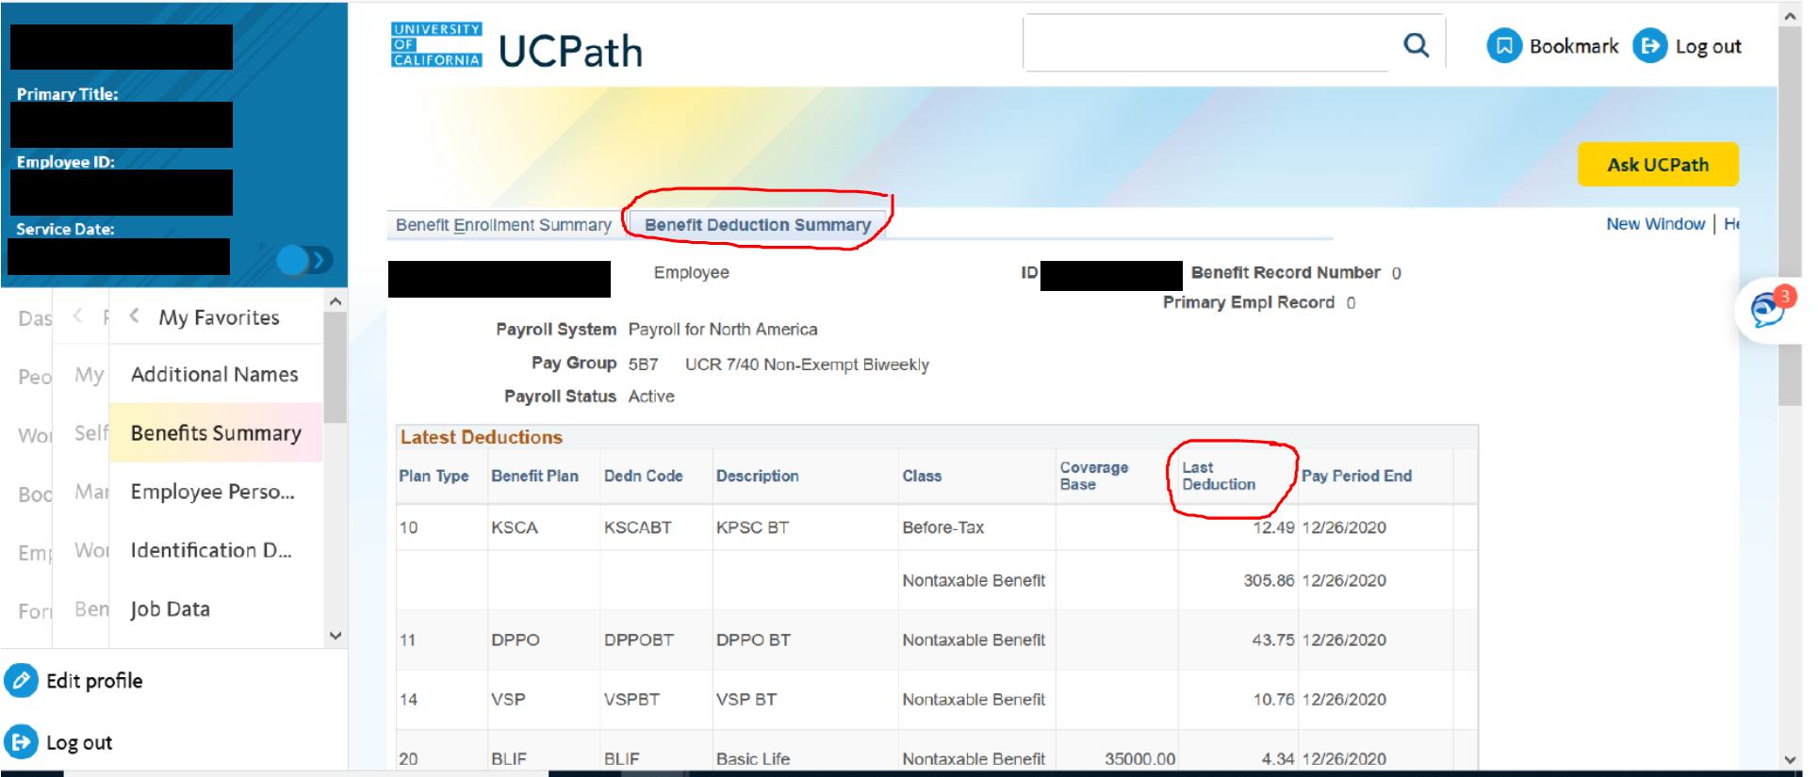
UCPath Center Benefits Summary Page Review

Slide 6
Cancelling or Reinstating Benefits
Employees have the option to continue all or some benefits while on leave.
No action is required if an employee does not wish to cancel benefits
Completion of an “Benefit Election Form” is required and must be submitted to the UCPath Center to cancel or suspend any benefits
To reinstate benefits upon return from leave, a “Reinstatement form” must be completed and submitted to the UCPath Center.
It is important to note that employees must be reminded to review all benefits to insure all coverage elections have been reinstated
Specifically, disability benefits may need manual reinstated by the UCPath Center upon return from leave.

Slide 7
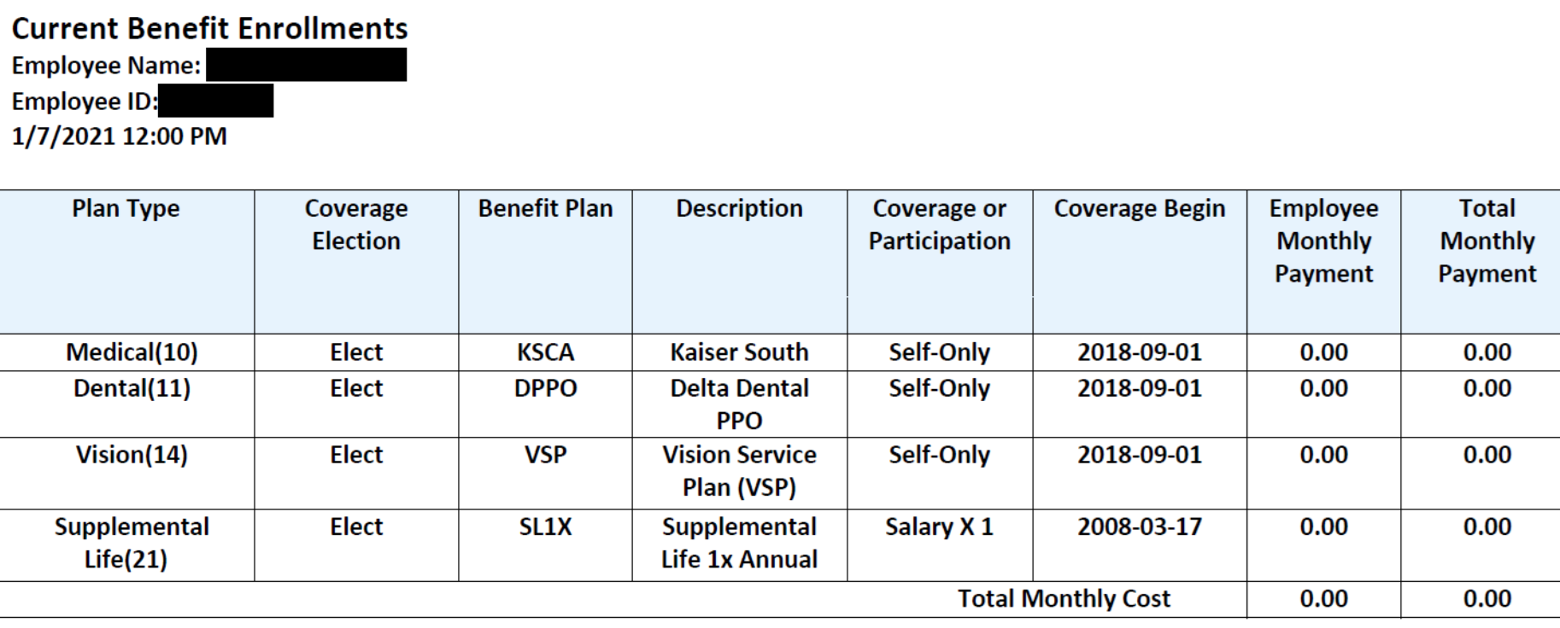
Employee Benefits Election Form

Slide 8
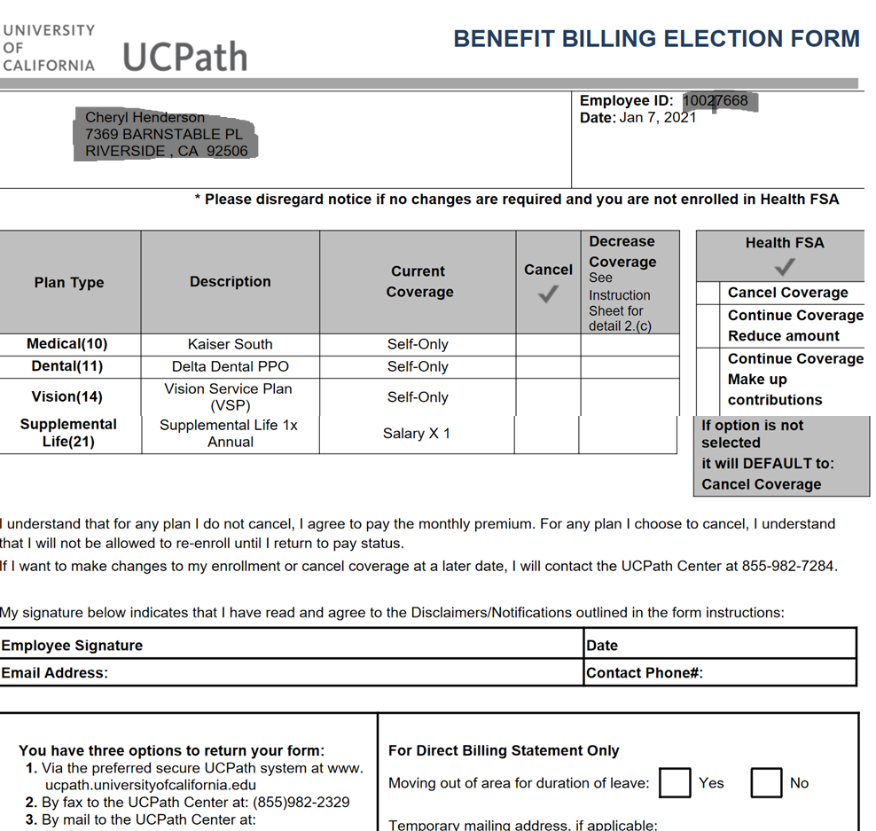
Benefits Billing Election Form

Slide 9
Benefits Billing Invoice
Once the temporary layoff is updated in the UCPath System, the employee will receive at their home via U.S. mail the Benefits Billing Invoice from the UCPath Center.
If not received, please contact the UCPath Center to request the statement:
Email: ucpath@universityofcalifornia.edu
Phone: (855) 982-7284

Slide 10
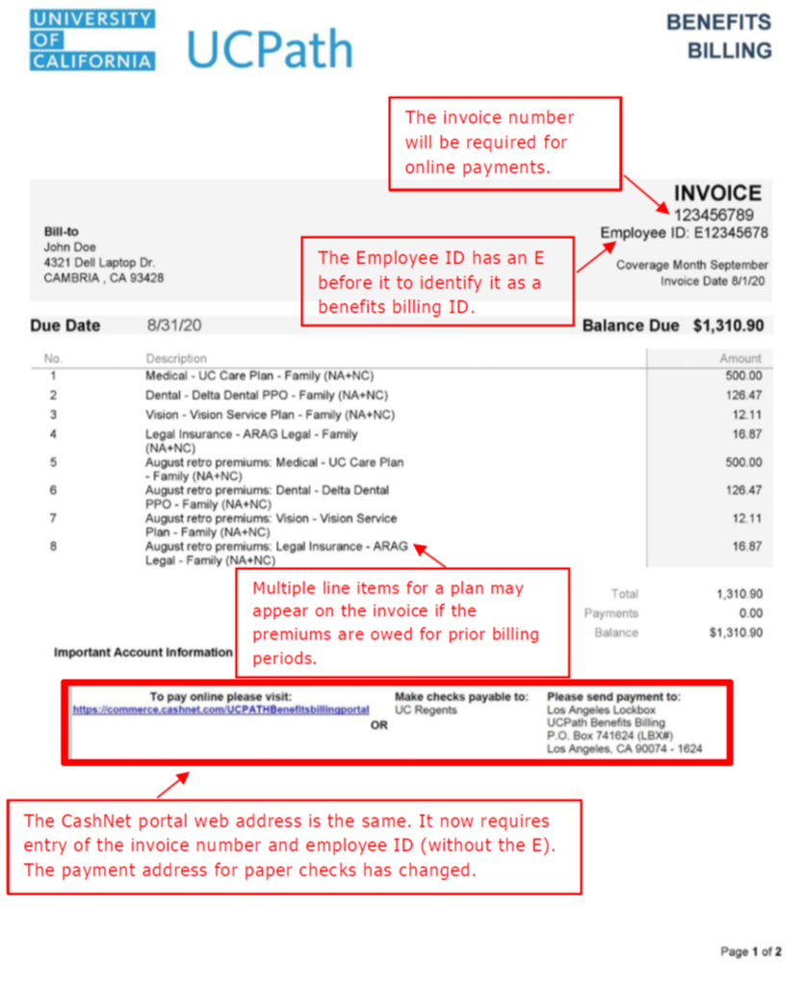
Benefits Billing

Slide 11
Benefits Ineligible to Continue
Not all benefits are eligible for continuation during temporary layoff status
Disability benefits and Business Traveler’s Insurance are not available to continue
Basic Disability, Voluntary Disability and Business Travel Accident coverage ends your last day actively at work before the layoff begins
Upon return to work, be sure that Disability coverage has been reinstated since it is a manual process and contact the UCPath Center at (855) 982-7284 if not properly reinstated

Slide 12
Dependent Care and Health Flexible Spending Accounts
Flexible Spending Account contributions and coverage stop when employees goes off pay status
Employees may continue participation in the Health FSA through COBRA
Employee may be reimbursed for eligible expenses incurred through the end of the pay period in which employee made the last contribution
Reimbursements are paid as long as expenses are submitted by the filing deadline for the year the expenses were incurred
Discovery Benefits Customer Service: (844) 561-1338
If employee misses the filing deadline, they will forfeit any money left in the accounts.

Slide 13
Voluntary Retirement Savings Plans
Contributions to the DC, 403(b) and/or 457(b) plans:
Contributions stop with the last paycheck
Employees may be able to take a distribution from their DC, 403(b) or 457(b) plans due to COVID-19 (temporary layoff)
Employees may take a distribution from their DC Plan After-tax rollover account at any time
403(b) Plan Loans
If the employee has an outstanding 403(b) loan, they will need to arrange with Fidelity to make payments during your layoff
Employees may make monthly payments, pay the amount they owe for the entire layoff period, or repay the total amount
The employee would need to make arrangements with Fidelity Investments at (866) 682-7787

Slide 14
California Casualty Insurance
Home/Auto/Renter’s Coverage
Employees may continue coverage to the end of the contract year by paying premiums directly to the vendor
Contact California Casualty directly at (866) 680-5143 to make the premium payment arrangements

Slide 15
Retirement and Leave Accruals
UC Retirement Plan
UC retirement service credit does not accrue during the temporary layoff status
Upon return to work, the time lost is eligible for purchase (or buy back) by contacting the Retirement Administration Service Center at (800) 888-8267
Employees cannot withdraw their UCRP contributions or Capital Accumulation Payment (CAP) during the temporary layoff period
Vacation, Sick Accrual and Employment Service Credit
Vacation, sick or employment service credit does not accrue during the temporary layoff status

Slide 16
UCPlus Supplemental Health Plans (Aflac)
The UCPlus Supplemental Health Plans premiums are not included in the Benefits Billing Invoice as are other eligible benefits for employees on temporary layoff status
The UCPath Center will defer all questions about the billing for the Aflac plan to the vendor
UCPlus Customer Service number is (888) 212-7201.
The Employee must decide within 90 days to continue or cancel the UCPlus Supplemental plans
Plan premiums are paid directly to Aflac (UCPlus)
AFLAC will bill the employee directly

Slide 17
Benefit Site Contact Information
UCPath Center – Benefits Enrollment - Portal Website https://ucpath.universityofcalifornia.edu/home Telephone Number: (855) 982-7284
UCRAYS website – UC Retirement Plan – Pension https://retirementatyourservice.ucop.edu/UCRAYS/Account/LoginE
Telephone Number: (800) 888-8267
Fidelity Investments – Voluntary Retirement Benefits https://nb.fidelity.com/public/nb/default/home
Telephone Number: (866) 682-7787

