Slide 1
Benefits Election Form Presentation
Direct Billing Process
Updated August 23, 2023

Slide 2
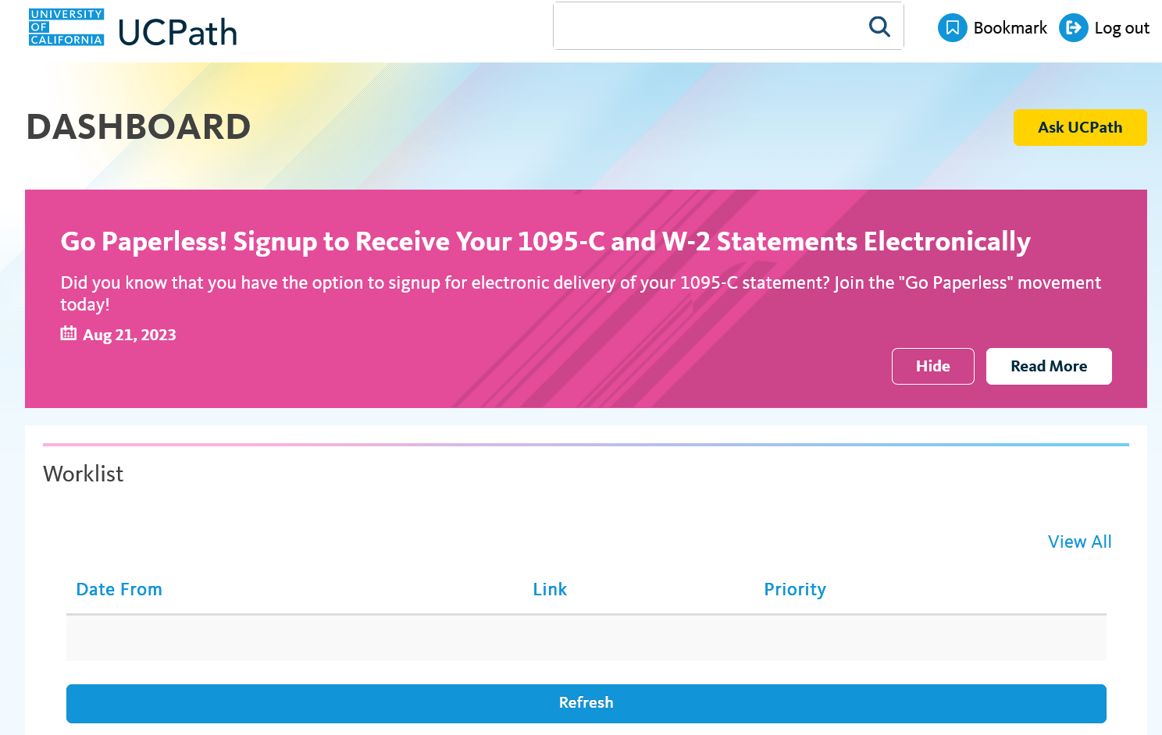
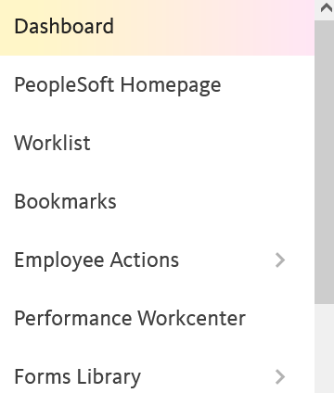
UCPath – Benefits Summary
Click on PeopleSoft Homepage

Slide 3
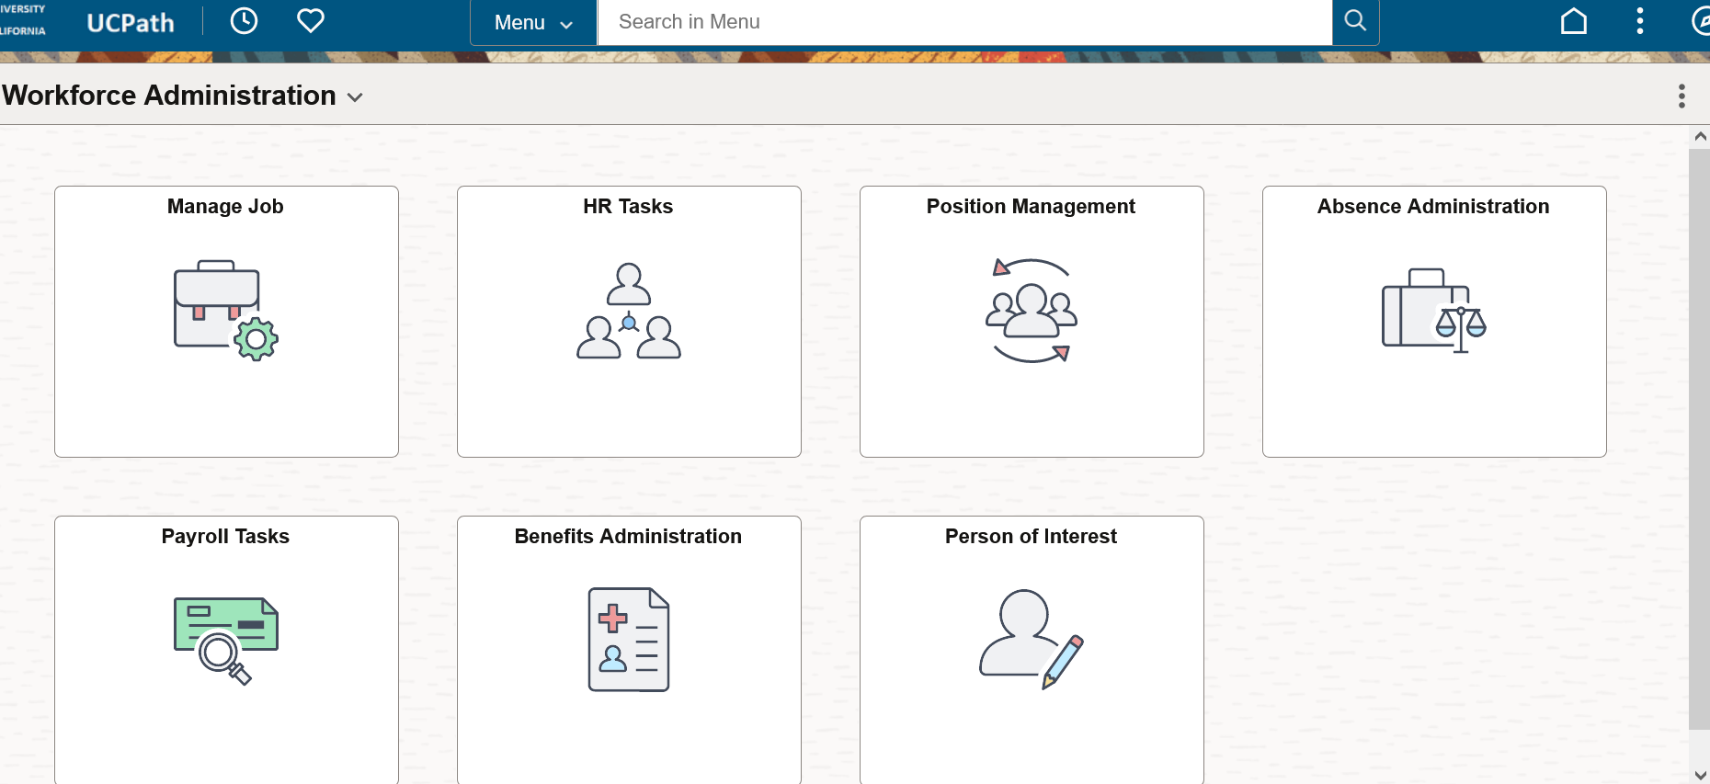
UCPath – Benefits Summary
Click on Benefits Administration Tile

Slide 4
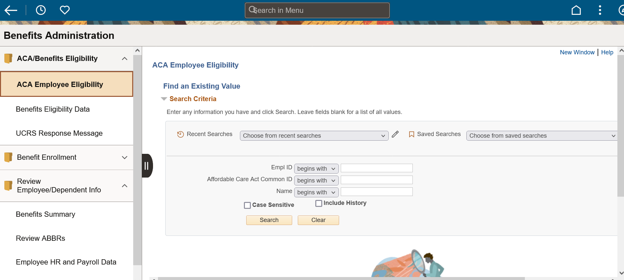
UCPath – Benefits Summary
Click on Review Employee Dependent Info, then Click Benefits Summary

Slide 5
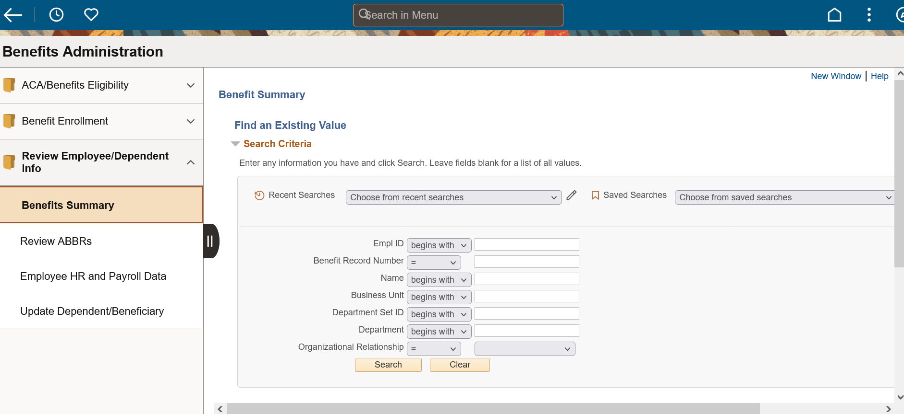
UCPath – Benefits Summary
Search for Employee by Name or Employee ID#

Slide 6
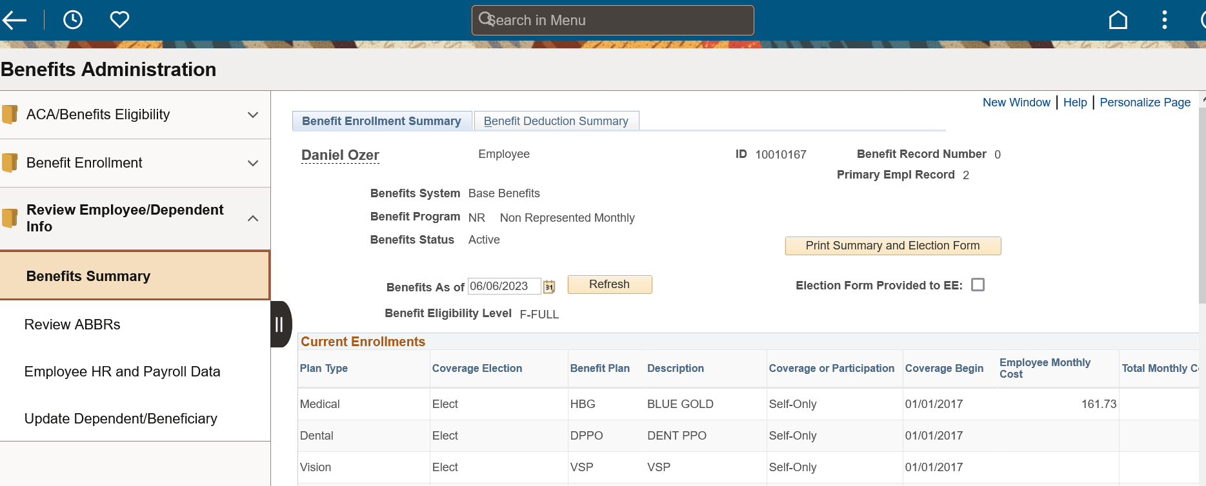
UCPath – Benefits Summary
Click Print Summary and Election Form

Slide 7
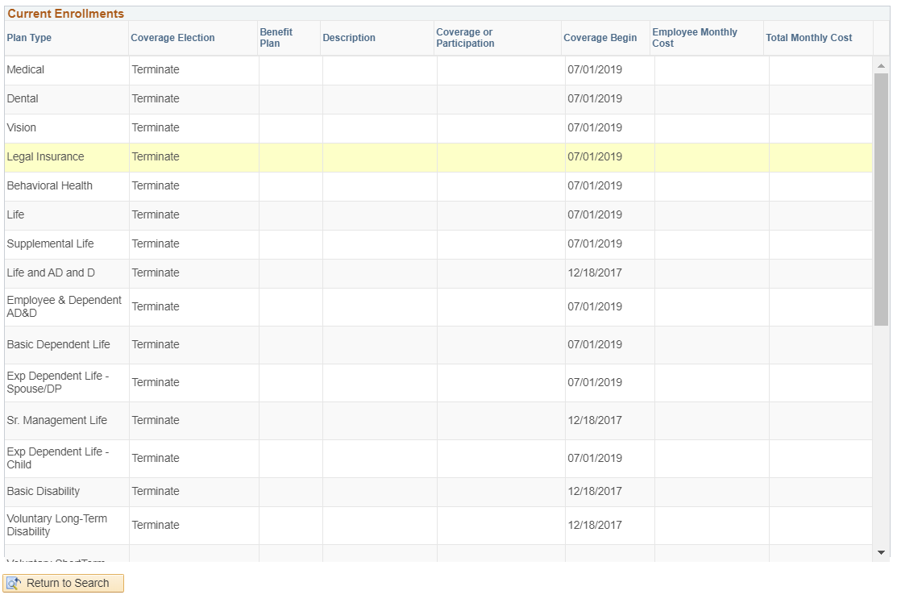
UCPath – Benefits Summary

Slide 8
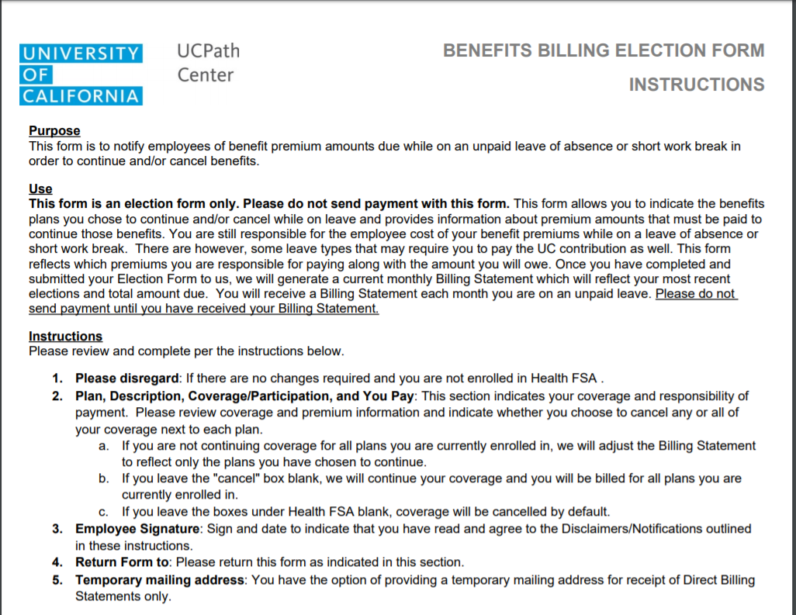
Billing Election

Slide 9
Submission of the Form

Slide 10
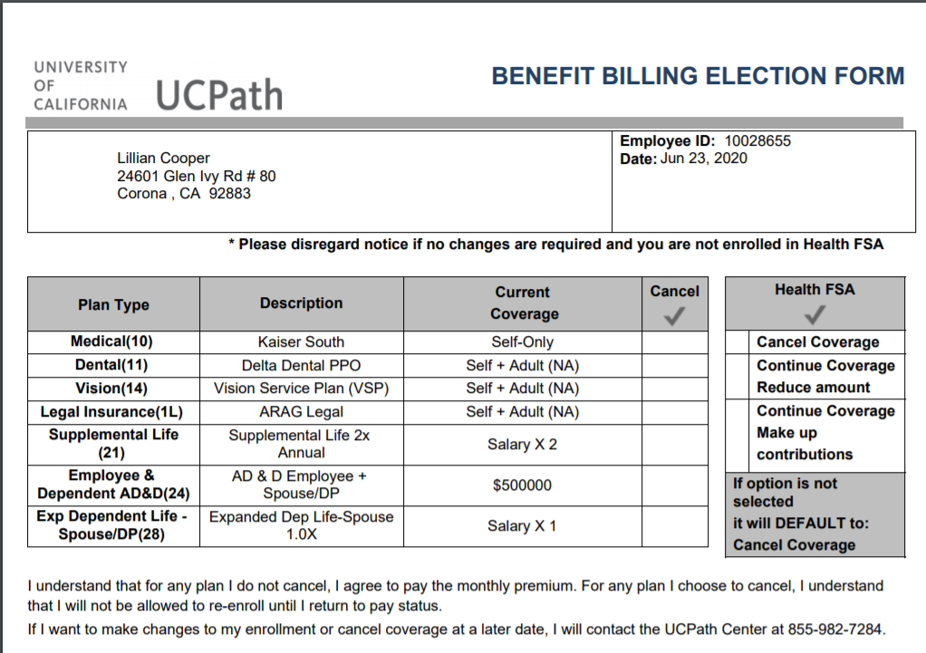
UCPath – Benefits Election Form
Employee Name
Mailing Address

Slide 11
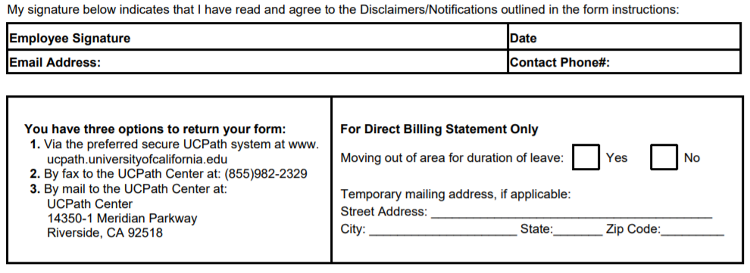
UCPath – Benefits Election Form

Slide 12
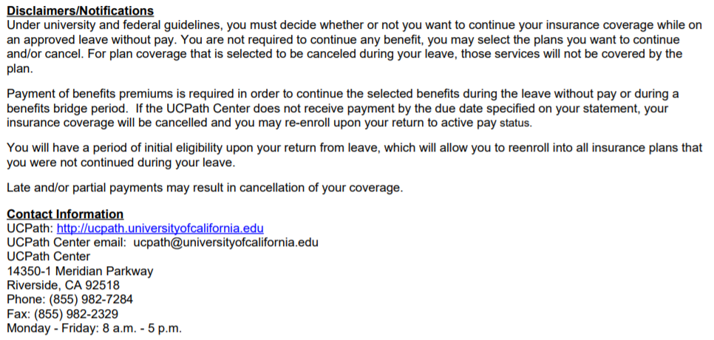
Contact Information for Employees

Slide 13
Return From Leave Health Benefits Reinstatement Form

Slide 14
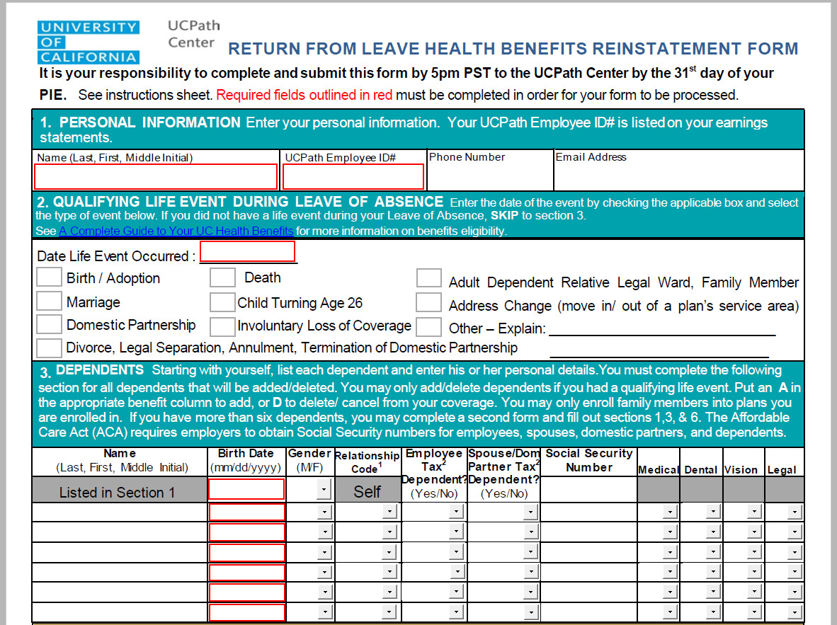
Reinstatement Form

Slide 15
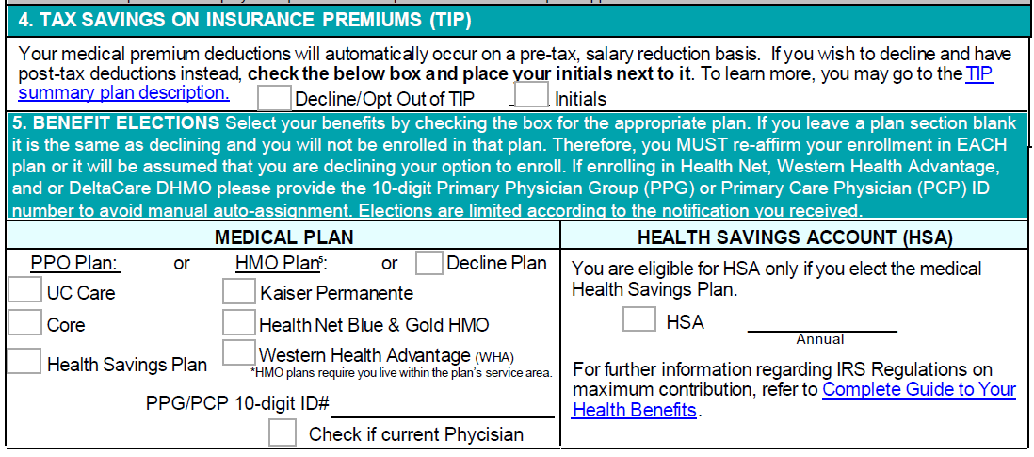
Reinstatement Form (cont.)

Slide 16
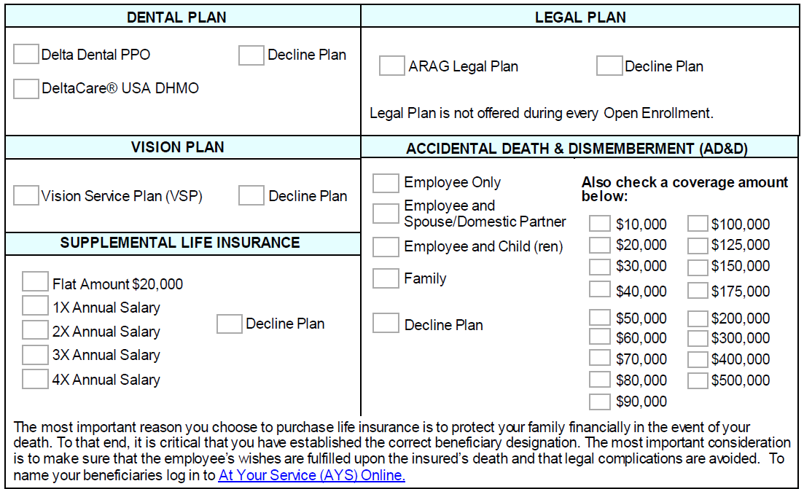
Reinstatement Form (cont.)

Slide 17
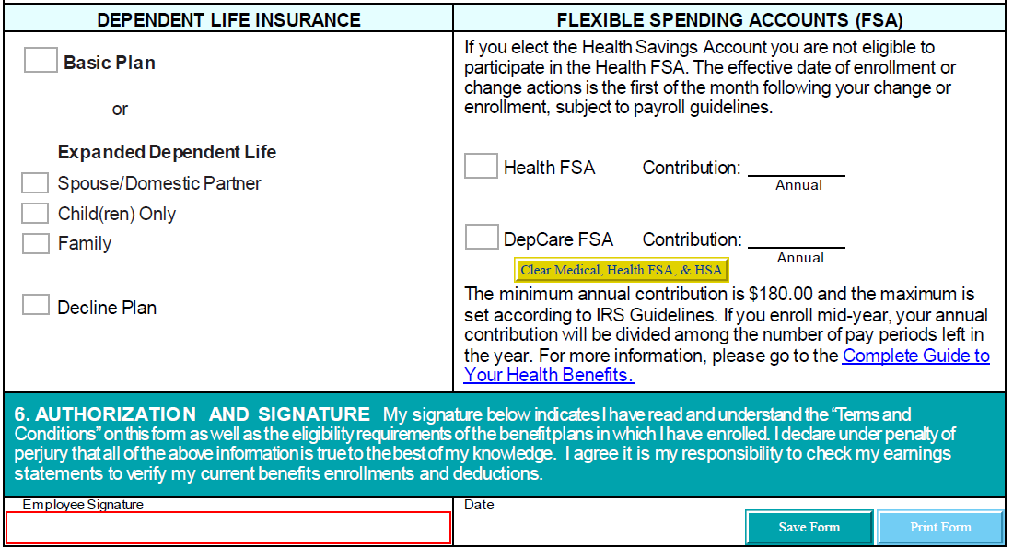
Reinstatement Form (cont.)

Slide 18
Questions?

