Slide 1
UC Disability Benefits Training
August 2023
Tina Rodriguez and Ranada Palmer
August 17, 2023

Slide 2
UC Disability Plans
UC offers three disability options
Electing both short-term and long-term coverage provides the most comprehensive protection.
Lincoln Financial Group is the disability benefit plan administrator.
Disability payments begin at the end of the 14 calendar day waiting period or after use of 22 business days of available sick leave, whichever is later.
Benefits are paid bi-weekly by Lincoln Financial Group and subject to Social Security and Medicare withholdings. Employee may elect Federal and/or State withholdings.
Basic
Short-Term
Long-Term

Slide 3
Basic UC Disability Benefits
Basic Disability Plan
UC Paid Disability benefit
Automatic Enrollment
14 Calendar Days waiting period.
Maximum benefit: 55% of gross wages, up to $800 per month (taxable).
Maximum benefit period: up to 6 months.

Slide 4
Short-Term Disability Benefits
Voluntary Short-Term Disability (VSTD)
Employee Paid
Disability payments begin after 14 calendar days waiting period.
Provides 60% of eligible monthly earnings up to $15,000 per month, for up to 6 months.
Disability payments are generally not taxable, premiums are paid with after-tax dollars.

Slide 5
Long-Term Disability Benefits
Voluntary Long-Term Disability (VLTD)
Employee Paid
Provides 60% of eligible monthly earnings up to $15,000 per month.
Disability payments are generally not taxable since premiums are paid with after-tax dollars.
Disability payments begin after 6 months, until reaching social security normal retirement age.

Slide 6
State Disability Insurance (SDI)
UC employees do not pay into SDI, instead UC has a private disability plan through Lincoln Financial Group.
SDI is applicable if employed with UCR less than 18 months.
If an employee has contributed to SDI through a previous or second employer, it is recommended to apply for SDI benefits.

Slide 7
State Disability Insurance Benefits
Maximum paid:
55% of gross wages earned with prior employer (non-taxable).
Paid Family Leave Benefit (additional six weeks of disability benefits for baby bonding).
7 calendar days
Waiting Period
For more info go to www.edd.ca.gov or call 1-800-480-3287.

Slide 8
Pregnancy Disability Benefits
Normal Pregnancy
Six weeks for normal pregnancy.
C-section Pregnancy
Eight weeks for C-section.
If employee elects to leave work prior to two weeks before due date, documentation of pregnancy complications must be provided.
Once pregnancy disability benefit has been exhausted through Lincoln Financial Group, the employee may elect to use available vacation or sick leave, or the Pay for Family Care and Bonding program for baby bonding to continue receiving income.

Slide 9
Lactation Program
Human Resources (HR) is collaborating with the campus community to ensure lactation rooms are located within close proximity to work locations.
Ten (10) private lactation rooms are available These beautifully decorated lactation rooms are sanitary, located in a private space and have locking doors. Each room is equipped with a table, electrical outlet, mini refrigerator, microwave, comfortable chair and a multi-user hospital grade breast pump.
While we are making efforts to offer additional locations, we have developed alternate options to help departments and nursing mothers create a temporary lactation space in their department or office.
If a lactation room is not easily accessible (more than a 5–7-minute walk), Human Resources will loan a breast pump and breast pump kit to nursing mothers. This option will allow departments to set up a temporary private lactation space and help ensure nursing mothers feel supported. A Lactation Accommodation Program Breast Pump Loan Agreement will be required to reserve a breast pump and breast pump kit.
Additionally, breast pumps are also available through the UC Medical Plan vendor, employees should contact the medical plan provider to request a breast pump.
For more information on this option, please contact lactationprogram@ucr.edu.

Slide 10
Leave Administrator Role and Responsibilities

Slide 11
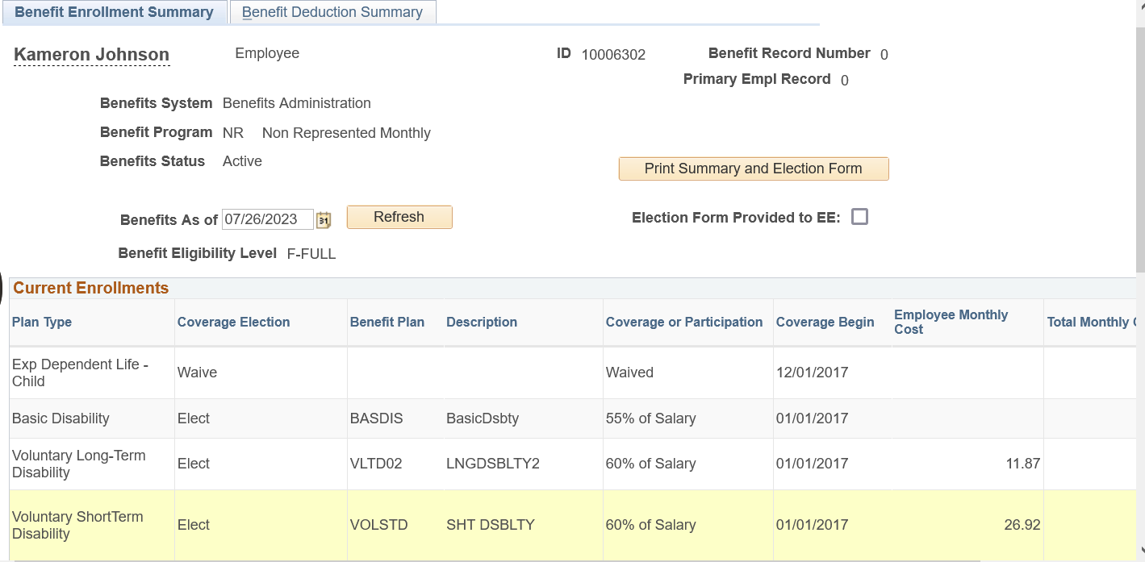
Determining Disability Benefits Eligibility
Review the “Benefits Summary” page on UCPath to determine disability benefits eligibility.

Slide 12
Reviewing the Campus Disability Process
Review the Disability Leave and Pregnancy Disability Checklists and guide for employees to file a disability claim.
Review the How to File for Disability Checklist.
https://hr.ucr.edu/sites/default/files/2023-06/how-to-file-disability2023.pdf
Review the How to File for Pregnancy Disability Checklist.
https://hr.ucr.edu/sites/default/files/2023-06/how-to-file-pregnancydisability2023.pdf

Slide 13
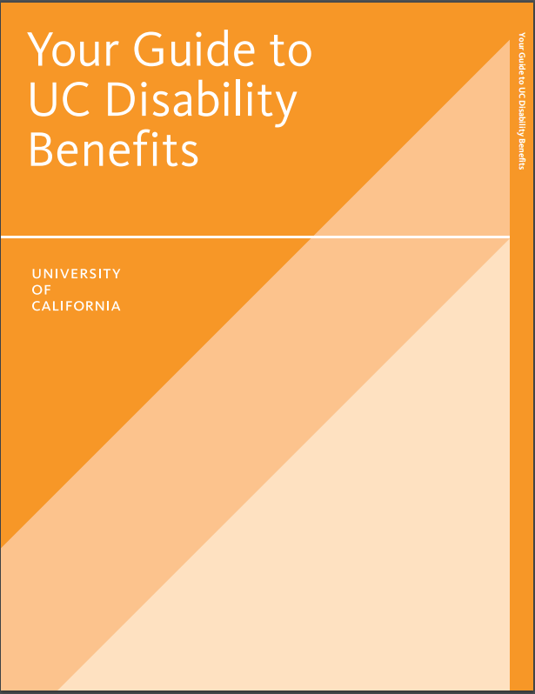
Disability Benefits
https://ucnet.universityofcalifornia.edu/forms/pdf/your-guide-to-uc-disability-benefits-fact-sheet.pdf

Slide 14
Paid Leave Options
Lincoln Financial Group disability benefits income
Basic Disability (Employer Paid)
Short Term Disability (Employee Paid)
Long Term Disability (Employee Paid)
Sick Leave
(if available)
Vacation Leave
(if available)
Compensation (Comp) Time
(if available)
Catastrophic Leave Program
(if eligible)
The Pay for Family Care and Bonding (PFCB) program
(100% salary)

Slide 15
Catastrophic Leave Sharing Program
The UCR Catastrophic Leave Sharing Program permits temporary salary and benefit continuation for career staff and academic employees who accrue vacation and have exhausted all paid leave credits due to a catastrophic illness or injury.
The illness or injury can be to the employee or a member of the employee’s family or household.
The employee must be on an approved Leave of Absence.
Donations must come from vacation accruals only, sick leave accruals cannot be donated.
Employees who are receiving University disability benefits or Workers’ Compensation payments are not eligible.

Slide 16
Catastrophic Leave Sharing Program
In the case of the employee’s own serious health condition, donated time may be applied to the disability waiting period only.
Donations can be made to: 1) any eligible employee or 2) a specific employee in need.
Donations are reflected as an hour-for-hour deduction from the vacation leave balance of the donating employee and will be received on an hour-for-hour basis by the eligible recipient.
No more than one (1) month or 184 hours of donated leave allowed in a rolling 12-month period beginning with the date of the first donation.

Slide 17
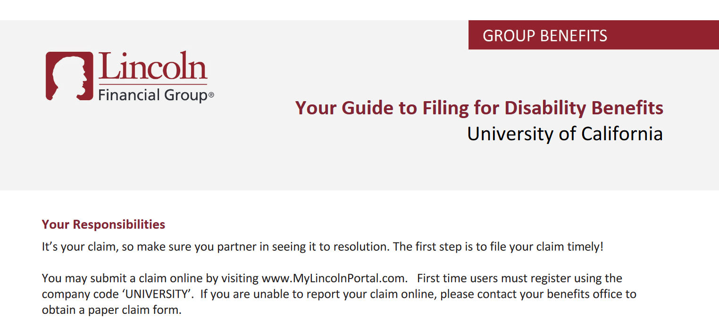
Filing for Disability Benefits
Review The Guide to Filing for Disability.
https://hr.ucr.edu/document/guide-filing-disability

Slide 18
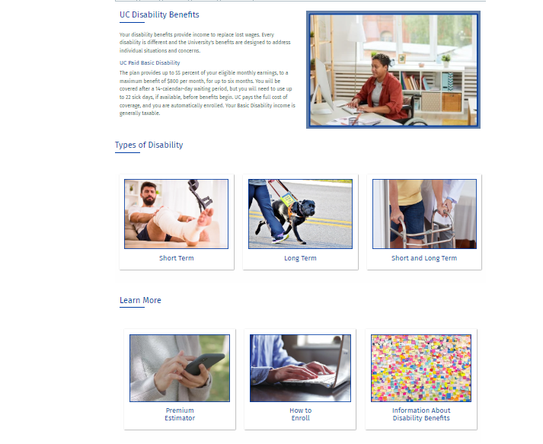
UC Disability Website
Leave Administrators are recommended to share the link to the UC Disability website which offers valuable information.
UC Disability Benefits | Human Resources (ucr.edu)

Slide 19
Reasons for a Pending Disability Claim
The UCPath Center has not provided the UC Statement to Lincoln Financial Group.
Lincoln Financial Group will state the employer information is pending.
The leave without pay was not entered in the UCPath portal.
The UCPath Center cannot complete the UC Statement if the leave without pay is not entered.
The physician’s office has not provided medical records to support the medical condition.
Lincoln Financial cannot review the disability claim without the medical records.

Slide 20
Disability Work Restrictions
Lincoln Financial Group offers the Stay at Work/Return to Work Program.
Employees may apply for partial disability with Lincoln Financial Group if eligible for short-term or long-term disability.
Employees may return to work part-time due to pregnancy complications or any disability which may require reasonable accommodations.
Work restrictions are coordinated between the department and the Return to Work Coordinator to ensure proper accommodations are available.
Contact Ariel Caluag at ariel.caluag@ucr.edu if the employee has physician supported work limitations.

Slide 21
UC Benefits Information

Slide 22
Benefits Information
UC Health Savings HSA (Anthem Blue Cross)
In-patient hospital – 20% in-network, 40% up to $360 per day out-of-network.
UC Care (Anthem Blue Cross)
Prenatal and postnatal care – UC Select $20 (initial visit only), Blue Cross Preferred 30%, out of network 50%.
In-patient hospital – UC Select $250 copay, Blue Cross Preferred 30%, out-of-network 50% up to $300 per day.
Health Net Blue & Gold and Kaiser Permanente
Prenatal and postnatal care covered at 100% (no co-payment).
In-patient hospital co-payment $250.
Prenatal and postnatal care – 20% in-network, 40% out-of-network.

Slide 23
DepCare & Health FSA
Dependent Care Flexible Spending Account (DepCare FSA)
Allows employee to pay for eligible dependent care expenses on a pre-tax, salary reduction basis.
Health Flexible Spending Account (Health FSA)
Allows employee and eligible family members to pay on a pre-tax, salary reduction basis, for eligible health care expenses not covered by the medical, dental or vision plans (e.g., co-payments and prescriptions).
Both plans administered by WEX. Contact number: 844-561-1338 WEX Health website.

Slide 24
Adding Newborn to Benefit Plans
Within 31 days from date of birth, Employee must enroll newborn through the UCPath Portal Life Event Option, or complete an eForm for health and benefits enrollment Life Event and submit to UCPath Center via email.
The UCPath steps to the eForm:
Log in – Forms Library – Access Forms – Faculty and Staff section - Benefits E form, Submit New Form. Automatically creates a case.
If employee fails to enroll newborn within 31 days, the following will occur:
Newborn is enrolled 90 days from the date the UCPath Center approves the Late Enrollment and Life Event forms.
The employee may enroll the newborn in dental and vision benefits during the next Open Enrollment period.
Employee may elect or make changes to DepCare and Health FSA.
Please see the “Family Changes Fact Sheet” to learn more about other benefit options including supplemental and dependent life insurance availability.

Slide 25
UCPath Benefits Premiums Continuation
Lincoln Financial Group disability checks do not deduct the benefit premiums.
Upon return to work, employees must complete a Reinstatement of Benefits form to re-enroll in any benefit plans discontinued while on leave.
Employees are responsible for making direct monthly payments to the UCPath Center (note: Lincoln disability benefit premium waived while on disability leave).
Allows for continuation of selected benefits plans.
Employee will receive a direct benefits billing statement once pay status ends.

Slide 26
Health Care Facilitator Program
The Health Care Facilitator (HCF) provides assistance for faculty, staff, retirees, survivors and their eligible family members with benefits and services available from the UC-sponsored health plans.
The HCF is a knowledgeable counselor who delivers confidential one-on-one assistance with:
Understanding the UC health plan coverage and patient rights
Defining and resolving issues and navigating through the health care system.
Understanding how Medicare benefits coordinate with UC-sponsored medical plans

Slide 27
Resources
Family and Medical Leave Fact Sheet 2023 (universityofcalifornia.edu)
UC Disability Benefits | Human Resources (ucr.edu)
Disability Benefits For Faculty Fact Sheet (universityofcalifornia.edu)
Taking a leave of absence | UCnet (universityofcalifornia.edu)
Having a baby | UCnet (universityofcalifornia.edu)
Pay for Family Care and Bonding | UCnet (universityofcalifornia.edu)
UC Riverside Health Care Facilitator – ranada.palmer@ucr.edu

Slide 28
Contact Information
Any questions, please email the Benefits Office at benefits@ucr.edu for further assistance.

