Slide 1
Supplemental Insurance
Helps protect you and your loved ones
with a safety net of benefits.
All coverages are issued by The Prudential Insurance Company of America (Prudential).

Slide 3
Accident Insurance

Slide 4
Accident Insurance
Pays for injuries and related medical services due to a covered accident including, but not limited to:
Fractures
Burns
Lacerations
Concussions
Ambulance
Dislocations
ER visits
Medical tests
Eye Injury
Pain management
WHAT’S IN IT FOR YOU

Slide 5
Accident Insurance
What’s Changing for 2025
NEW! $1,200 per intensive care unit (ICU) admission.
ICU hospital confinement benefit increasing from a maximum of three confinements per year to a maximum of 10 confinements per year.
Non-ICU hospital confinement benefit increasing from a maximum of three confinements per year to a maximum of 10 confinements per year.
Physician’s office visit benefit increasing from $75 per year to $100 per year.
NEW! Chiropractic or alternative therapy benefit of $50 per day.
Outpatient surgery and anesthesia benefit increasing from $500 to $700.
Covered spouse may elect to become the primary insured at the time of primary insured’s death.
Coverage Details
Covered Member(s) | Monthly Rate
Employee Only | $9.67
Employee + Spouse | $15.86
Employee + Child(ren) | $19.85
Family | $26.04
There will be no change in supplemental health plan premiums for 2025.

Slide 6
Accident Insurance
Benefits in action
Care received after injury | Benefit amount*
Ambulance (ground) | $400
Emergency room | $350
Medical testing | $300
Concussion | $300
Hospital admission | $1,200
Injury broken thigh bone & Anesthesia | $9,600
Hospital stay (2 additional days @$200/day) | $400
Medical equipment (crutches) | $100
Physical Rehabilitation ($50 x 10 visits) | $500
Total benefit | $13,150
Meet Christine
Christine suffered serious injuries when she collided with a car at an intersection. Her Accident benefits helped pay for what her medical plan didn’t cover.

Slide 7
Critical Illness Insurance

Slide 8
Critical Illness Insurance
Coverage Details
Pays you a benefit for diagnosis of medical conditions, including, but not limited to:
Alzheimer’s Disease
Cancer
Coma
Coronary Artery Disease (severe)
Heart Attack
Major Organ failure
Paralysis
WHAT’S IN IT FOR YOU
Employee coverage up to $30,000
Spouse/domestic partner coverage up to $30,000
Children coverage up to $15,000
Includes reoccurrence benefit

Slide 9
Critical Illness Insurance
What’s Changing for 2025
• Mammography benefit of $200 per year
• NEW! Dependent child benefits payable for autism, juvenile diabetes Type I, and Phenylalanine Hydroxylase Deficiency
• NEW! $100 per year payable for new cancer screenings, including bone mass density, spiral CT, ctyological screening, DNA stool analysis, and HIV test via nucleic acid
• Illness recurrence provision changing from 6 months to 90 days
• Covered spouse may elect to become the primary insured at the time of primary insured’s death
Monthly Rate Coverage Details By Age
Per $10,000 of Coverage
Age | Employee (includes child) | Spouse
<26 | 4.87 | 4.87
26-30 | 5.84 | 5.84
31-35 | 6.51 | 6.51
36-40 | 8.01 | 8.01
41-45 | 9.66 | 9.66
46-50 | 10.19 | 10.19
51-55 | 16.86 | 16.86
56-60 | 15.91 | 15.91
61-65 | 26.17 | 26.17
66-99 | 54.36 | 54.36
Per $30,000 of Coverage
Age | Employee (includes child) | Spouse
<26 | 9.46 | 9.46
26-30 | 12.35 | 12.35
31-35 | 14.37 | 14.37
36-40 | 18.86 | 18.86
41-45 | 23.81 | 23.81
46-50 | 25.41 | 25.41
51-55 | 45.43 | 45.43
56-60 | 42.57 | 42.57
61-65 | 73.34 | 73.34
66-99 | 157.93 | 157.93
There will be no change in supplemental health plan premiums for 2025.

Slide 10
Critical Illness Insurance
Benefits in action
Covered condition | Benefit amount*
Breast cancer—initial diagnosis | $30,000
Lodging benefit ($100 x 2 days) | $200
National Cancer Institute (NCI) Evaluation | $750
Breast cancer—second diagnosis five years later (recurrence) | $30,000
Total benefit | $60,750
Meet Cindy
Cindy is a wife, mother, and office manager.
Recently diagnosed with breast cancer, Critical Illness Insurance helped provide her with a financial cushion.
*$30,000 initial benefit with a lifetime maximum benefit.

Slide 11
Supplemental Health Wellness Benefit
Your coverage includes a wellness benefit of $100 for Critical Illness, which helps you to stay healthy by rewarding you for health screening tests such as:
Abdominal aorta ultrasound screening for aneurysms
Bone marrow testing
Carotid doppler
Chest x-rays
Colonoscopy
Doppler Screening for peripheral vascular disease
Echocardiogram
Electrocardiogram (EKG)
Flexible Sigmoidoscopy
Hemoccult stool specimen
Lipid panel
Oral cancer screening
Pap smears/Thin prep pap test
Prostate-Specific Antigen test (PSA)
Routine health check-up exam
Serum protein electrophoresis
Skin cancer biopsy
Skin cancer screening
Stress test on bicycle or treadmill
Thermography
Triglycerides blood test
For a complete list of health screening tests, please see your Outline of Coverage. The Wellness benefit is payable once per calendar year, per covered person, if the covered person receives a covered health screening test while not confined in a hospital.

Slide 12
Hospital Indemnity Insurance

Slide 13
Hospital Indemnity Insurance
Coverage Details
Pays you for events related to your hospitalization:
Hospital Admissions
Intensive Care Unit Admission
Daily In-Hospital Stays
Pays a daily benefit up to 30 days per hospitalization.
WHAT’S IN IT FOR YOU

Slide 14
Hospital Indemnity Insurance
What’s Changing for 2025
• NEW! Mammography benefit of $100 per year
• NEW! Benefit for intermediate intensive care unit (ICU) step-down unit
• Hospital admission benefit increasing from a maximum of five times per year to a maximum of 10 times per year
• Hospital confinement benefit increasing from a maximum of five confinements per year to a maximum of 10 confinements per year
• Hospital ICU confinement benefit increasing from a maximum of five confinements per year to a maximum of 10 confinements per year
• NEW! $1,200 per intensive care unit (ICU) admission
• No exclusions for substance abuse related hospitalizations
Hospital Indemnity Rates
Covered Member(s) | Monthly Rate
Employee Only | $16.19
Employee + Spouse | $32.52
Employee + Child(ren) | $26.17
Family | $42.49
Hospital Indemnity Schedule of Benefits
Benefit | Benefit Amount
Hospital Admission Benefit | $1,200
Hospital Confinement Benefit | $200
ICU Confinement Benefit | $400
There will be no change in supplemental health plan premiums for 2025.

Slide 15
Hospital Indemnity Insurance
Benefits in action
Covered event | Benefit amount
Hospital admission | $1,200
Intensive Care Unit (ICU) confinement (2 days @ $400 / day) | $800
Hospital confinement (5 days @ $200 / day) | $1,000
Total benefit | $3,000
Susan
Susan was seriously injured in a car accident. Hospital Indemnity helped provide her with a financial cushion benefit to pay what her medical plan didn’t cover.

Slide 16
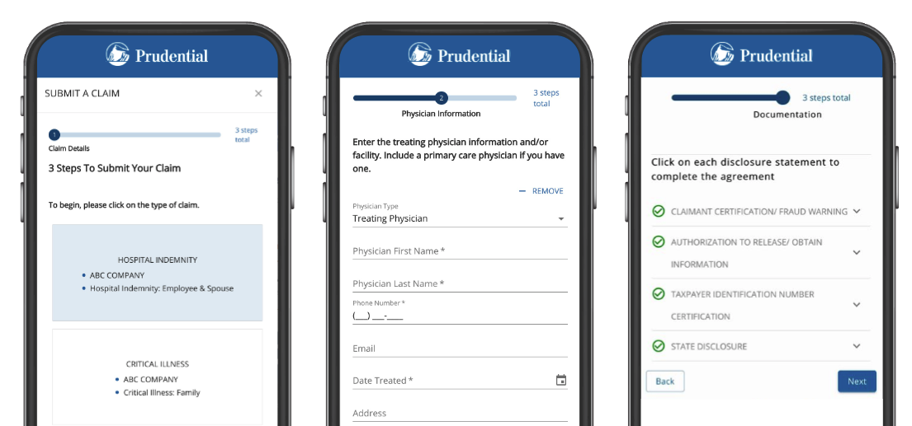
Submit your claim online in 3 easy steps.
Claims are effective January 1, 2025
No paper forms
No chasing medical records
No fine print
Prudential takes everything from there
Members will need to go online to create a profile.
Log in to www.prudential.com/mybenefits or scan using your mobile device to access our Workplace Benefits site.
Learn more with our claims video. Visit
www.prudential.com/landing/voluntary-claims.

Slide 17
Life Accidental Death and Dismemberment

Slide 18
Term Life Insurance
Could help pay living expenses if something happened to you or your covered loved one
Typically income tax-free
There’s no lapse in coverage if you leave the company
Provides extra financial security
¹ LIMRA 2021 Life Insurance Barometer Study.

Slide 19
AD&D Insurance
Could help pay living expenses if something happened to you
Relatively inexpensive compared to other benefits
Benefits:
For the designated beneficiary/beneficiaries if insured’s death results from an accident
For a serious injury, a percentage of the coverage amount is paid to the insured
Even if the insured has disability or life insurance
¹ Center for Disease Control and Prevention. Deaths and Mortality 2020. https://www.cdc.gov/nchs/fastats/deaths.htm.
² CDC,10 Leading Causes of Death by Age Group, United States, 2018.

Slide 20
Employer Provided Coverage
Basic Term Life Insurance | Coverage Offered (Employer Paid)
Core Plan | A flat amount of $5,000
Career Plan | 1x covered annual earnings up to a maximum of $50,000, minus the $5,000 core benefit
Senior Management Plan | 2x covered annual earnings up to a maximum of $800,000. This is in addition to the Career Plan benefit
Scan using your mobile device to access our Life Needs Estimator Calculator

Slide 21
Optional Term Life Insurance
Optional Term Life | Coverage Offered (Employee Paid)
Employee | You can enroll for the following options: Flat amount of $20,000 1.0x covered annual earnings to a max of $250,000 2.0x covered annual earnings to a max of $500,000 3.0x covered annual earnings to a max of $750,000 4.0x covered annual earnings to a max of $1,000,000 If enrolling when first eligible, you may enroll for any amount without providing proof of good health to Prudential.
Spouse/Domestic Partner | Enroll for 50% of your Optional Term Life amount up to a max of $200,000. If you elect Dependent Optional Term Life, your spouse/domestic partner will automatically be enrolled for $5,000 in Basic Dependent Term Life. If enrolling when first eligible, you may elect any coverage amount without providing proof of good health to Prudential.
Dependent Child(ren) Child coverage begins from live birth to age 26 | Enroll for a flat amount of $10,000. If you elect Dependent Optional Term Life, your dependent child(ren) will automatically be enrolled for $5,000 in Basic Dependent Term Life.

Slide 22
Optional AD&D Insurance
Optional AD&D Insurance | Coverage Offered (Employee Paid)
Employee | You can enroll for the following options Enroll for coverage in increments of $10,000 to a maximum of $500,000. Purchase coverage for a flat amount of $125,000 Purchase coverage for a flat amount of $175,000
Family Plan Child coverage begins from live birth to age 26 | Spouse/Domestic partner only coverage amount: 60% of your Optional AD&D amount, not to exceed $300,000. Child only coverage amount: 20% of your Optional AD&D amount, not to exceed $100,000. Spouse/Domestic partner & Child combined amount: 50% of your Optional AD&D amount, not to exceed $300,000, for spouse/domestic partner, 20% of your Optional AD&D amount, not to exceed $100,000 for dependent child(ren).

Slide 23
Any Questions?
Donna Yockey
Prudential National Account Manager
donna.yockey@prudential.com

Slide 24
For more information:
Call (855) 483-1438 M-F, 8 a.m. to 9 p.m. ET.
This coverage is not health insurance coverage (often referred to as “Major Medical Coverage”). This type of plan is NOT considered “minimum essential coverage” under the Affordable Care Act and therefore does NOT satisfy the individual mandate that you have health insurance coverage.
This policy provides ACCIDENT insurance only. It does NOT provide basic hospital, basic medical, or major medical insurance as defined by the New York State Department of Financial Services.
Group Accident, Hospital Indemnity, and Group Critical Illness Insurance coverages are limited benefit policies issued by The Prudential Insurance Company of America, a Prudential Financial company, Newark, NJ. Prudential’s Group Accident, Hospital Indemnity, and Group Critical Illness Insurance coverages are not substitutes for medical coverage that provides benefits for medical treatment, including hospital, surgical, and medical expenses, and they do not provide reimbursement for such expenses. The Booklet-Certificate contains all details, including any policy exclusions, limitations, and restrictions which may apply. If there is a discrepancy between this document and the Booklet-Certificate/Group Contract issued by The Prudential Insurance Company of America, the Group Contract will govern. A more detailed description of the benefits, limitations, and exclusions applicable are contained in the Outline of Coverage provided at time of enrollment. Please contact Prudential for more information. Contract provisions may vary by state. Contract Series: 83500 and 114774. Products may not be available in all states at this time.
© 2023 Prudential Financial, Inc. and its related entities. Prudential, the Prudential logo, and the Rock symbol are service marks of Prudential Financial, Inc. and its related entities, registered in many jurisdictions worldwide.

