Slide 1



Slide 2

2025 Medical Plans Review

Slide 3
Ongoing Increasing Cost of Health Coverage
The national trends that increased medical costs and medical plan premiums last year have continued. UC’s medical plan costs will rise again this year due to increased health care utilization, an aging population, a rise in chronic health conditions, enhanced benefits, and the rapidly expanding use of costly new drugs and treatments.
View this link to A letter to the community from Systemwide HR Vice President, Cheryl Lloyd, Spanish version, and this link to frequently asked questions on Ucnet.

Slide 4
2025 Medical Plans
Non-Medicare Plans
Medicare Plans
UC Blue & Gold HMO
Kaiser Permanente HMO*
UC Care
UC Health Savings Plan with Health Saving Account (HSA)
CORE
Kaiser Senior Advantage
UC Medicare PPO
UC Medicare PPO without Prescription Drugs
UC High Option Supplement to Medicare
UC Medicare Choice PPO
Via Benefits Medicare Coordinator Program (outside California)
*Optum provides behavioral health benefits as an overlay for Kaiser members

Slide 5
2025 HMO Medical Plans for Emeriti and Retirees
UC Blue & Gold HMO
Kaiser HMO
Optum Behavioral Health
Kaiser Senior Advantage

Slide 6
UC Blue & Gold and Kaiser HMO
Legislative Mandate
Assembly Bill 904: Health Care Coverage: Doula Services
UC Blue & Gold |  |  | Kaiser
 | 2024 | 2025 | 2024 | 2025
Doula Services | N/A | $0 Copay 11 visits per pregnancy; members pay full cost of services after 11 free visits | N/A | $0 Copay 11 visits per pregnancy; members pay full cost of services after 11 free visits
myStrength digital tool is rebranding to Teladoc Mental Health
myStrength will sunset for existing users on 12/31/2024

Slide 7
UC Blue & Gold HMO
Plan Design Changes
 | 2024 | 2025
Office Visits and Urgent Care | Medical: $20 Copay Behavioral Health: Visits 1-3: No Copay Visits 4+: $20 Copay | Medical: $30 Copay Behavioral Health: Visits 1-3: No Copay Visits 4+: $30 Copay
Acupuncture and Chiropractic | $20 Copay | $20 Copay

Slide 8
UC Blue & Gold HMO
Plan Design Changes
 | 2024 | 2025
Pharmacy Benefit | $5/$25/$40 – Retail 30-day supply $10/$50/$80 – Retail/Mail Order 90-day supply Office-administered injectable drugs - $20 | $10/$30/$50 – Retail 30-day supply $20/$60/$100 – Retail/Mail Order 90-day supply Tier 4: Specialty Drugs (Oral and Injectable) 30% coinsurance up to $150 maximum per prescription Office-administered injectable drugs - $30

Slide 9
Kaiser HMO
Plan Design Changes
 | 2024 | 2025
Office Visits and Urgent Care | Medical and Behavioral Health $20 Copay | Medical and Behavioral Health $30 Copay
Acupuncture and Chiropractic | $15 Copay | $15 Copay
Reminder: myStrength will sunset for existing users on 12/31/2024

Slide 10
Kaiser HMO
Plan Design Changes
 | 2024 | 2025
Pharmacy Benefit | Kaiser Pharmacy Tier 1/Tier 2 $5/$25 – 30-day supply $10/$50 – 31-60 day supply $15/$75 – 61-100 day supply Mail Order $5/$25 – 30-day supply $10/$50 – 31-60 day supply | Kaiser Pharmacy Tier 1/Tier 2 $10/$30 – 30-day supply $20/$60 – 31-60-day supply $30/$90 – 61-100-day supply Mail Order $10/$30 – 30-day supply $20/$60 – 31-60-day supply Tier 4: Specialty Drugs (Oral and Injectable) 30% coinsurance up to $150 maximum per prescription

Slide 11
Optum Behavioral Health
Plan Design Changes
 | 2024 | 2025
Office Visits and Urgent Care | Medical: $20 Copay Behavioral Health: Visits 1-3: No Copay Visits 4+: $20 Copay | Medical: $30 Copay Behavioral Health: Visits 1-3: No Copay Visits 4+: $30 Copay
Emergency Room | $75 | $125

Slide 12
Kaiser Senior Advantage
Plan Design Changes
 | 2024 | 2025
Office Visit & Urgent Care Copay | Medical and Behavioral Health $20 Copay Manual manipulation of the spine $20 Copay | Medical and Behavioral Health $30 Copay Manual manipulation of the spine $20 Copay
Fitness Benefit | N/A | Adding One Pass Membership with access to a wide variety of in-network gyms through the premium network

Slide 13
Kaiser Senior Advantage
Plan Design Changes
 | 2024 | 2025
Pharmacy Benefit | Pharmacy $5/$25 for up to a 30-day supply $10/$50 for a 31-to-60-day supply $15/$75 for 61-to-100-day supply Mail Order $5/$25 for up to a 30-day supply $10/$50 for a 31-to-100-day supply | Pharmacy $10/$30 for up to a 30-day supply $20/$60 for a 31-to-60-day supply $30/$90 for 61-to-100-day supply Mail Order $10/$30 for up to 30-day supply $20/$60 for a 31-to-100-day supply

Slide 14
2025 PPO Medical Plans for Emeriti and Retirees
Anthem UC Care, CORE, and
UC Health Savings Plan
Anthem UC Medicare PPO Plan
Anthem High Option Supplement Plan
United Healthcare UC Medicare Choice

Slide 15
UC Health Savings Plan (HSP)
In-Network Deductible
  $1,650 for self-only coverage (from $1,600)
  $3,300 for family coverage (from $3,200)
Out-of-Network Deductible (remains the same)
  $2,600 for self-only coverage
  $5,200 for family coverage
Copay for Accolade Care Telehealth & Virtual Visits
  From $0 copay for first 12 visits to $30/visit for all visits
  $115 copay eliminated
  Counts toward deductible

Slide 16
NEW for 2025
Contribution to CORE PPO
CORE will have a contribution starting Jan 1, 2025
  Rates are subject to graduated eligibility
  Remains the lowest cost plan
  No changes to coverage and benefits

Slide 17
CORE PPO
Not an HSA-compatible plan
Calendar Year Deductible $3,000/individual (no change)
  Less than the $3,300 that IRS requires
Ambulance Benefit waives a member's deductible - not compliant with IRS requirement

Slide 18

UC Care – Tier 1 (UC Select) Office Visit Copay
Office Visits
  From $20 to $30
  Includes all visits to Specialists, Rehabilitation and Behavioral Health.
  Chiropractic & Acupuncture copays remain the same
Urgent Care for Tier 1 and Tier 2
  From $20 to $30

Slide 19
UC Care – Pharmacy Benefit Structure
Prescription Drug Tiers
Tier 1 - Preferred generics and some lower-cost brand products
Tier 2 - Preferred brand products and some higher-cost non-preferred generics
Tier 3 - Non-preferred products (could include some higher-cost non-preferred generics)
Tier 4 - Specialty products
Pharmacies Retail Pharmacies: Preferred or Participating Mail Order Pharmacy Specialty Pharmacy Out-of-Network Pharmacy

Slide 20
UC Care – Change to Pharmacy Benefit Copays
Pharmacies / Drug Type | Tier 1 | Tier 2 | Tier 3 | Tier 4
Preferred Retail, Participating Retail Mail Order up to 30-day supply | $5 to $10 | $25 to $30 | $40 to $50 | N/A
Preferred Retail, Participating Retail Mail Order up to 31 to 60-day supply | $10 to $20 | $50 to $60 | $80 to $100 | N/A
Preferred Retail & Mail Order up to 61 to 90-day supply | $10 to $20 | $50 to $60 | $80 to $100 | N/A
Participating Retail 61 to 90-day supply | $15 to $30 | $75 to $85 | $120 to $130 | N/A
Specialty Pharmacy (up to 30-day supply) Up to $150 per prescription drug | No change 30% Coinsurance to a max of $150 per Prescription Drug, 30-day supply
Out-of-Network Pharmacies (up to 30-day supply) | No change. 50% coinsurance per prescription drug |  |  | N/A

Slide 21
Medicare PPO/High Option Supplement – Change to Pharmacy Benefit Copays
2024 Part D Retail up to 30-day supply $10/30/45/30 Part D Mail Order up to 90-day supply $20/60/90/Not available Part D Select Retail Pharmacy $10/30/45 for up to 30-day supply $20/60/90 for 31to 90-day supply Non-Part D Extra Covered Drugs $10/30/45 Retail & Mail Order (up to 30 days) $20/60/90 Retail (31-60 days) $30/90/135 Retail (61-90 days) $20/60/90 Mail Order (31-90 days) | 2025 Part D Retail up to 30-day supply $15/35/50/35 Part D Mail Order up to 90-day supply $30/70/100/Not available Part D Select Retail Pharmacy $15/35/50 for up to 30-day supply $30/70/100 for 31 to 90-day supply Non-Part D Extra Covered Drugs $15/35/50 Retail & Mail Order (up to 30 days) $30/70/100 Retail (31-60 days) $45/105/150 Retail (61-90 days) $30/70/100 Mail Order (31-90 days)

Slide 22
UC Medicare Choice – United Healthcare
Co-pay Change for all Medical/Office visits and Urgent Care from $20 to $30 except for chiropractic care which remains at a $20 copay
  Primary Care Physicians, Specialists and Urgent Care
24/7 Clinical Support: from 24/7 Nurse Support to 24/7 Doctor Access
  Available through Amwell, Doctors on Demand and Teladoc
New Vendor for Fitness Program from Renew Active to Silver Sneakers

Slide 23
UC Medicare Choice
Change to Pharmacy Benefit Copays
 | 2024 | 2025
Retail Pharmacy 30-day supply | $5/25/40/25 | $10/30/45/30*
Retail Pharmacy 90-day supply (2x to 3x 30-day copay) | $10/50/80/50 | $30/90/135/Not Available**
Mail Order 90-day supply* (still 2x 30-day copay) | $10/50/80/50 | $20/60/90/30**
* Includes UC Pharmacies. ** Specialty drugs dispensed at 30-day supply Note: 60-day copay = No change. Remains at 2x retail or mail order cost

Slide 24

Medicare Coordinator Program
Via Benefits provides medical coverage for UC retirees living outside of California
Eligibility
HRA
  UC-provides up to $3,000 for each participant based on graduated eligibility
  All funds combined into a single HRA for couples and families
  Administered by Via Benefits
    Medicare-eligible or Medicare-entitled, Part A&B
  Non-California U.S. Resident
  Eligible for UC retiree health insurance
  Not a recipient of UCRP disability income
  No End-Stage-Renal Disease (ESRD) diagnosis

Slide 25
Via Benefits Medicare Coordinator Program
Enrollment
Medicare Annual Open Enrollment Period: October 15 – December 7, 2024
  Offered to current members only
  Monthly enrollment available for newly eligible retirees and families
  Work with Via Benefits or HRA is forfeited
  Passive enrollment – no changes, no action is required
  Coverage effective January 1, 2025
More Information:
  UCnet: https://ucnet.universityofcalifornia.edu/retirees/retiree-benefits/retiree-health/medical-plans-for-retirees/medicare-coordinator-program/
  Via Benefits website: https://my.viabenefits.com/uc
  FAQs found on both UCnet and Via Benefits website

Slide 26
Inflation Reduction Act (IRA) for Medicare
Part D Plans
Medicare PPO, High Option Supplement, Kaiser Senior Advantage Plan, UC Medicare Choice
Changes for 2025
Sunset of the Coverage Gap Phase (also called the "donut hole")
Changes to Share of Medicare Part D Drug Costs
Capping of Out-Of-Pocket (OOP) Costs at $2,000
Calculation of True Out-Of-Pocket (TrOOP)
The Medicare Discount Program
Introduction of the Medicare Prescription Payment Program which allows members to enroll in a payment plan for costs incurred at the pharmacy

Slide 27
Member ID Cards

Slide 28
2025 Member ID Cards
Non-Medicare HMO Plans
Kaiser Permanente HMO | New Members Only
Kaiser Senior Advantage
UC Blue & Gold HMO (Health Net) | All Members: New ID Cards with New Copays

Slide 29
2025 Member ID Cards
Non-Medicare PPO Plans administered by Anthem Blue Cross & Navitus
CORE | New Members only
UC Care | All Members
UC Health Savings Plan | Plan ID Cards: All Members HSA Debit Card: New HSP Members + Current Members with expiring HSA debit cards will receive a new card (Debit card is good for 3 years from the issue date).

Slide 30
2025 Member ID Cards
Medicare PPO Plans administered by Anthem Blue Cross
UC Medicare PPO | New Members: 2 ID cards: Medical card from Anthem and pharmacy card from Navitus Continuing Members: Continue to use current Anthem and Navitus ID cards Anthem Health Guide will continue to provide customer service
UC High Option Supplement to Medicare
UC Medicare PPO w/o Rx | New Members: Medical ID card from Anthem. Continuing Members: Continue to use current Anthem card Anthem Health Guide will continue to provide customer service
Medicare PPO Plan insured by UnitedHealthcare
UC Medicare Choice | All Members: new ID card with new copay info

Slide 31
2025 Emeriti and Retiree Rates

Slide 32
2025 Retiree Medical Contributions
UC aggregate contribution remains above floor of 70%
    Non-Medicare (pre-65 retirees)
    Medicare-eligible retirees in California
Contributions for non-Medicare retirees ages 65+ align to average contributions paid by UC Medicare retirees
Medicare Coordinator Program for Medicare-eligible retirees outside of California
    Continued UC contribution up to $3,000 per enrolled individual to a Health Reimbursement Arrangement (HRA) to help pay for eligible health expenses, including Medicare Part B

Slide 33
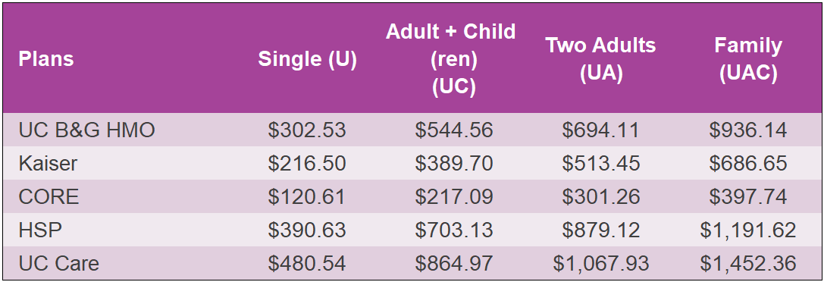
2025 Non-Medicare (pre-65) Retiree Share
Rates based on full UC contribution (no graduated eligibility)

Slide 34
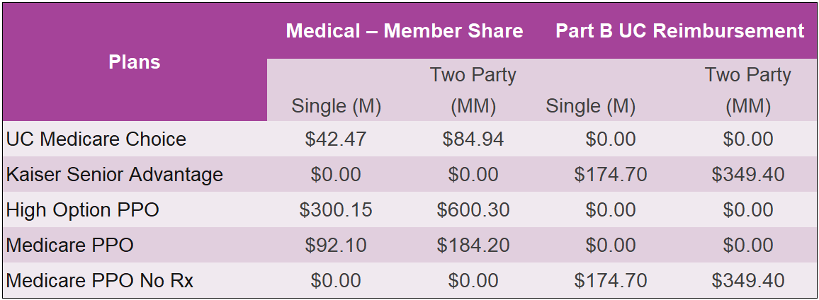
2025 Medicare Retiree Share
Rates based on full UC contribution (no graduated eligibility)

Slide 35
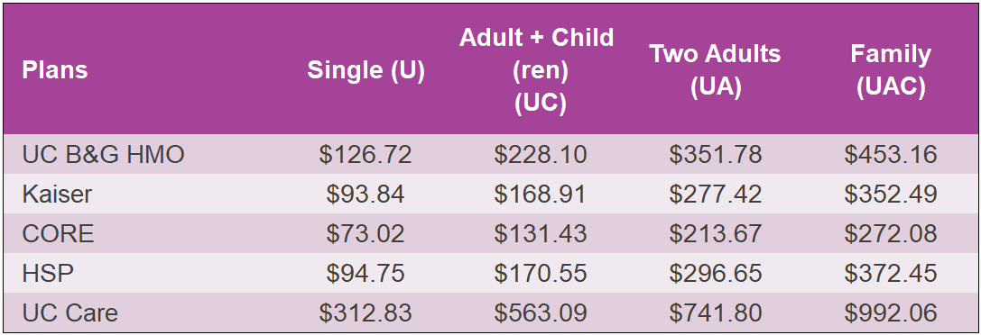
2025 Non-Medicare 65+ Retiree Share
Rates based on full UC contribution (no graduated eligibility)

Slide 36
Non-Medical Benefits Update
Delta Dental
VSP Vision
ARAG Legal
Experian Identity Theft
Nationwide Pet Insurance

Slide 37
Delta Dental and VSP Vision
Benefit Changes
There are no benefit changes for either the DPPO or DHMO Plans
Premium Changes
No premium changes for the Delta Dental PPO Plan
Delta Dental HMO premium is increasing by 3.4%, applied based on graduated eligilbity
Enrollment
Both plans are open for enrollment
There are no benefit changes for the VSP Vision coverage
VSP Vision premium is increasing by 5%

Slide 38
Legal Insurance - ARAG
Enhanced Benefits
Premium Changes
No rate changes for 2025
Enrollment
Open for enrollment
Identity Theft Coverage Enhancements
Cash recovery is now included as part of the $1 million restoration coverage
Option to add up to four senior adults to Identity Theft Protection, which includes the following services: Identity Theft Monitoring • Full-Service Identity Restoration • Lost Wallet services • Identity Theft Insurance

Slide 39
Additional Benefits Available
Identity Theft Protection - Experian
No changes to monitoring and restoration services, UC continues to pay the full premium for retirees and dependent children up to age 18
Enrollment is automatic; after activation, individuals self-select the data elements they want monitored
https://ucnet.universityofcalifornia.edu/benefits/home-family/identity-theft-protection/
Pet Insurance – Nationwide
No benefit or premium changes
Pet Insurance is always open for enrollment; enroll directly with Nationwide
https://ucnet.universityofcalifornia.edu/retirees/retiree-benefits/retiree-health/for-retirees-pets/

Slide 40
Thank You!
Questions? Please contact us:
Tina Rodriguez, Benefits Manager
Ranada Palmer, Health Care Facilitator/Benefits Lead
Kimberly Grossmann, Benefits Consultant
Contact Us:
  benefits@ucr.edu

