Slide 2
Open Enrollment (OE) Dates
Starts
Thursday, October 31, 8:00 AM
Friday, November 22, 5:00 PM
Ends*

Slide 3
Actions & Reminders
Change or enroll in medical, dental, vision and legal
Add eligible family members in medical, dental, vision or legal
Enroll in Health and/or Dependent Care FSA (must re-enroll each year)
Start or change contribution to Health Savings Account (HSA)
Learn more about your plans
Reminder: If you do not wish to make any changes, you do not need to take any action (except for Health and/or Dependent FSA, you must re-enroll each year). Your current insurance coverage will continue, but your costs may change.
Notes:
OE is the time to make change

Slide 4
2025 Medical Plans Review

Slide 5
Ongoing Increasing Cost of Health Coverage
The national trends that increased medical costs and medical plan premiums last year have continued. UC’s medical plan costs will rise again this year due to increased health care utilization, an aging population, a rise in chronic health conditions, enhanced benefits, and the rapidly expanding use of costly new drugs and treatments.
View this link to A letter to the community from Systemwide HR Vice President, Cheryl Lloyd, Spanish version, and this link to frequently asked questions on Ucnet.

Slide 6
2025 Medical Plans
Health Net UC Blue & Gold HMO
Kaiser Permanente HMO*
Anthem UC Care PPO
Anthem UC Health Savings PPO Plan with Health Saving Account (HSA)
Anthem CORE PPO
*Optum provides behavioral health benefits as an overlay for Kaiser members

Slide 7
2025 HMO Medical Plans for Faculty and Staff
Health Net UC Blue & Gold
Kaiser
Optum Behavioral Health

Slide 8
UC Blue & Gold and Kaiser HMO
Legislative Mandate
Assembly Bill 904: Health Care Coverage: Doula Services
UC Blue & Gold |  |  | Kaiser
 | 2024 | 2025 | 2024 | 2025
Doula Services | N/A | $0 Copay 11 visits per pregnancy; members pay full cost of services after 11 free visits | N/A | $0 Copay 11 visits per pregnancy; members pay full cost of services after 11 free visits
myStrength digital tool is rebranding to Teladoc Mental Health
myStrength to sunset for existing users on 12/31/2024

Slide 9
UC Blue & Gold HMO Plan Design Changes
 | 2024 | 2025
Office Visits and Urgent Care | Medical: $20 Copay Behavioral Health: Visits 1-3: No Copay Visits 4+: $20 Copay | Medical: $30 Copay Behavioral Health: Visits 1-3: No Copay Visits 4+: $30 Copay
Acupuncture and Chiropractic | $20 Copay | $20 Copay

Slide 10
UC Blue & Gold HMO Plan Design Changes
 | 2024 | 2025
Pharmacy Benefit | $5/$25/$40 – Retail 30-day supply $10/$50/$80 – Retail/Mail Order 90-day supply Office-administered injectable drugs - $20 | $10/$30/$50 – Retail 30-day supply $20/$60/$100 – Retail/Mail Order 90-day supply Tier 4: Specialty Drugs (Oral and Injectable) 30% coinsurance up to $150 maximum per prescription Office-administered injectable drugs - $30

Slide 11
Kaiser HMO Plan Design Changes
 | 2024 | 2025
Office Visits and Urgent Care | Medical and Behavioral Health $20 Copay | Medical and Behavioral Health $30 Copay
Acupuncture and Chiropractic | $15 Copay | $15 Copay
Reminder: myStrength will sunset for existing users on 12/31/2024

Slide 12
Kaiser HMO Plan Design Changes
 | 2024 | 2025
Pharmacy Benefit | Kaiser Pharmacy Tier 1/Tier 2 $5/$25 – 30-day supply $10/$50 – 31-60 day supply $15/$75 – 61-100 day supply Mail Order $5/$25 – 30-day supply $10/$50 – 31-60 day supply | Kaiser Pharmacy Tier 1/Tier 2 $10/$30 – 30-day supply $20/$60 – 31-60-day supply $30/$90 – 61-100-day supply Mail Order $10/$30 – 30-day supply $20/$60 – 31-60-day supply Tier 4: Specialty Drugs (Oral and Injectable) 30% coinsurance up to $150 maximum per prescription

Slide 13
Optum Behavioral Health Plan Design Changes
 | 2024 | 2025
Office Visits and Urgent Care | Medical: $20 Copay Behavioral Health: Visits 1-3: No Copay Visits 4+: $20 Copay | Medical: $30 Copay Behavioral Health: Visits 1-3: No Copay Visits 4+: $30 Copay
Emergency Room | $75 | $125

Slide 14
2025 Anthem Blue Cross PPO Medical Plans for Faculty and Staff
UC Care
CORE
UC Health Savings Plan

Slide 15
Health Savings Account (HSA)
HSA contribution limits
$4,300 for self-only coverage (up from $4,150)
$8,550 for family coverage (up from $8,300)
Same Catch-up contribution for members 55 and over: $1,000 for the year
Same UC Contribution for the year: up to $500 for single or $1,000 for family coverage
Same HSA custodian - HealthEquity

Slide 16
UC Health Savings Plan (HSP)
In-Network Deductible
$1,650 for self-only coverage (from $1,600)
$3,300 for family coverage (from $3,200)
Out-of-Network Deductible (remains the same)
$2,600 for self-only coverage
$5,200 for family coverage
Copay for Accolade Care Telehealth & Virtual Visits
From $0 copay for first 12 visits to $30/visit for all visits
$115 copay eliminated
Counts toward deductible

Slide 17
NEW for 2025
Employee Contribution to CORE PPO
CORE will have an employee contribution starting Jan 1, 2025
Lowest cost plan
No changes to coverage and benefits

Slide 18
CORE PPO
Not an HSA-compatible plan
Calendar Year Deductible $3,000/individual (no change)
Less than the $3,300 that IRS requires
Ambulance Benefit waives a member's deductible - not compliant with IRS requirement

Slide 19
UC Care – Tier 1 (UC Select) Office Visit Copay
Office Visits
From $20 to $30
Includes all visits to Specialists, Rehabilitation and Behavioral Health.
Chiropractic & Acupuncture copays remain the same
Urgent Care for Tiers 1 and 2
From $20 to $30

Slide 20
2025 Member ID Cards
HMO Plans
Kaiser Permanente HMO | New Members Only
UC Blue & Gold HMO (Health Net) | All Members: New ID Cards with New Copays

Slide 21
2025 Member ID Cards
PPO Plans administered by Anthem Blue Cross & Navitus
CORE | All Members
UC Care
UC Health Savings Plan | Plan ID Card: All Members HSA Debit Card: New HSP Members + Current Members with expiring HSA debit cards will receive a new card (Debit card is good for 3 years from the issue date).

Slide 22
2025 Pay Bands, Rates, and Contributions

Slide 23
2025 Employee Pay Bands
Pay band thresholds adjusted each year based on the Consumer Price Index (CPI) from the California Department of Finance’s index for urban wage earners and clerical workers (CPI-U)
 | 2024
1 | $68,000 and under
2 | $68,001 to $136,000
3 | $136,001 to $204,000
4 | $204,001 and above
2025
1 | $71,000 and under
2 | $71,001 to $140,000
3 | $140,001 to $210,000
4 | $210,001 and above
Definition of Range for the 2025 Medical Contribution Base Using Full-Time Salary as of January 2024

Slide 24
Change in Employee Percentage of Cost 2024 vs. 2025 Contributions
% Difference | Pay Band
 | 1 | 2 | 3 | 4
UC Blue & Gold HMO | 9% | 9% | 11% | 11%
Kaiser HMO | 9% | 9% | 11% | 11%
UC Health Savings Plan | 9% | 9% | 11% | 11%
UC Care | 9% | 9% | 11% | 11%
With the exception of CORE:
Pay Bands 1 and 2: 9% employee contribution increases for all plans and coverage tiers
Pay Bands 3 and 4: 11% employee contribution increases for all plans and coverage tiers

Slide 25
Change in Employee Costs - 2024 vs. 2025
 | Pay Band 1 |  |  |  |  | Pay Band 2
 | U | UC | UA | UAC |  | U | UC | UA | UAC
UC Blue & Gold HMO | $8.97 | $16.05 | $25.26 | $32.28 |  | $13.03 | $23.31 | $34.25 | $44.44
Kaiser Permanente - CA | $3.28 | $5.91 | $9.93 | $12.32 |  | $7.62 | $13.71 | $23.59 | $29.10
CORE PPO | $25.91 | $46.63 | $110.50 | $131.22 |  | $73.02 | $131.43 | $218.05 | $276.46
Health Savings Plan | $7.13 | $11.68 | $16.27 | $20.51 |  | $16.81 | $27.50 | $39.27 | $49.20
UC Care | $19.17 | $34.24 | $46.34 | $61.47 |  | $23.49 | $41.98 | $55.89 | $74.44

Slide 26
Change in Employee Costs - 2024 vs. 2025
 |  | Pay Band 3 |  |  |  |  | Pay Band 4
 |  | U | UC | UA | UAC |  | U | UC | UA | UAC
UC Blue & Gold HMO |  | $21.10 | $37.74 | $51.90 | $68.39 |  | $26.39 | $47.21 | $62.14 | $82.76
Kaiser Permanente - CA |  | $14.81 | $26.64 | $43.96 | $54.83 |  | $20.47 | $36.81 | $59.53 | $74.65
CORE PPO |  | $121.22 | $218.19 | $314.14 | $411.11 |  | $170.90 | $307.61 | $413.24 | $549.96
Health Savings Plan |  | $32.79 | $53.66 | $73.45 | $93.06 |  | $45.40 | $74.30 | $99.64 | $126.95
UC Care |  | $34.27 | $61.23 | $79.07 | $106.10 |  | $39.91 | $71.31 | $89.95 | $121.43

Slide 27
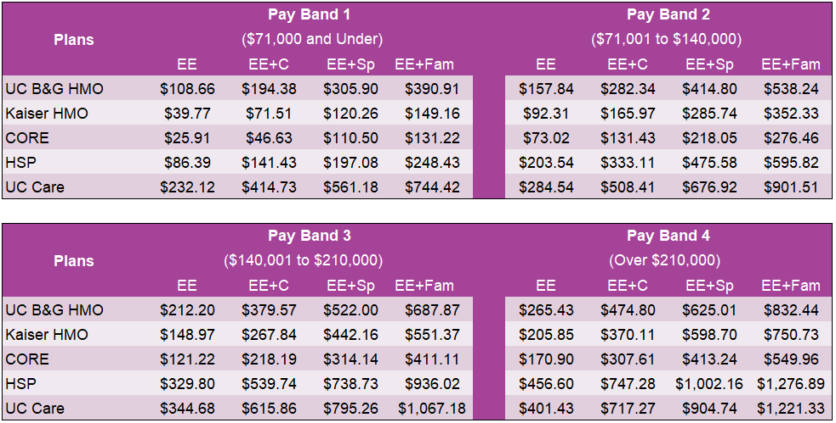
2025 Employee Contributions

Slide 28
2025 Employee Premium Cost Share
Systemwide Bargaining Units
Bargaining Units in Status Quo as of October 2024:
EX (Patient Care Technical)
HX (Residual Health Care Professionals)
RX (Research Support Professionals)
SX (Service)
TX (Technical)
2025 employee contributions will be held at each bargained unit’s 2024 levels
Negotiations of union contracts for bargained units with open contracts is underway, and any conclusion resulting in a change to the rates currently in place will be announced separately following the settlement of each contract.

Slide 29
2025 Employee Premium Cost Share Systemwide Bargaining Units (cont.)
Systemwide Bargaining Units will move to 2025 premium cost share and pay band levels with some units having:
$25/month increase cap above 2024 for Kaiser and UC Blue & Gold HMO plans.
NX (Registered Nurses) - cap applies to all salary bands
CX (Clerical & Allied Services) - cap only applies to salary bands 1 and 2

Slide 30
Non-Medical Benefits Update
Delta Dental
VSP Vision
ARAG Legal
ALEX Tool
Flexible Spending Plans
Supplemental Health Plans

Slide 31
Delta Dental and VSP Vision
Benefit Changes
There are no benefit changes for either the DPPO or DHMO Plans
Premium Changes
Delta Dental HMO premium is increasing by 3.4%, but paid fully by UC
Enrollment
Both plans are open for enrollment
There are no benefit changes for the VSP Vision coverage
VSP Vision premium is increasing by 5%, but paid fully by UC
No premium changes for the Delta Dental PPO Plan

Slide 32
Legal Insurance - ARAG
Enhanced Benefits
Premium Changes
No rate changes for 2025
Enrollment
Open for enrollment
Identity Theft Coverage Enhancements
Cash recovery is now included as part of the $1 million restoration coverage
Option to add up to four senior adults to Identity Theft Protection, which includes the following services: Identity Theft Monitoring • Full-Service Identity Restoration • Lost Wallet services • Identity Theft Insurance

Slide 33
Accident - Prudential
$1,200 ICU Hospital Admission benefit
Enhanced Benefits
ICU Hospital Confinement benefit increases to a maximum of 10 per calendar year
Non-ICU Hospital Confinement benefit increases to a maximum of 10 per calendar year
Initial Physician office visit increasing to $100
New
Benefits
Premium
No premium changes for 2025
Restored Benefits
$50 Chiropractic or Alternative Therapy benefit
$700 Outpatient surgery and anesthesia benefit
$950 Sacrum Fracture benefit
Successor Benefit: A covered spouse may elect to become the primary insured at the time of the primary employee’s death

Slide 34
Critical Illness - Prudential
Premium
No premium changes for 2025
Restored Benefits
Mammography $200
Successor Benefit: A covered spouse may elect to become the primary insured at the time of the primary insured’s death
Enhanced Benefits
Recurrence Provision: The waiting period for a benefit payment after a positive diagnosis of an illness or procedure has been reduced from 6 months to 90 days
Childhood Conditions: Autism $•$Juvenile Type 1 Diabetes $•$ Phenylalanine Hydrolase Deficiency
Childhood Conditions: Autism • Juvenile Type 1 Diabetes • Phenylalanine Hydrolase Deficiency
Wellness Benefits: Bone Mass Density $•$ Spinal CT$•$ Cytological Screening $•$ DNA Stool Analysis $•$ HIV Nucleic Acid
Wellness Benefits: Bone Mass Density • Spinal CT• Cytological Screening • DNA Stool Analysis • HIV Nucleic Acid

Slide 35
Hospital Indemnity - Prudential
Premium
No premium changes for 2025
New Benefit
ICU Admission $1,200
Restored Benefits
Mammography $100
ICU Step-Down Unit $100 for each 18-hour period of confinement for a covered illness
Enhanced Benefits
Hospital Admission increases to a maximum of 10 per calendar year
Hospital Confinement increases to a maximum of 10 per calendar year
Hospital ICU Confinement increases to a maximum of 10 per calendar year
Substance abuse exclusion for hospitalization with advice of doctor removed

Slide 36
ALEX BENEFITS COUNSELOR

Slide 37
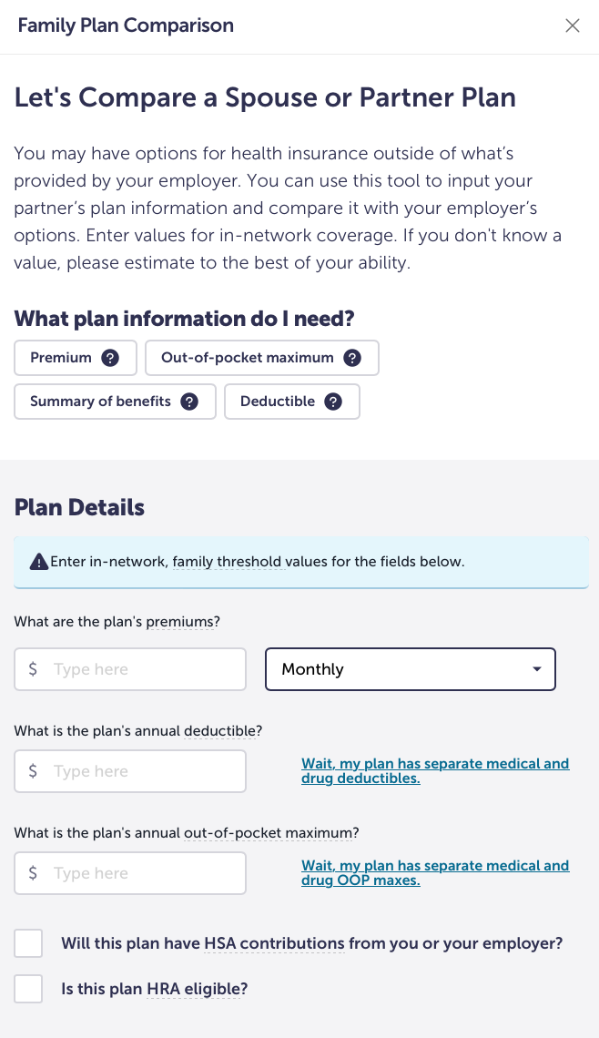
ALEX BENEFITS COUNSELOR
VS ALEX GO
ALEX Benefits Counselor
In-depth education that explains your benefits options
Experience combines audio, video, animation, and text
Audio available in English, text available in English and Spanish
Closed Captioning available
Expanded Hospital Indemnity information
ALEX Go
A streamlined text-based
experience
Step-by-step guidance for the
Family Plan Comparison tool

Slide 38
Flexible Spending Accounts
All limits and deadlines apply to both Faculty/Staff and Postdocs.
2025 Health FSA Contribution Limit: $3,200
Health FSA carryover limit
$640 for carryover from 2024 to 2025 Plan Year
$640* for carryover from 2025 to 2026 Plan Year
2025 Dependent Care FSA Contribution Limit
$5,000 for non-highly compensated employees
$2,500 for Highly-Compensated Employees (HCEs) as defined by the IRS
$155K or greater income in 2024

Slide 39
Flexible Spending Accounts
2024 Health FSA
Run-out period (filing deadline): April 15, 2025
Carryover: Funds available in January 2025
2024 Dependent Care FSA
Run-out period (filing deadline): April 15, 2025
Grace period: January 1, 2025 – March 15, 2025
2025 Health FSA
Run-out period (filing deadline): April 15, 2026
Carryover: Funds available in January 2026
2025 Dependent Care FSA
Run-out period (filing deadline): April 15, 2026
Grace period: January 1, 2026 – March 15, 2026

Slide 40
Limited Purpose FSA
Available only to employees meeting all of the following criteria:
Are eligible for the Faculty/Staff Benefits program, and
Participated in the Health FSA during a plan year, and
Have a carry-over balance greater than $25 at the end of that plan year, and
Enroll in the UC Health Savings Plan for the following plan year
Balance of the Health FSA up to $640 is placed in the Limited Purpose FSA (LPFSA)
Participant may not contribute additional funds
Eligible expenses are restricted to dental, vision, and preventive care services
Participation limited to one year; any balance remaining at the end of the run-out period is forfeited

Slide 41
Additional Benefits Available
Identity Theft Protection - Experian
No changes to monitoring and restoration services, UC continues to pay the full premium for Faculty, Staff, and dependent children up to age 18
Enrollment is automatic; after activation, individuals self-select the data elements they want monitored
Adoption – WEX Health
The reimbursement limit for eligible adoption-related expenses remains at $5,000
No enrollment is needed; eligible employees submit the Adoption Verification Form to WEX after finalizing the adoption to start the reimbursement process.
Pet Insurance – Nationwide
No benefit and premium changes
Pet Insurance is always open for enrollment; employees enroll directly with Nationwide
Family Care Services – Bright Horizon
UC continues to pay the cost for access to referral services
Eligible employees are automatically enrolled and pay providers directly for care

Slide 42
Thank You!
Questions? Please contact us:
Tina Rodriguez, Benefits Manager
Ranada Palmer, Health Care Facilitator/Benefits Lead
Kimberly Grossmann, Benefits Consultant
Contact Us:
benefits@ucr.edu

