Slide 1
Employee & Organizational Development
Facilitated by: Shane O’Brien
Notes:
So, you are probably wondering what does Employee & Organizational Development mean? It’s basically a fancy way of saying Professional Development.

Slide 2
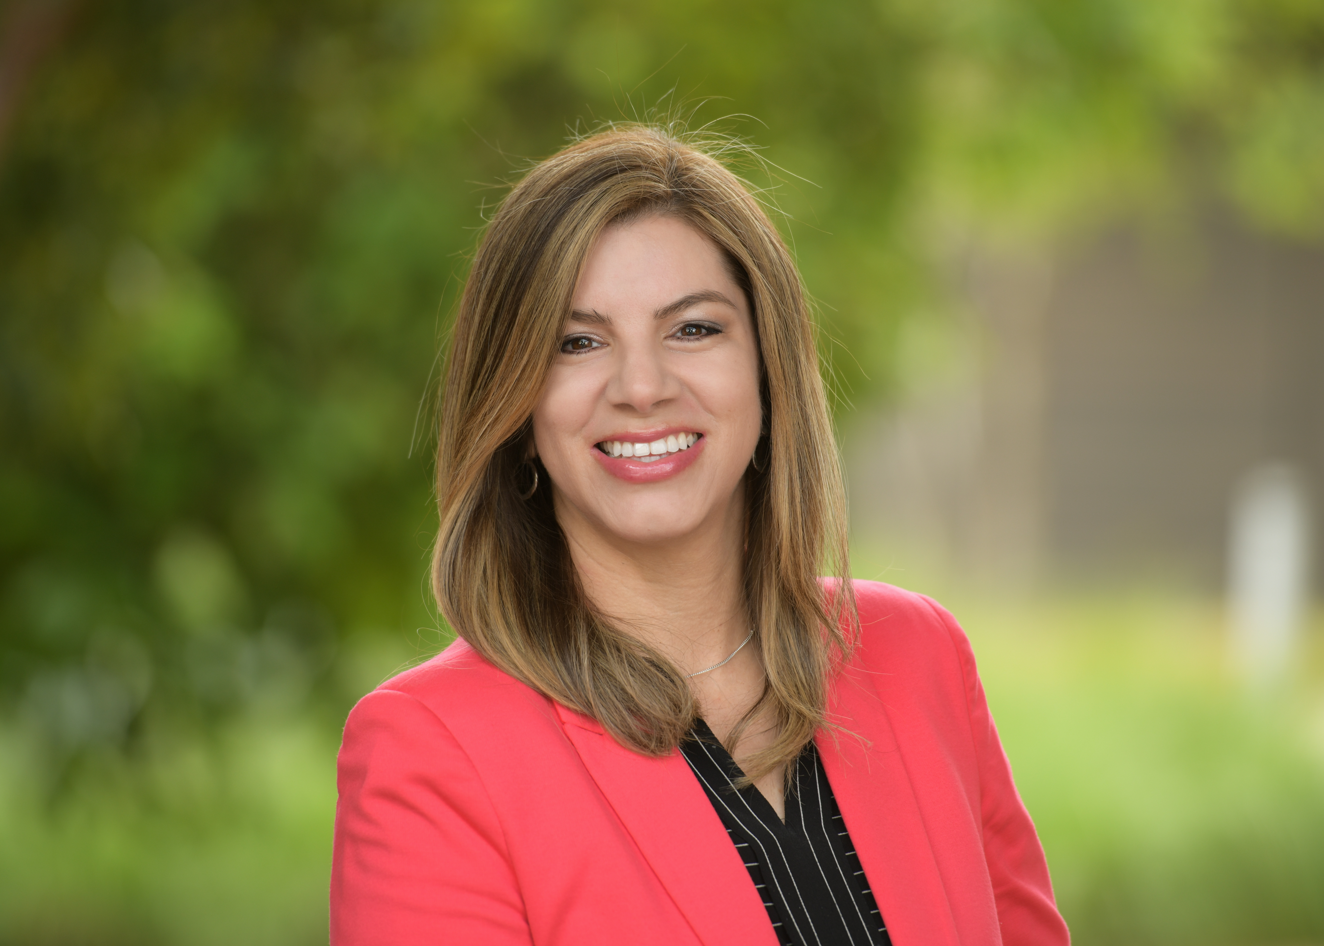
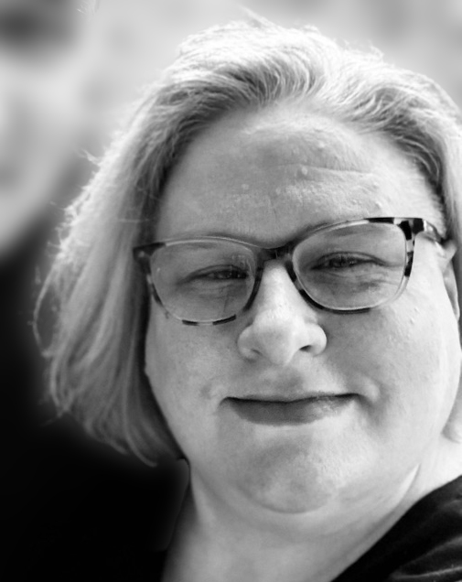
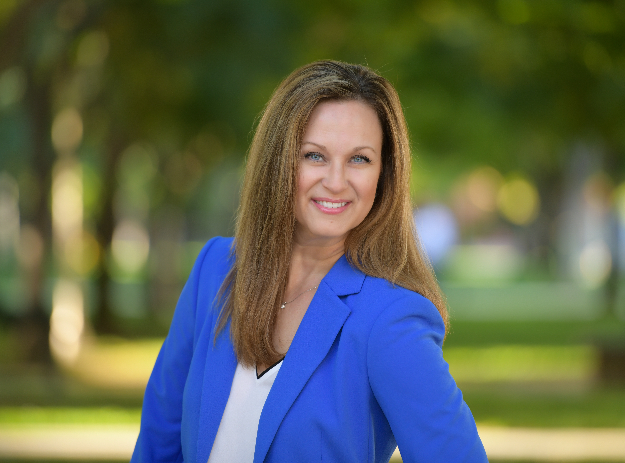
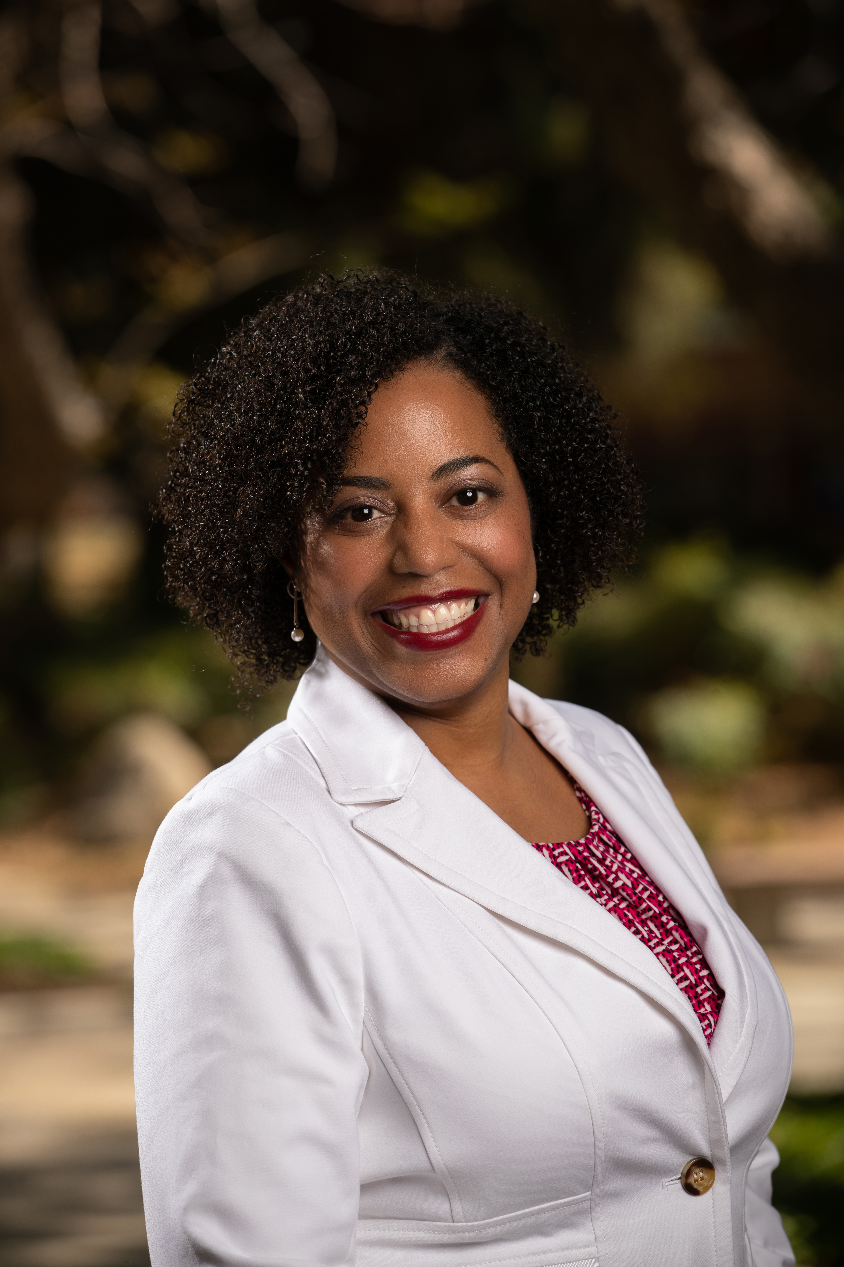
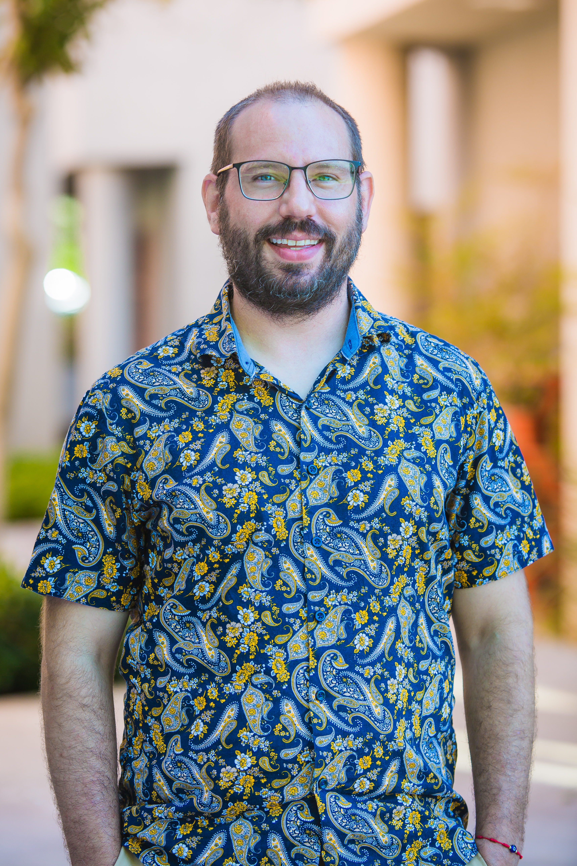
Meet the EOD Dream Team
Alex Rollins
JoAnna Van Brocklin
Marilyn Parker
Seana Núñez
Shane O’Brien
Notes:
Alex, Director
Seana, Sr. EE & Org Consultant/Trainer
Marilyn, Learning Systems & Training Manager (LMS)
JoAnna, EE & Org Consultant/Trainer
Shane, Training Coordinator and Learning Systems Analyst

Slide 3
EOD Resources/Programs

Slide 4



Online Learning Resources
LinkedIn Learning
Accessed through R’Space
Includes UCR curated Collections
Deloitte Human Capital Research & Sensing
Links on EOD and UCLC websites
HR research, insights, and tools
Gartner
Links on EOD and UCLC websites
Targeted to HR professions, includes virtual training
Transferable Skills Library
Develop current skills or learn new skills needed for future role
E-Learning topics align under 20 standard skillsets mapped to the UC Core Competencies
Notes:
LinkedIn Learning: free learning to you, available 24/7
Can be found under our EOD website and UCLC (bottom left icon)
An online educational platform that offers thousands of video-based courses taught by industry experts in business, technology, and creative fields. It provides a way for professionals to develop new skills, advance their careers, and stay competitive through personalized, on-demand learning experiences.
Courses are broken down into smaller, individual videos, making them flexible and easy to consume.
Personalized learning: The platform offers recommendations based on your skills and career interests.
Deloitte (now Insights2Action): free platform provides daily insights on biggest trends to provide you with strategic insights to shape outcomes for your team.
Gartner: free platform, identifies emerging key themes and HR trends such as remote work, employee engagement, and more.
TSL: Developed by UC Riverside’s Human Resources Employee and Organizational Development (EOD) team, the Transferable Skill Library (TSL) features the most popular on-demand courses from LinkedIn Learning using 20 job standard skillsets under UC core competencies (ABCs on screen – Achieving results, Building relationships, and Creating the future). Topics includes time management, critical thinking, leadership, communication, and more!
All of these can be found on our EOD website under Online Learning Resources on the left side: https://hr.ucr.edu/employee-and-organizational-development

Slide 5
How many hours per year do employees receive for professional development?
Notes:
CHAT RESPONSE
Per PPSM-50: represented staff receive approximately 40 hours per calendar year (depends on union agreement)
Non-represented staff receive 80 hours per calendar year.

Slide 6
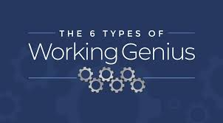
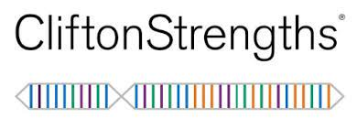

EOD Core Services & Offerings
Assessments
ViewSuite 360
CliftonStrengths
Everything DiSC
Working Genius
Consultation
Team/Org training requests
LEGO® SERIOUS PLAY® method (LSP)
Franklin Covey Courses
7 Habits of Highly Effective People
Leading at the Speed of Trust
Working at the Speed of Trust
Multipliers
Unconscious Bias
Change for Leaders
Change for Individual Contributors
6 Critical Practices of Leading a Team
Navigating Difficult Conversations
Project Management
Inclusive Leadership
UC Policy PPSM-50: Professional Development
Notes:
LEGO® SERIOUS PLAY®
It is a facilitated method for thinking, communication, and complex problem-solving. It's designed to build robust solutions for organizational challenges.
Unique Mechanism: Hands-on, Minds-on
The methodology taps into the hand-mind connection to access deeper knowledge and insights.
Participants build tangible, metaphorical 3D models to represent ideas.
It is based on the concept of “hand knowledge,” i.e., the research that shows the hands are connected to 70-80% of our brain cells. Focuses on bringing out solutions from the subconscious part of your brain/abstract thinking.
Key Outcome: 100% Participation: It ensures equal contribution from every person in the room ("100% of the people contribute 100% of the time").
Bottom 3 Courses: Focus is on personal & team effectiveness with CliftonStrengths, Working Genius, and Crucial Conversations.
CliftonStrengths – take the Top 5 strengths assessment and attend the course to learn how to use your strengths to succeed at work and live your best possible life. Understanding your natural talents unlocks your potential and leads you to greater performance.
Working Genius – People who understand their genius (what gives you energy) show up to work happier, are more effective, and work well with others.
20% personality assessment and 80% productivity tool.
The 6 Types of Working Genius = Wonder/Invention/Discernment/Galvanizing/Enablement/Tenacity
Geniuses
Definition: Areas where an individual has a natural aptitude, finds joy, and is energized.
Energy level: High; activities feel effortless and fulfilling, like a "flow state".
Example: A person with a genius for Tenacity will feel energized by seeing a project through to completion.
Competencies
Definition: Areas where an individual can perform the task well but without significant passion or joy.
Energy level: Neutral to negative; these tasks don't bring energy and can drain it over time if done too frequently.
Example: Someone with a competency in Galvanizing can motivate a team when necessary, but it's not something they find fulfilling.
Frustrations
Definition: Areas that an individual finds draining, frustrating, and lacks natural ability in.
Energy level: Draining; these tasks feel like a chore and sap energy and enthusiasm, even if the person is capable of doing them.
Example: A person with a frustration for Wonder will not enjoy coming up with new ideas and will find the process draining.
Everyone has 2 Geniuses, 2 Competencies, and 2 Working Frustrations
Can be used to have more productive meetings as well (right people in the room for productive discussions)
Crucial Conversations for Mastering Dialogue
Backed by 30 years of social science research
Teaches skills for creating alignment and agreement by fostering open dialogue around high-stakes, emotional, or risky topics—at all levels of your organization. By learning how to speak and be heard (and encouraging others to do the same), you’ll surface the best ideas, make the highest-quality decisions, and then act on your decisions with unity and commitment.
Topics Covered:
Speaking persuasively, not abrasively
Fostering teamwork and better decision making
Building acceptance rather than resistance
Resolving individual and group disagreements
SEANA
Also talk about other Programs (Aspiring Leaders Program & BCSC) – self managed, self-paced program. Combo of UCLC e-Learning developed by EOD and LinkedIn Learning courses.
BCSC cohort-based program, offered 1x/yr. Meet once a month, Sept – May for online courses. Culminating program graduation in-person.
[CLICK] to show Coming Soon (Working Genius, CS and CC)
***HR will get a peek at CS during our May in-person meeting. Email communications will be forthcoming
IMORTANT – please complete the assessment by the due date (May 1)!
Attendee resource: EOD Course Catalog https://documents.ucr.edu/HR-Development/dev-eod-course-offerings.pdf?

Slide 7
Cohort Development Programs
INDIVIDUAL CONTRIBUTORS
Aspiring Leader Program (eLearning)
NEW Spark Your Potential – Coming Spring 2026
MANAGERS / LEADERS
Building Core Supervisory Competencies
NEW Mastering Management – Coming Winter 2026
UC-Wide DEVELOPMENT PROGRAMS
UC-CORO Systemwide Leadership Collaborative
UC Women’s Initiative for Professional Development
Notes:
Aspiring Leaders Program – self-managed, self-paced program. Combo of UCLC e-Learning developed by EOD and LinkedIn Learning courses.
Spark Your Potential
This program is designed to empower individuals like you to build the skills to achieve your personal and professional goals.
Discover Your Inner Compass:
Uncover your core values, identify your unique talents, and clarify your vision for the future.
Break Through Barriers:
Challenge self-doubt, conquer procrastination, and develop a resilient mindset to navigate obstacles.
Set Meaningful Goals:
Learn effective goal-setting techniques that align with your values and aspirations, transforming dreams into tangible targets.
Champion Change:
Discover strategies to manage your emotional reactions to change so that change goes from being something to fear to something to embrace.
Build Your Credibility:
Develop and demonstrate high-trust behaviors that build your character and competence.
Connect and Grow:
Engage with a supportive cohort of colleagues, fostering collaboration, inclusion, and shared learning.
[click] BCSC cohort-based program, offered 1x/yr. Meet once a month, Sept – May for online courses. Culminating program graduation in-person.
It’s designed to support the growth and success of early-career supervisors at UCR (2-5 years)
Participants will leave with practical strategies to motivate and guide their teams, resolve issues constructively, and foster a more productive and engaged work environment.
Mastering Management (Leaders/Managers with 5+ yrs of experience)
This program goes beyond theory, offering practical frameworks and actionable techniques you can immediately implement to enhance team performance, foster a positive work environment, and achieve organizational goals.
Lead With Trust:
Learn how to build trust by developing your character and competence, and how to demonstrate high-trust behaviors.
Create a Compelling Vision:
Develop a mission, vision, and strategy that your team can contribute to and support.
Successfully Execute Your Strategy:
Align your mission and vision to your strategy and how to execute that strategy in a way that ensures long-term success.
Coach Your Teams:
Effectively coach others on your team to build capacity and develop leadership potential.
Cultivate Inclusion:
See your team members as whole people and look for opportunities to connect so they feel valued and engaged.
Leverage the Strengths of Others:
Tap into the intelligence and capability of your team members to improve the results you all achieve.
UC –Wide Development Programs
UC CORO Systemwide Leadership Collaborative
Focuses on enhancing leadership skills and foster relationships, networking and cross-functional collaboration across UC while building a pipeline for executive leadership positions.
UC Women’s Initiative for Professional Development
A unique experiential professional development program committed to enabling the full participation, success, and advancement of woman-identified professionals at the University.

Slide 8
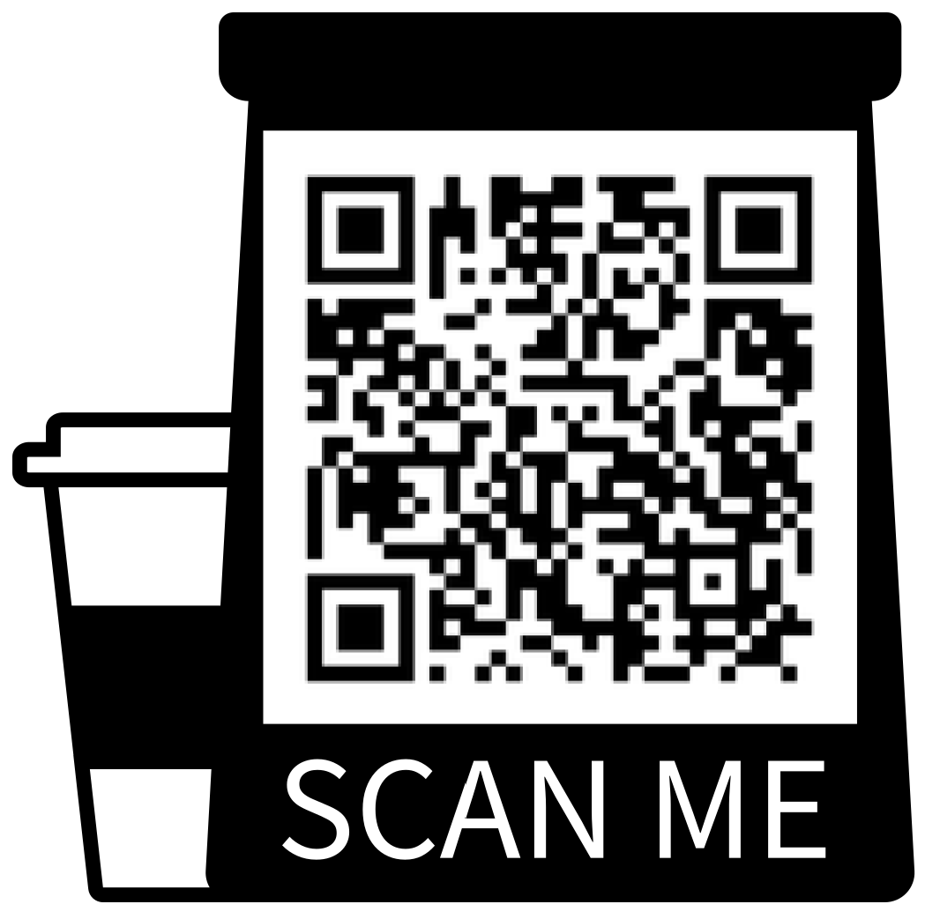
Thank You!
EOD Website
Shane O’Brien
Training Coordinator & Learning Systems Analyst
Employee & Organizational Development (EOD)
shane.obrien@ucr.edu
Receive professional development information from EOD by joining our email listserv.
From your UCR account, email hrtrainingnews-subscribe@lists.ucr.edu with “Subscribe” in the subject line.
Notes:
ALEX R.
CLOSING
Add EOD listserv info to chat: Receive professional development information from EOD by joining our email listserv.
From your UCR account, email hrtrainingnewssubscribe@lists.ucr.edu with “Subscribe” in the subject line.
(stop share and hand it over to Alex N.)
EOD Website: https://hr.ucr.edu/employee-and-organizational-development
EOD Course Catalog: https://documents.ucr.edu/HR-Development/dev-eod-course-offerings.pdf?
Contact Us: HrTrainingContacts@ucr.edu

