Slide 1

UCR Faculty and Staff
Wellness Program Resources
Hung Wu, MHA
Faculty and Staff Wellness Coordinator

Slide 2
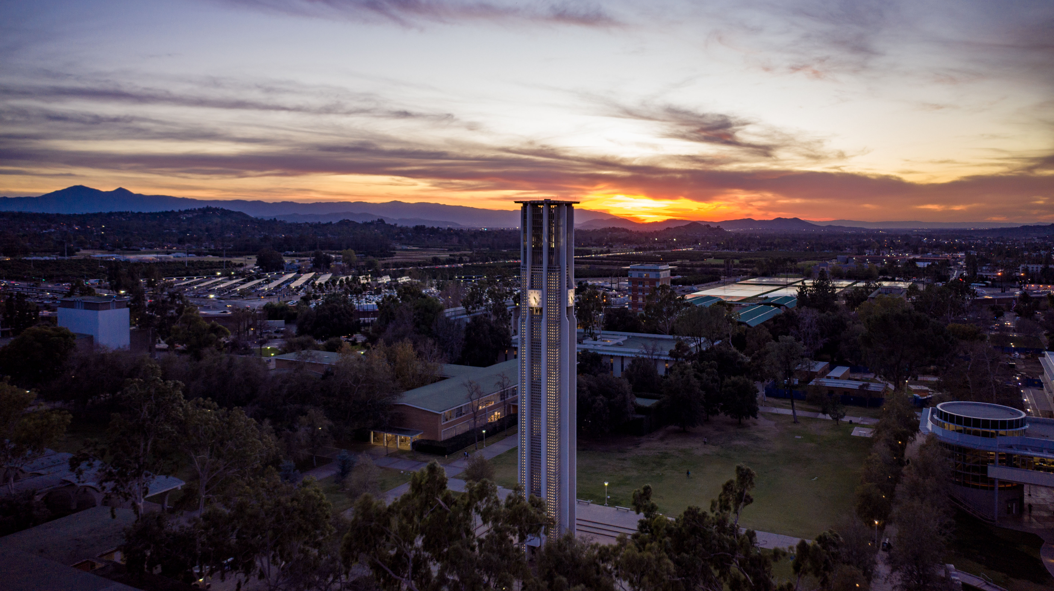
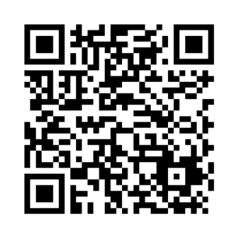

Diabetes Prevention Program
UCR offers a year-long Diabetes Prevention Program (DPP) to faculty and staff (18+). This NIH-backed program supports those with pre-diabetes, at risk for, or with Type 2 Diabetes. Through in-person or virtual group sessions led by a lifestyle coach, participants learn healthy eating, exercise, stress management, and motivation skills. The program consists of:
16 weekly sessions (Months 1-4)
4 bi-weekly sessions (Months 5-6)
6 monthly sessions (Months 7-12)
If you are interested in the participating in the next cohort, please scan the QR code and complete the interest form.

Slide 3
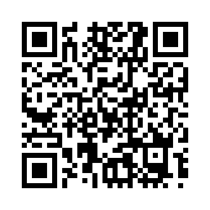
Wellness Ambassador Committee
Wellness Ambassadors
Promote: Share information about wellness events and activities
Engage: Encourage colleagues to participate
Participate: Join in and experience the benefits
Innovate: Contribute ideas for a healthier workplace
Collaborate: Work with others to create a positive culture
Why Become an Ambassador?
Wellness Perks: Enjoy special goodies and resources
Stay Informed: Be the first to know about new programs and events
Improve Your Well-being: Gain access to tools and information for a healthier lifestyle
Build Connections: Network with colleagues across campus
Make a Difference: Help foster a culture of wellness
Get Recognized: Receive annual recognition for your contributions
2026-2027 Wellness Ambassador Interest Survey
Wellness Ambassadors
Promote: Share information about wellness events and activities
Engage: Encourage colleagues to participate
Participate: Join in and experience the benefits
Innovate: Contribute ideas for a healthier workplace
Collaborate: Work with others to create a positive culture
Why Become an Ambassador?
Wellness Perks: Enjoy special goodies and resources
Stay Informed: Be the first to know about new programs and events
Improve Your Well-being: Gain access to tools and information for a healthier lifestyle
Build Connections: Network with colleagues across campus
Make a Difference: Help foster a culture of wellness
Get Recognized: Receive annual recognition for your contributions

Slide 4
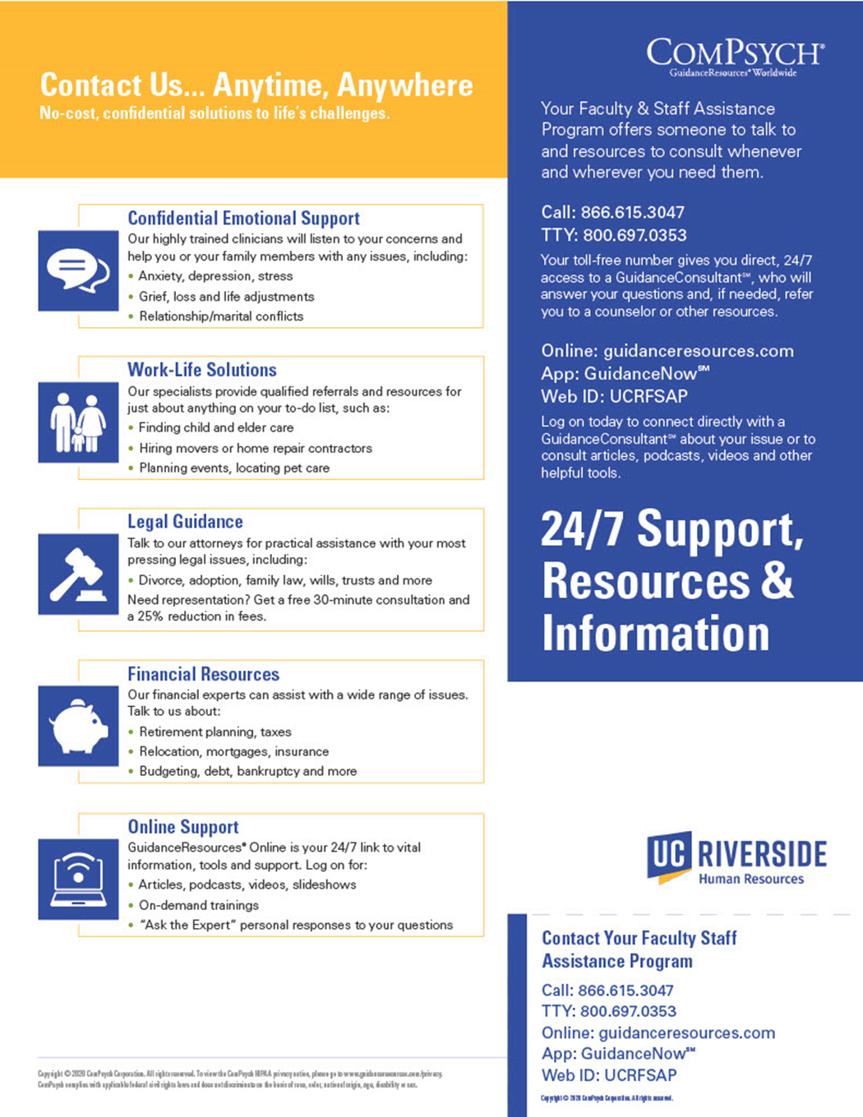
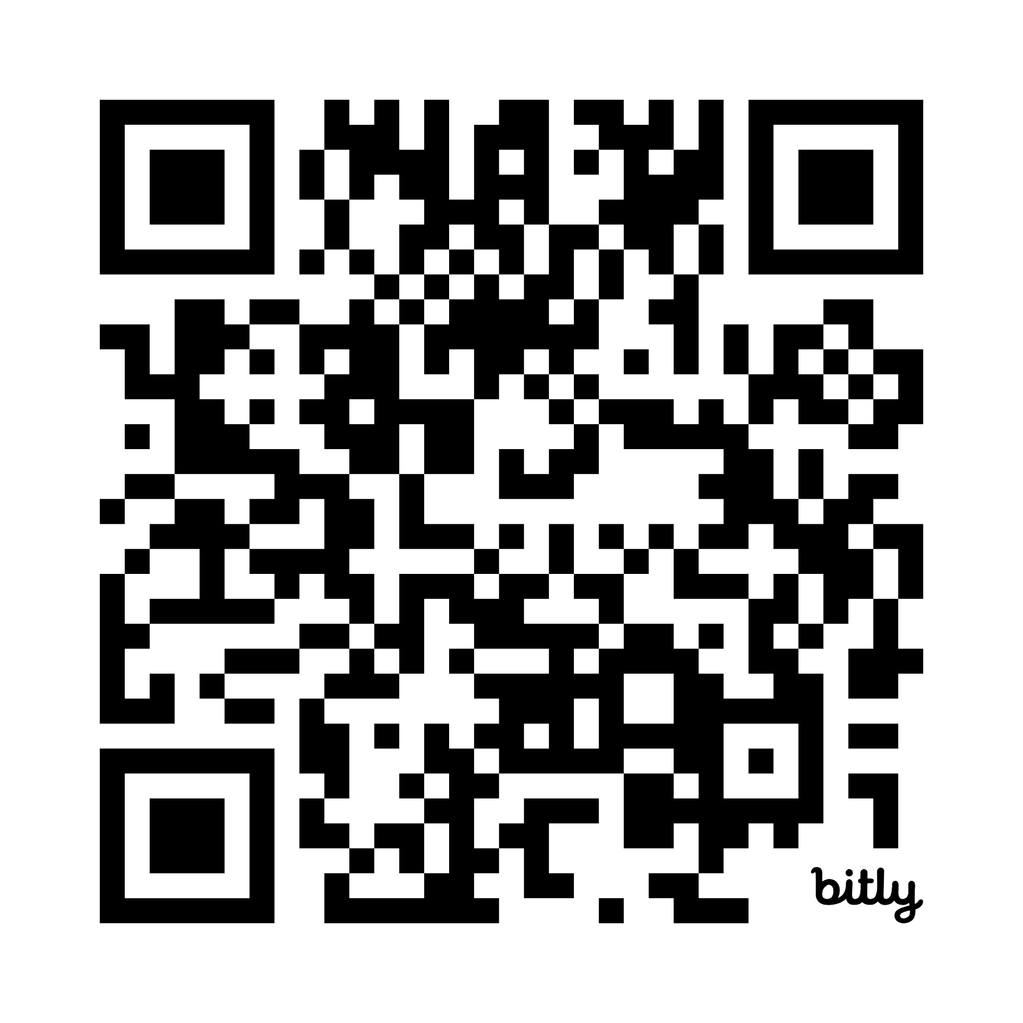
Faculty and Staff Assistance Program
Services provided through ComPsych
3 free session per member of your household
Including members who are not dependents
Work-Life
Finances
Mental and Emotional Health
Legal
Scan the QR Code

Slide 5
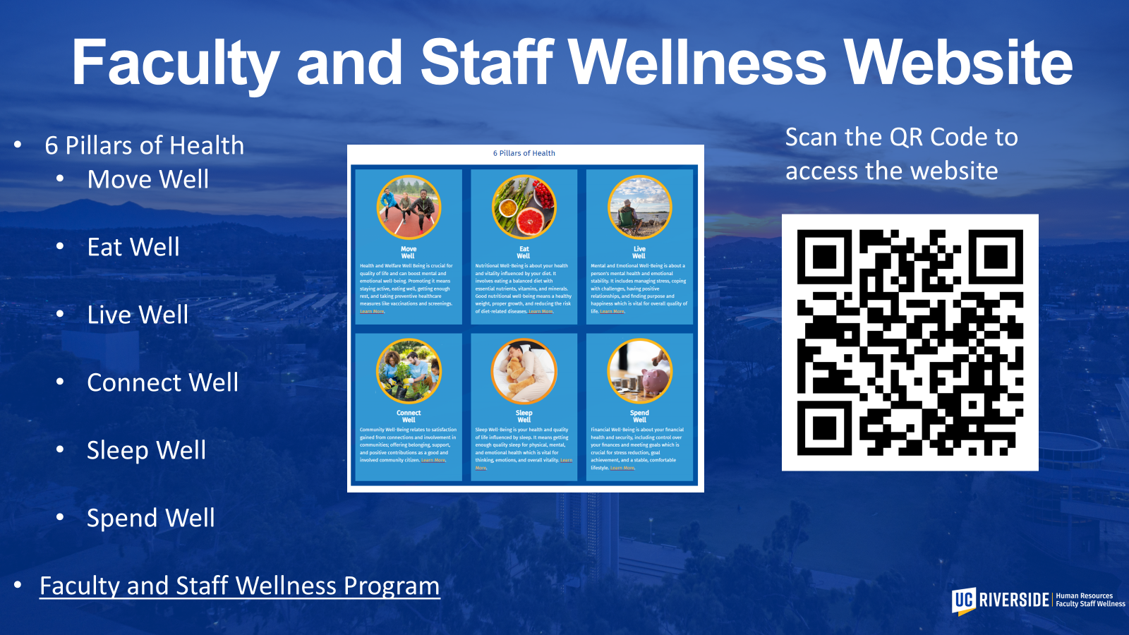
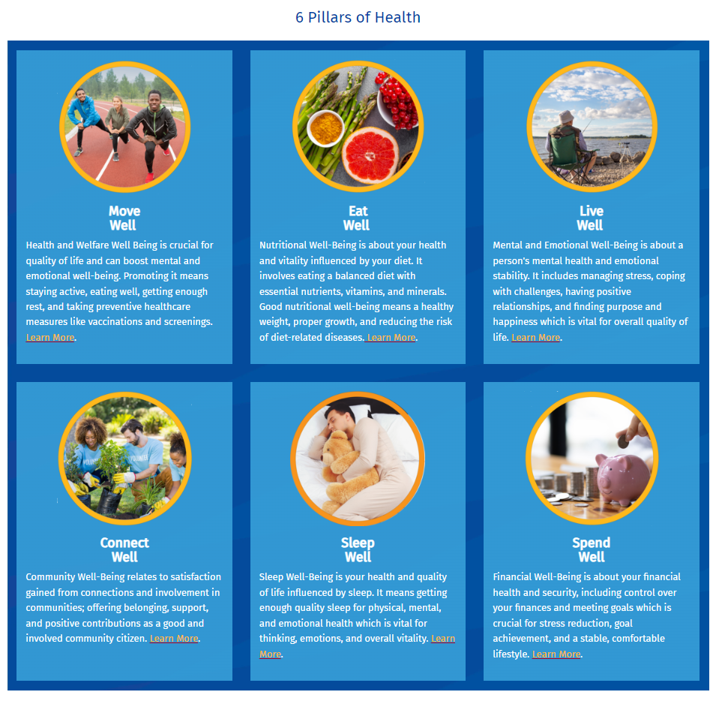

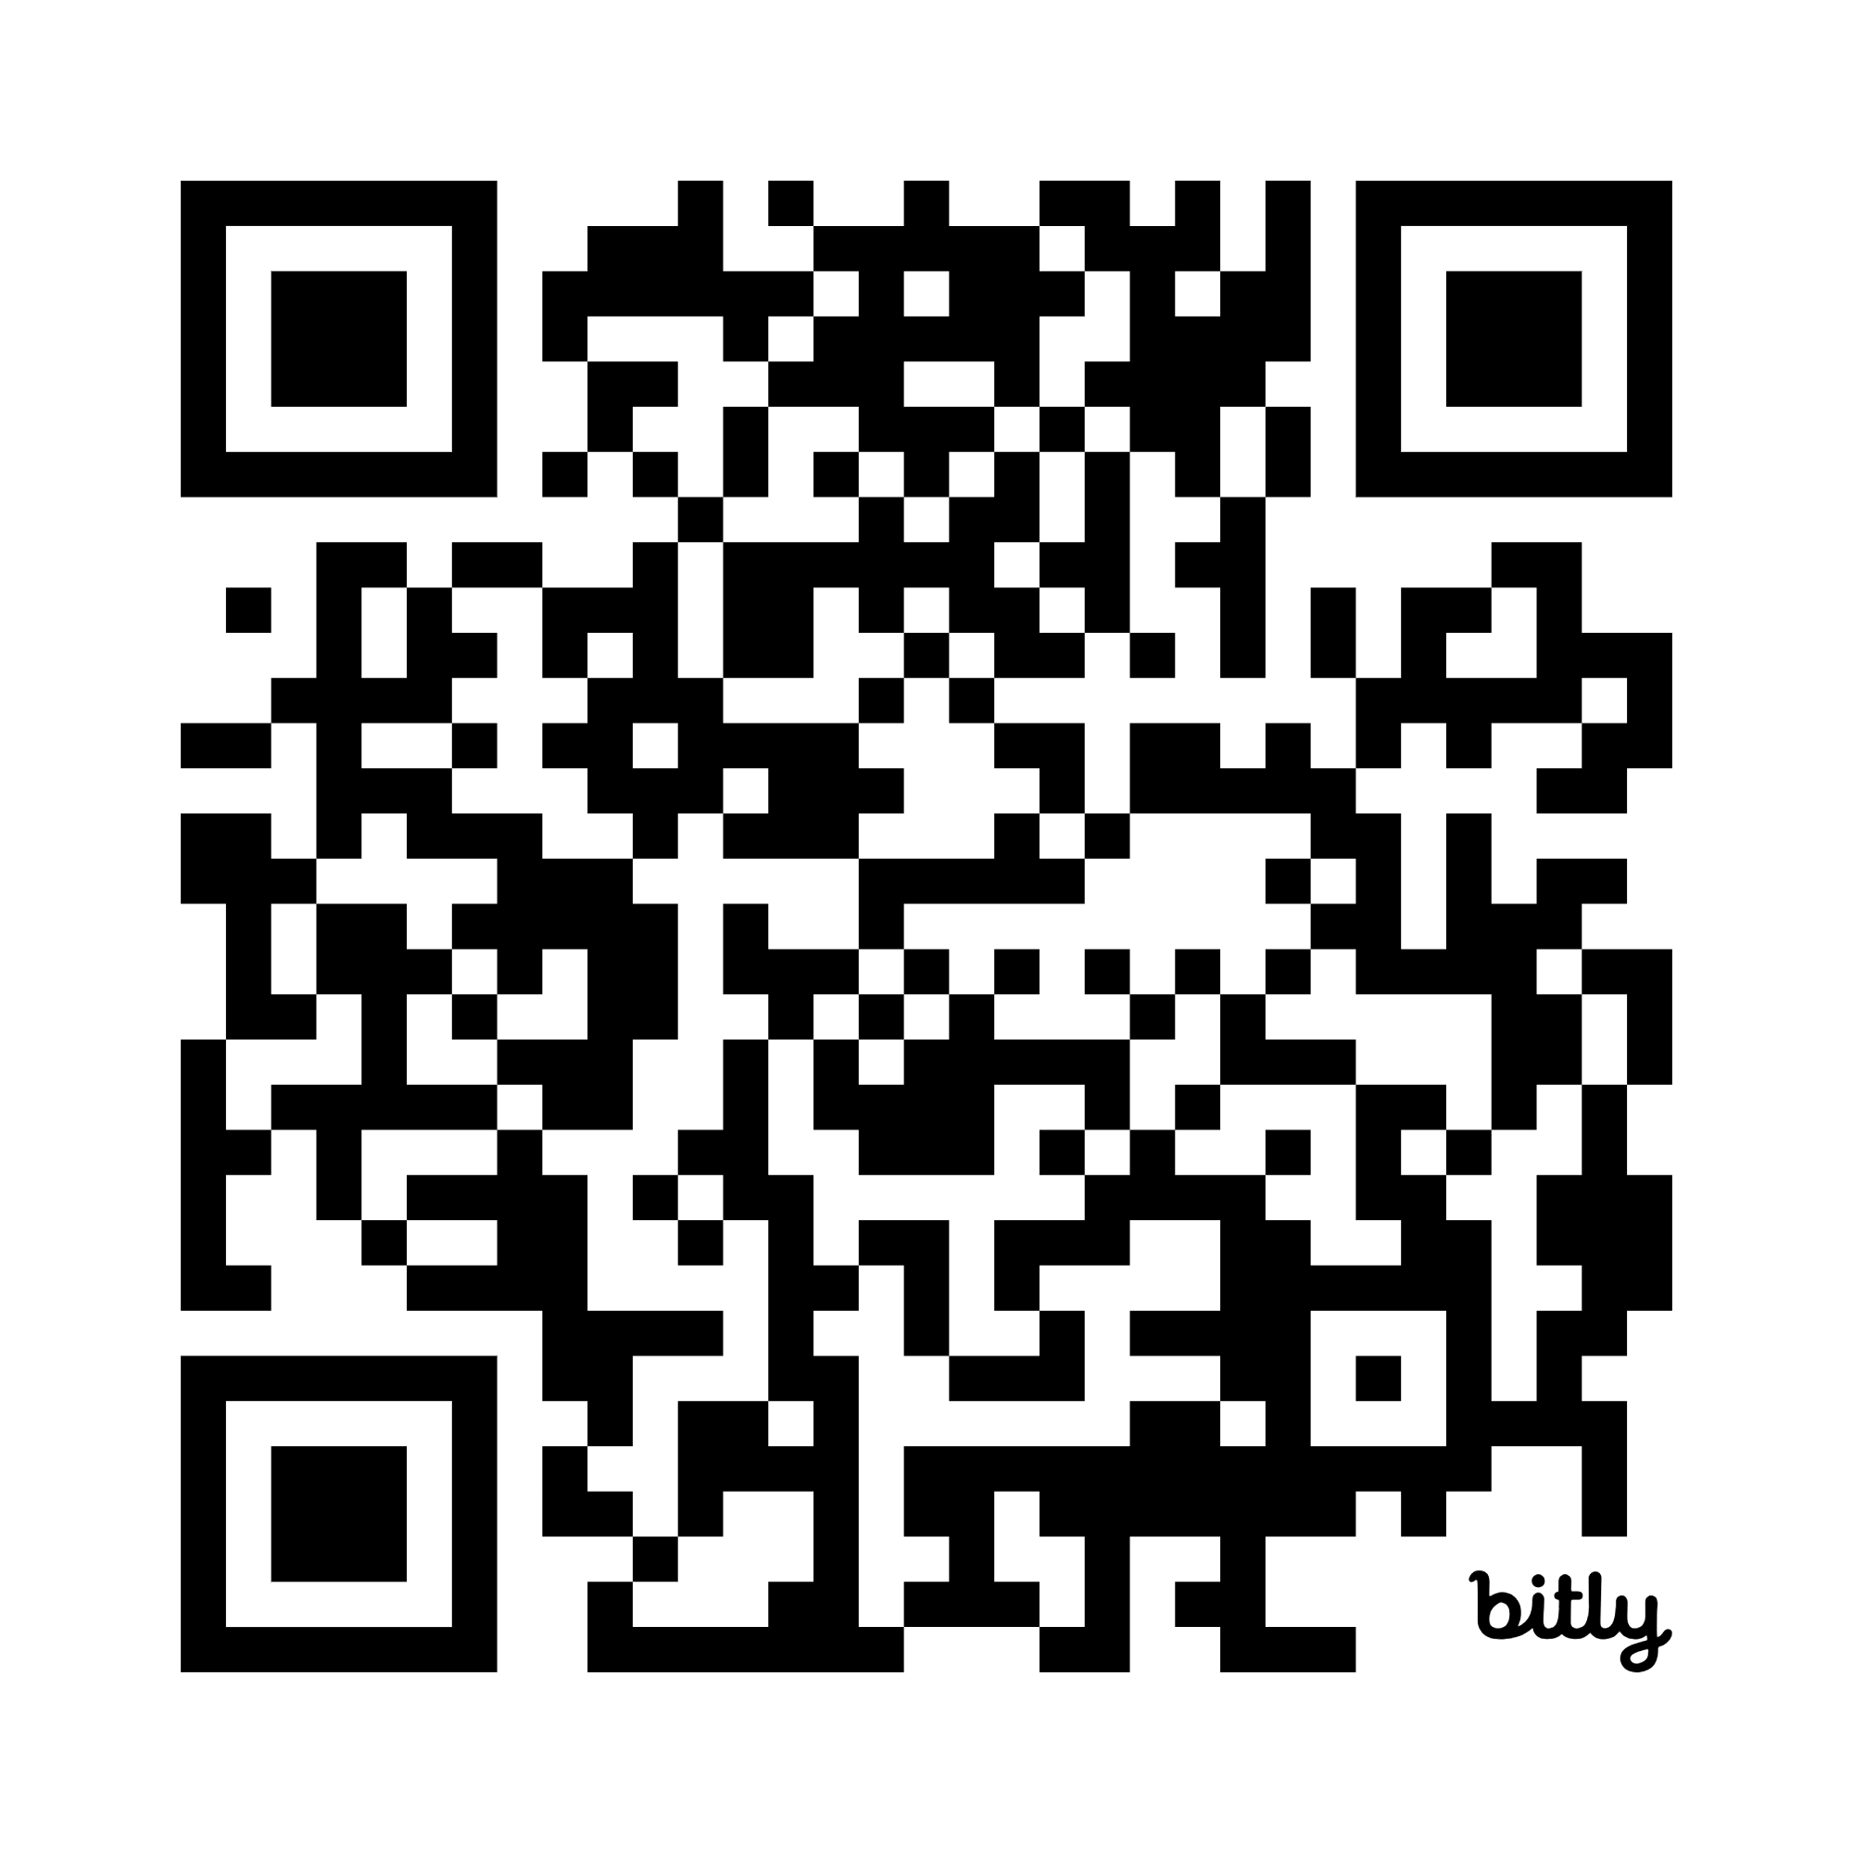
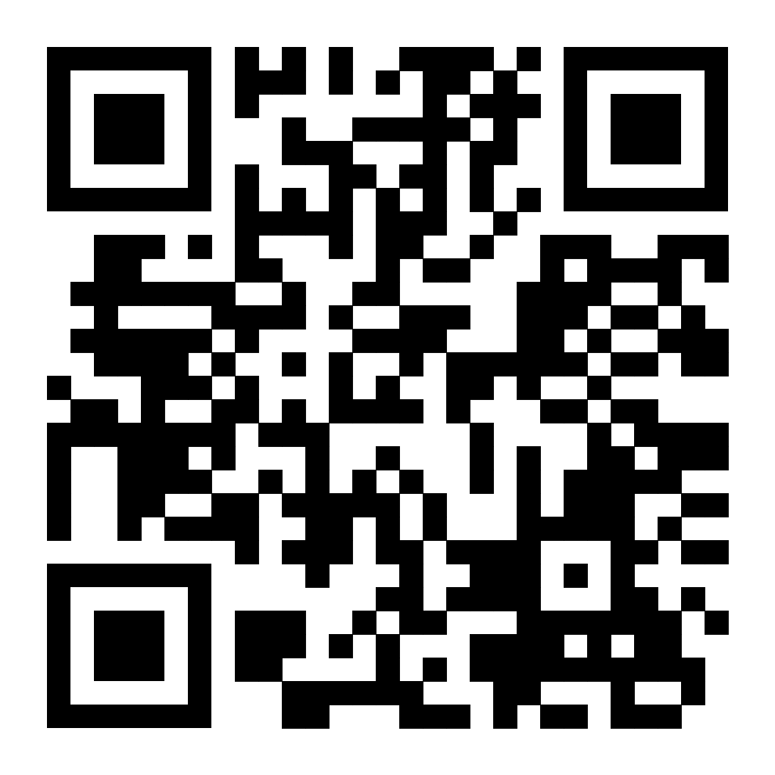
Faculty and Staff Wellness Website
6 Pillars of Health
  Move Well
  Eat Well
  Live Well
  Connect Well
  Sleep Well
  Spend Well
Faculty and Staff Wellness Program
Scan the QR Code to access the website

Slide 6
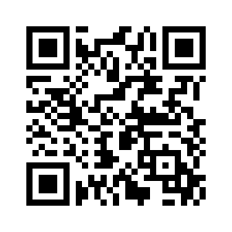
Faculty and Staff Well-being Bites
Scan the QR Code to sign up

Slide 7

A New Era of Well-being with the Okanagan Charter
Hung Wu, MHA
Faculty and Staff Wellness Coordinator
Marisol Torres, MPH
Assistant Director, The Well

Slide 8
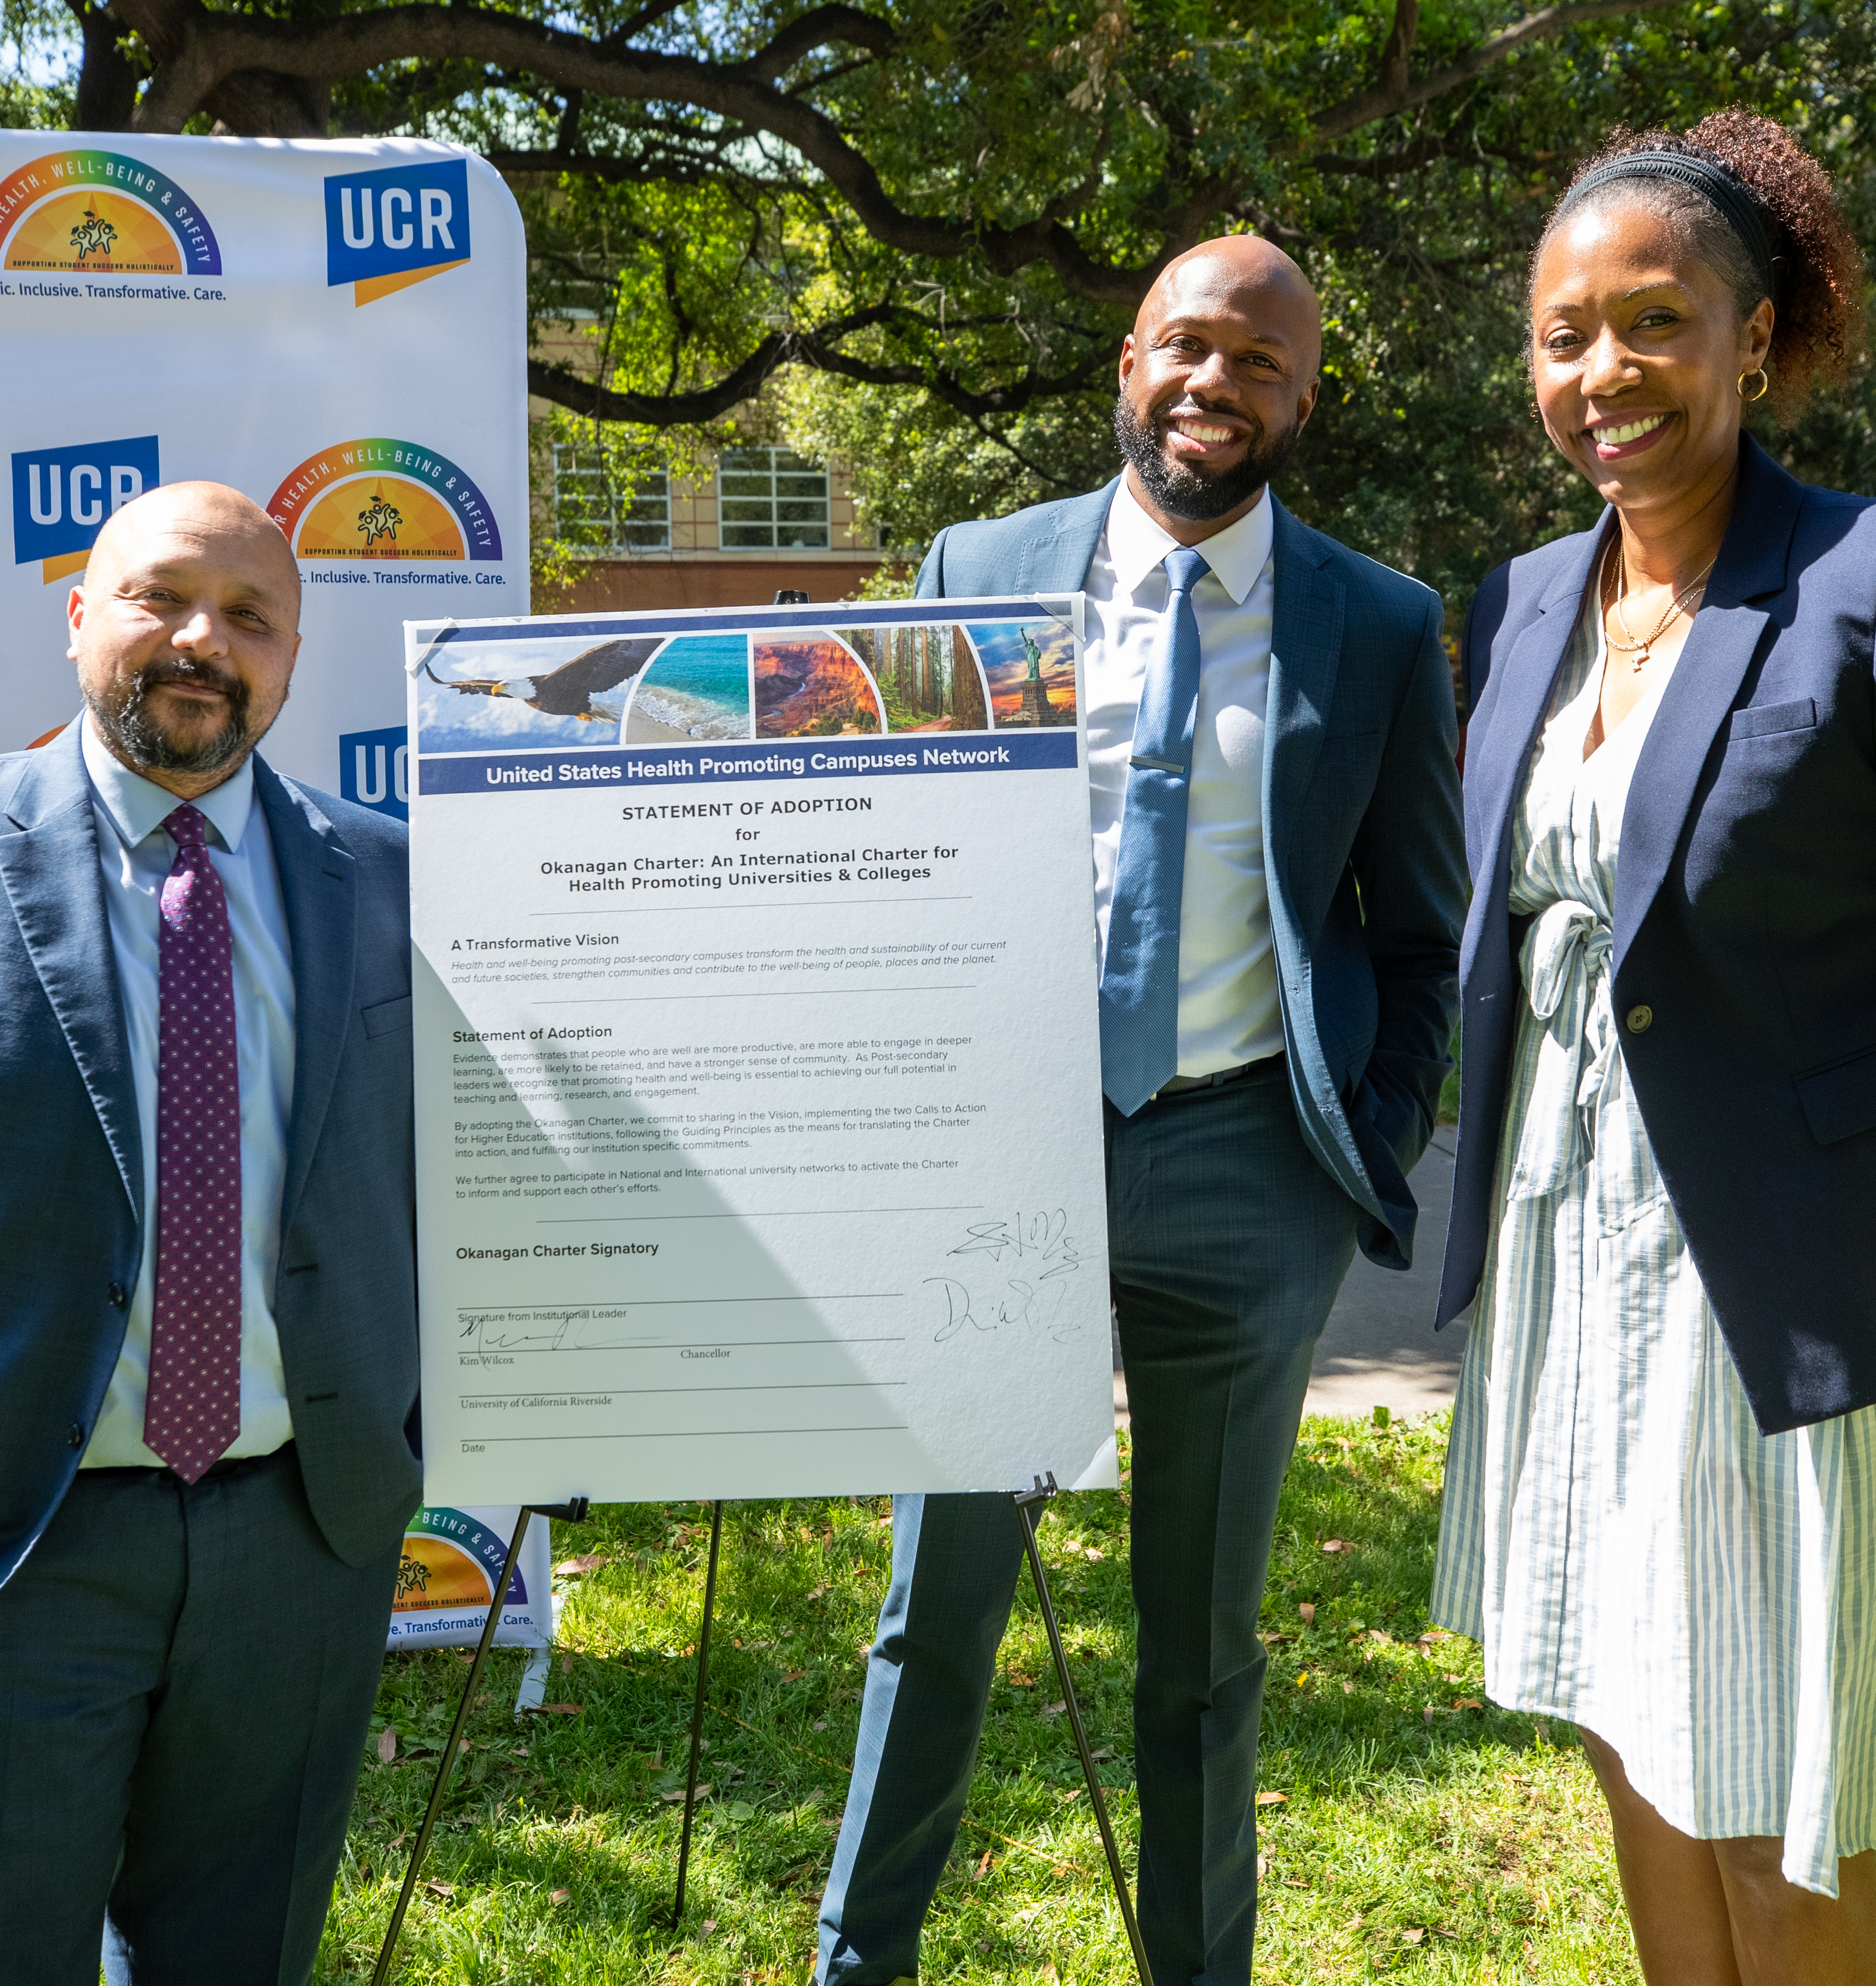

Okanagan Charter
The Okanagan Charter is an international framework established in 2015 to provide universities and colleges with
a common language, principles, and vision to promote health and wellness in all aspects of campus life and around the world.
Adopted by UC Riverside in April 2024
UCR is one of 38 campuses nationwide to sign the charter.
“The Okanagan Charter isn't just a document UCR signed. It is a philosophy we live by and a demonstration of our commitment to the well-being of the UCR campus community.”

Slide 9
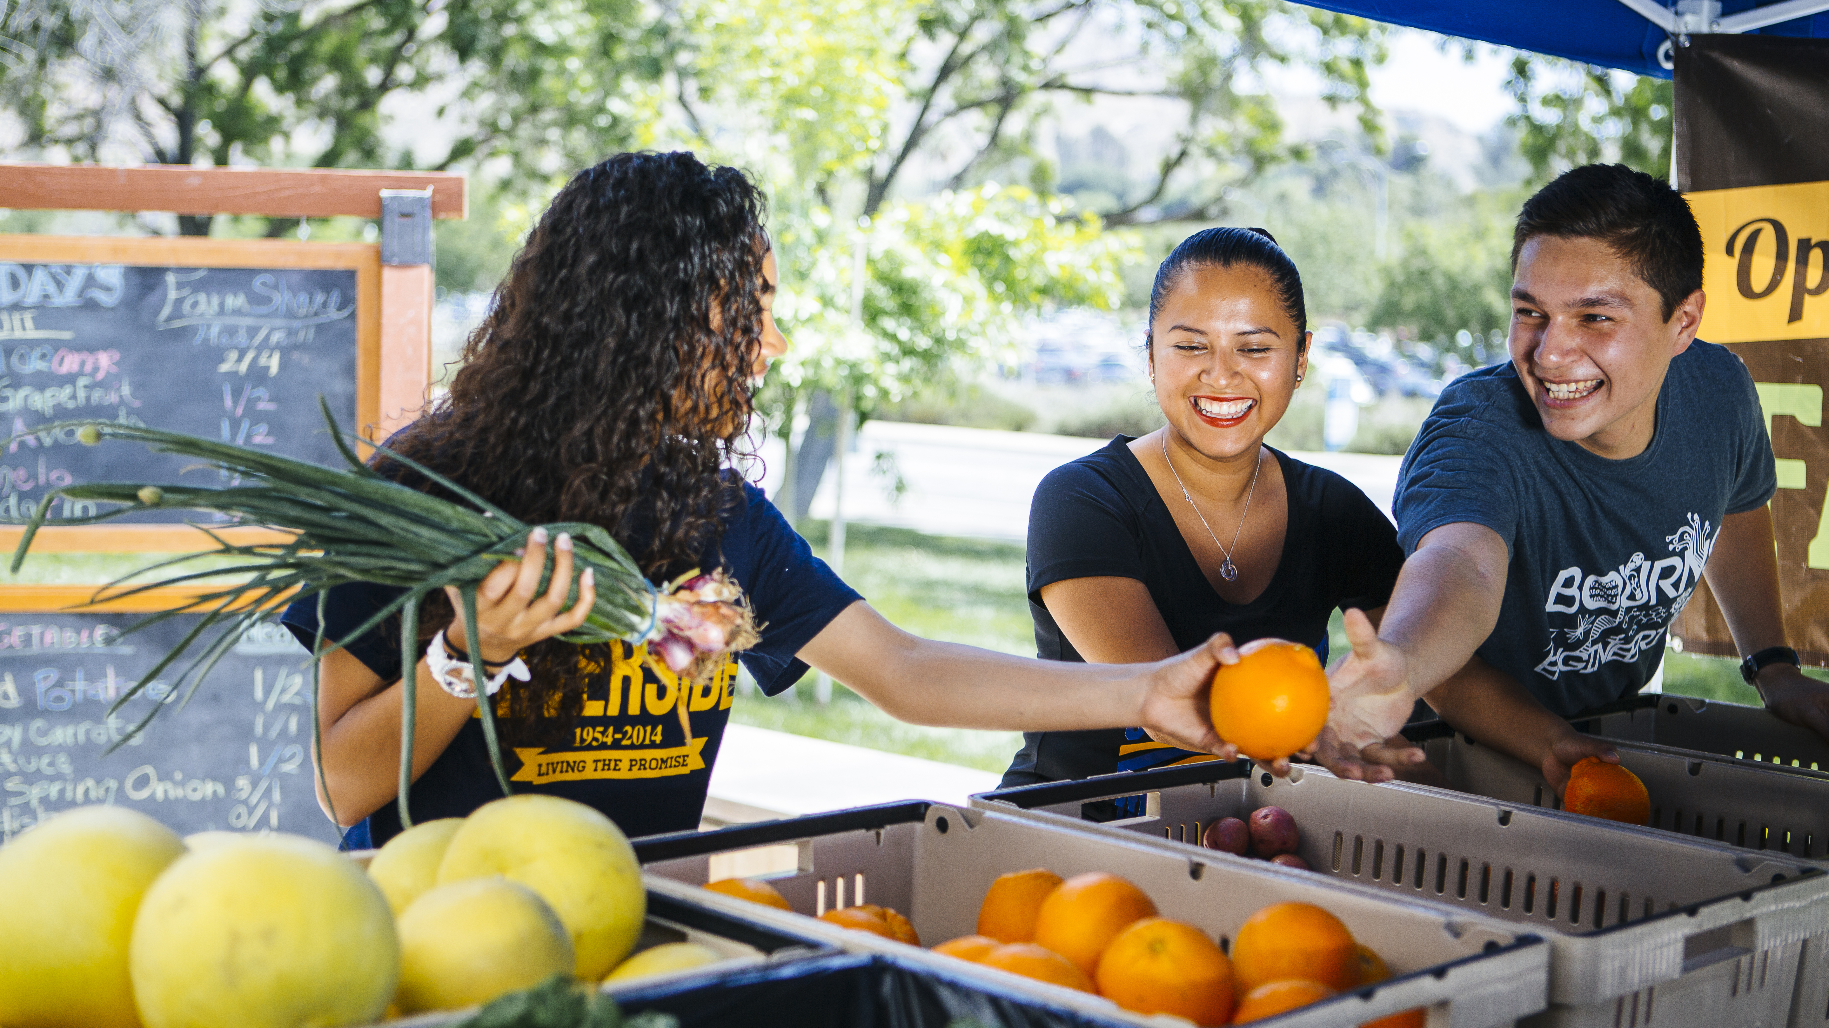
The Call to Action
The Okanagan Charter calls the UCR to:
Embed health into all aspects of campus culture, across the administration, operations, and academic mandates (policies and practices).
Lead health promotion action and collaboration locally and globally.
Keeping with these principles, in fall 2024, UCR introduced R’Healthy Campus to the Highlander community, launching a new era of the Okanagan Charter.

Slide 10
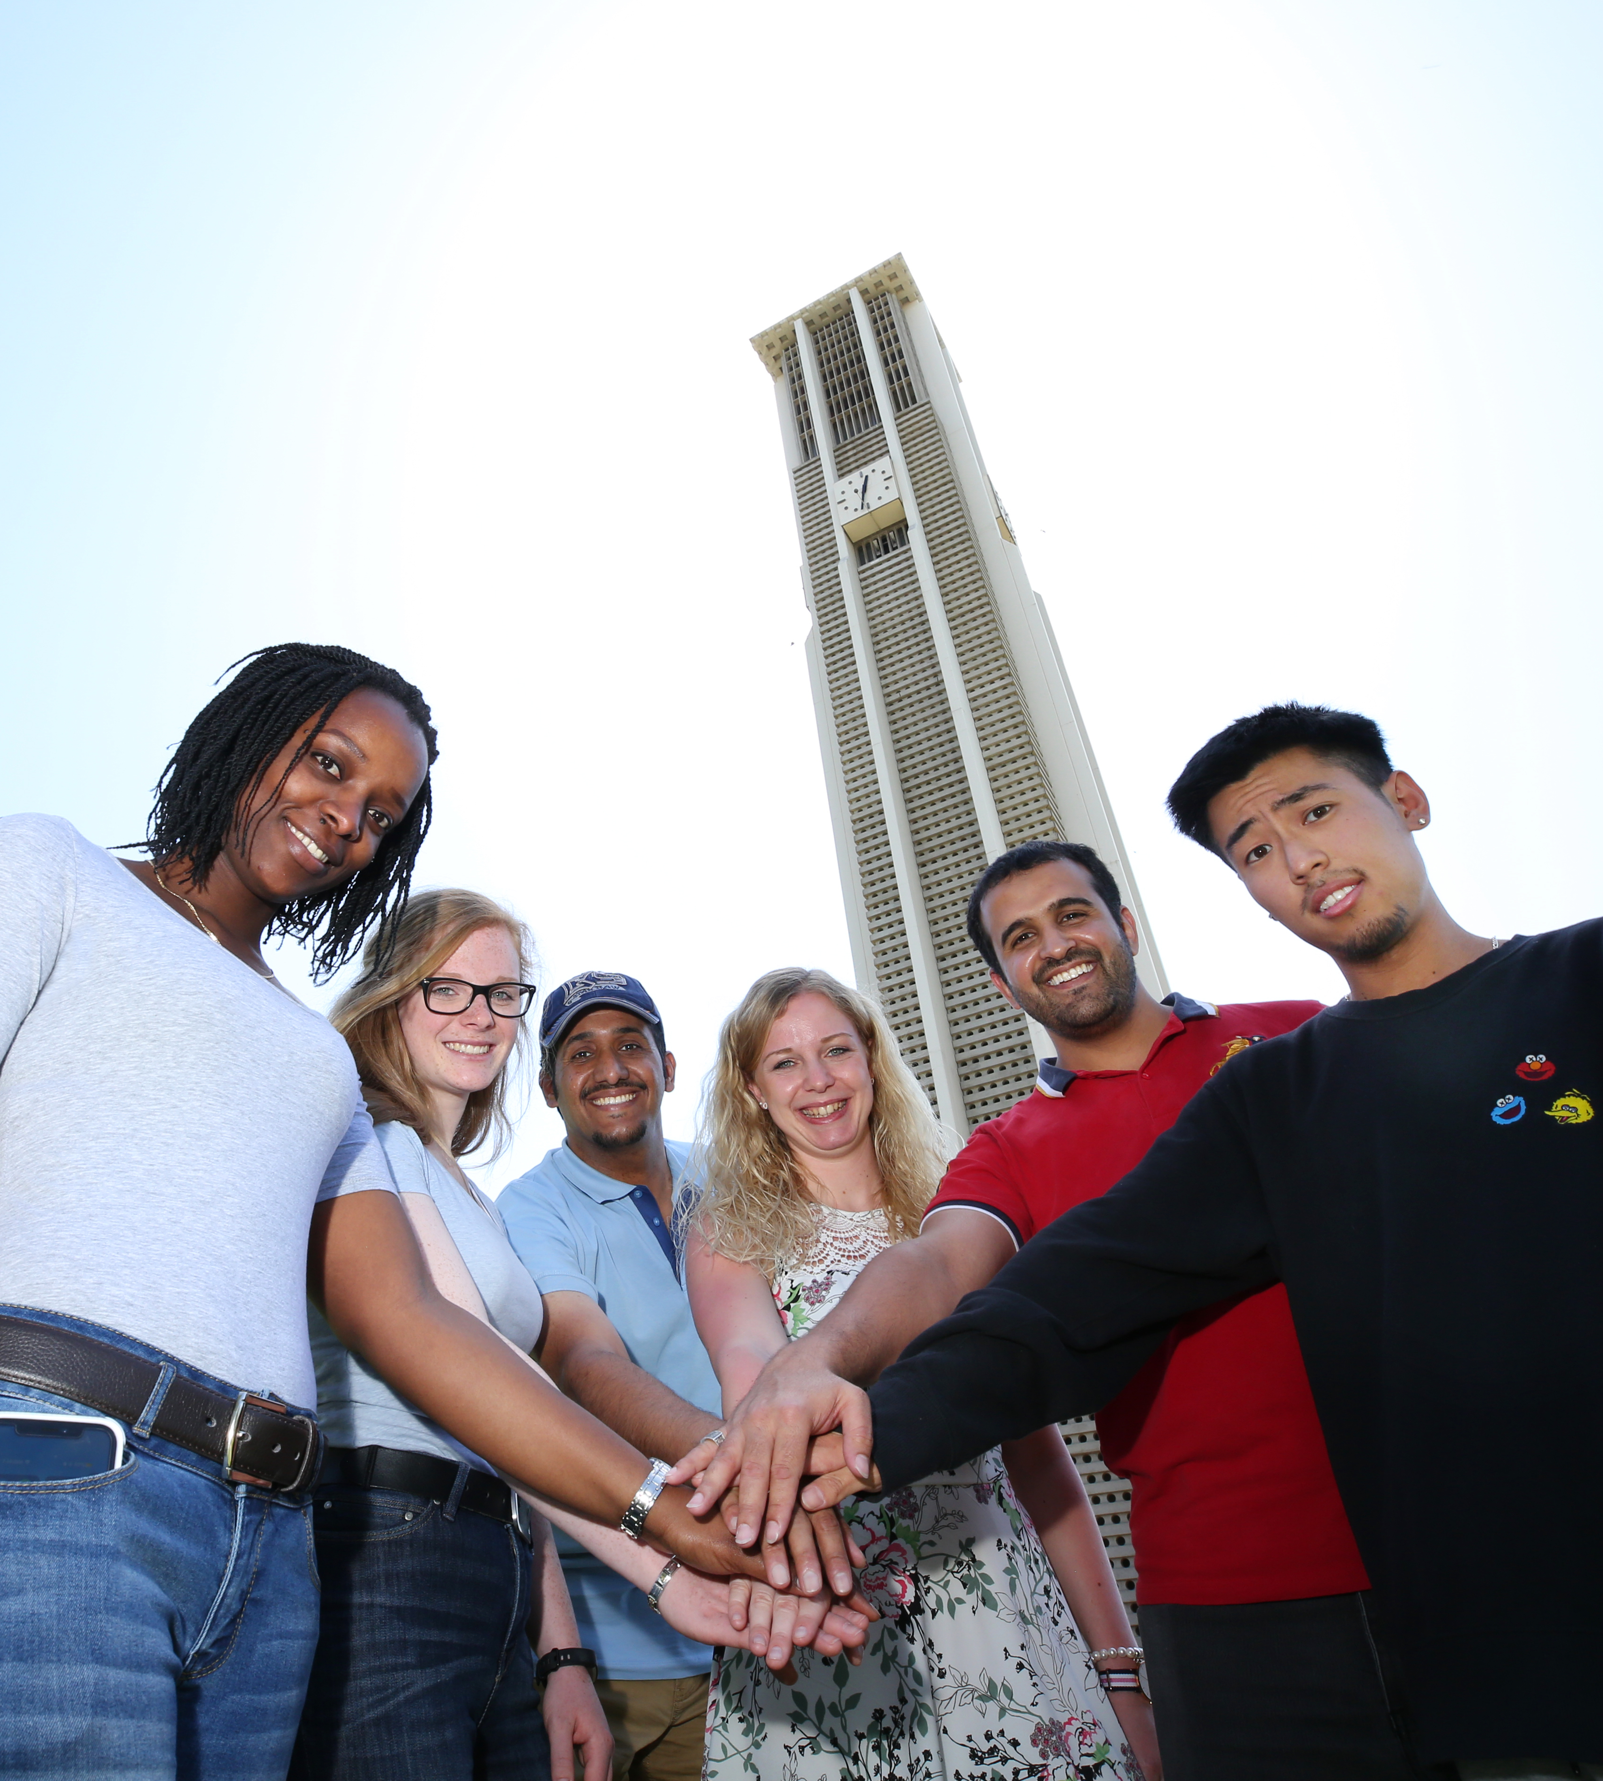
What is R’Healthy Campus?
R’Healthy Campus is a campus-wide movement to promote the health and well-being of UCR students, faculty, and staff.
The Mission: To foster a health-promoting campus culture where the discovery, communication, translation, application, and preservation of knowledge are seamlessly integrated with health and well-being, equity, and sustainability.
UCR strives to create an inclusive and supportive environment where every individual can thrive, while promoting sustainable practices and equitable access to health resources for the benefit of our entire community and the broader world.

Slide 11
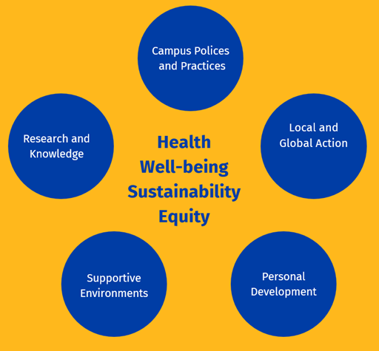
Vision and Pillars

Slide 12
Highlights of Research Findings
Vision Groups and Informational Sessions were held to gather insights on how to foster a healthier campus environment at UCR.
Top 3 Strengths of UCR as a Health Promoting Campus
Top 3 Opportunities to Improve as a Health Promoting Campus
1
Wellness programming resources
1
Work-life balance
2
Built and natural environments
2
Additional wellness resources for faculty and staff
3
Campus community and staff
3
Healthier and affordable food options

Slide 13
Introducing R’Healthy Campus
Guided by the research findings, UCR is creating an environment, policies, practices, and opportunities to enhance the health of all students, faculty, and staff.
Examples of how we are establishing a health-promoting campus at UCR include:
Sharing knowledge through campus-wide health and well-being activities.
Creating inclusive and equitable programs that serve diverse populations.
Fostering research that informs campus policies that support health and wellness.
Providing transformational educational opportunities that inspire students, faculty, and staff to build and sustain healthy lifestyles and communities.
R’Healthy Campus is aligned with the goals of the UCR 2030 strategic plan.

Slide 14
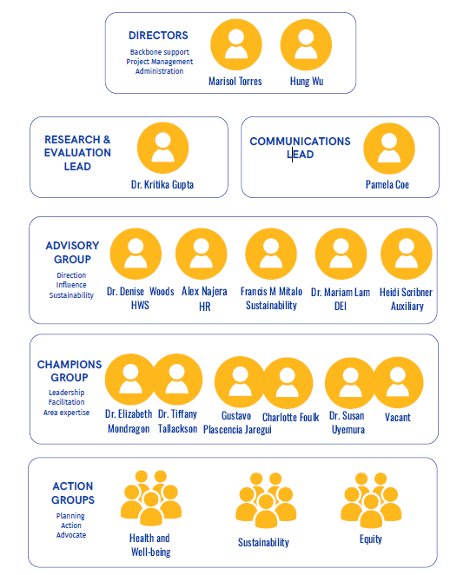
The Structure
Since adopting the Okanagan Charter, R’ Healthy Campus Advisory Groups, Champions and Action Groups were formed.
R’Healthy Campus is managed in partnership with UCR Human Resources and Health, Well-being & Safety to support all faculty, staff and students.

Slide 15
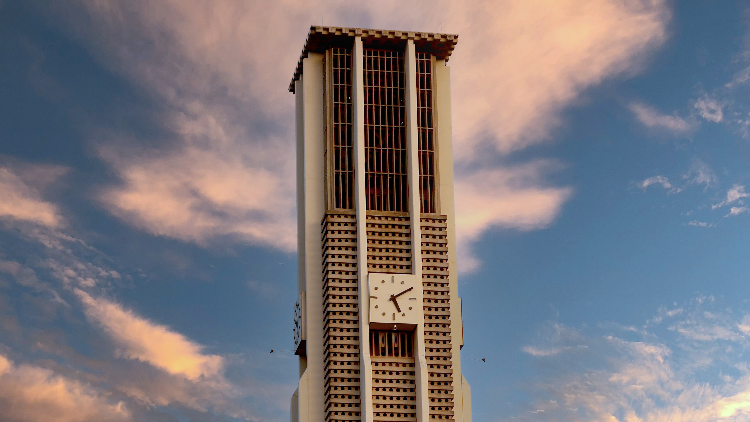
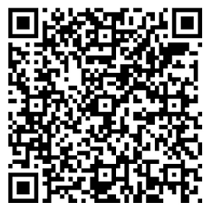
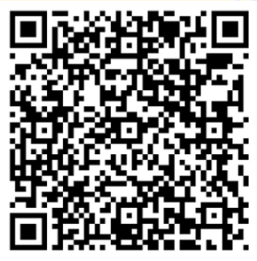
Looking Ahead
This year, each Action Group Co-champions (Health and Well-being, Sustainability, and Equity) performed an environmental scan and needs assessment for their respective action groups and created an action plan, identifying one initiative to facilitate in FY 25-26.
Systemic Change: Well-being considerations integrated into all levels of decision-making.
Healthier and Greener Campus: Increased activities that support health, well-being, and environmental responsibility.
Sustainability Awareness: Increased communications and initiative around sustainability efforts on campus.
Equity and Inclusion: Culturally safe, responsive, and inclusive health promotion practices that address inequities.
Action Group
Listserv
We are all doing well-being work.
Well-being work helps us all.

Slide 16
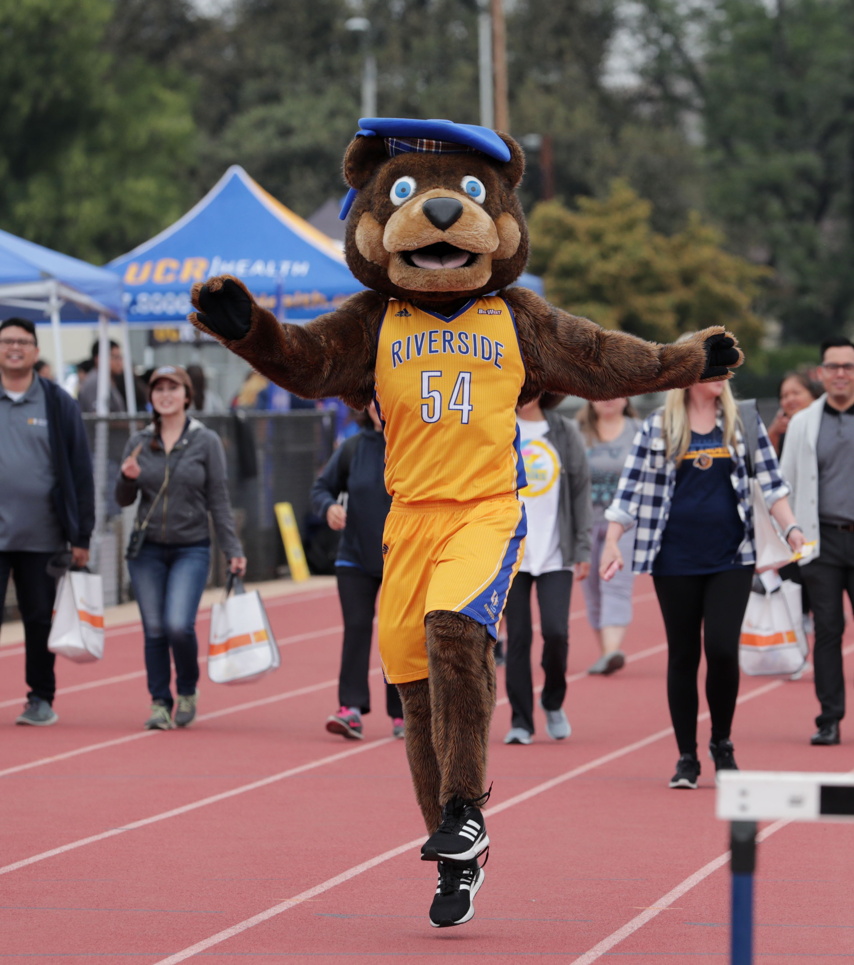
Mobilizing the UCR Community
Embedding health and wellness into all aspects of campus culture in a sustainable and equitable way will take the collective effort of all UCR community members and organizations.
New website: rhealthycampus.ucr.edu .
R’Healthy Campus Listserv and newsletter.
Action group recruitment (faculty, staff, and students).
Health-promoting programs and activities year-round.

Slide 17
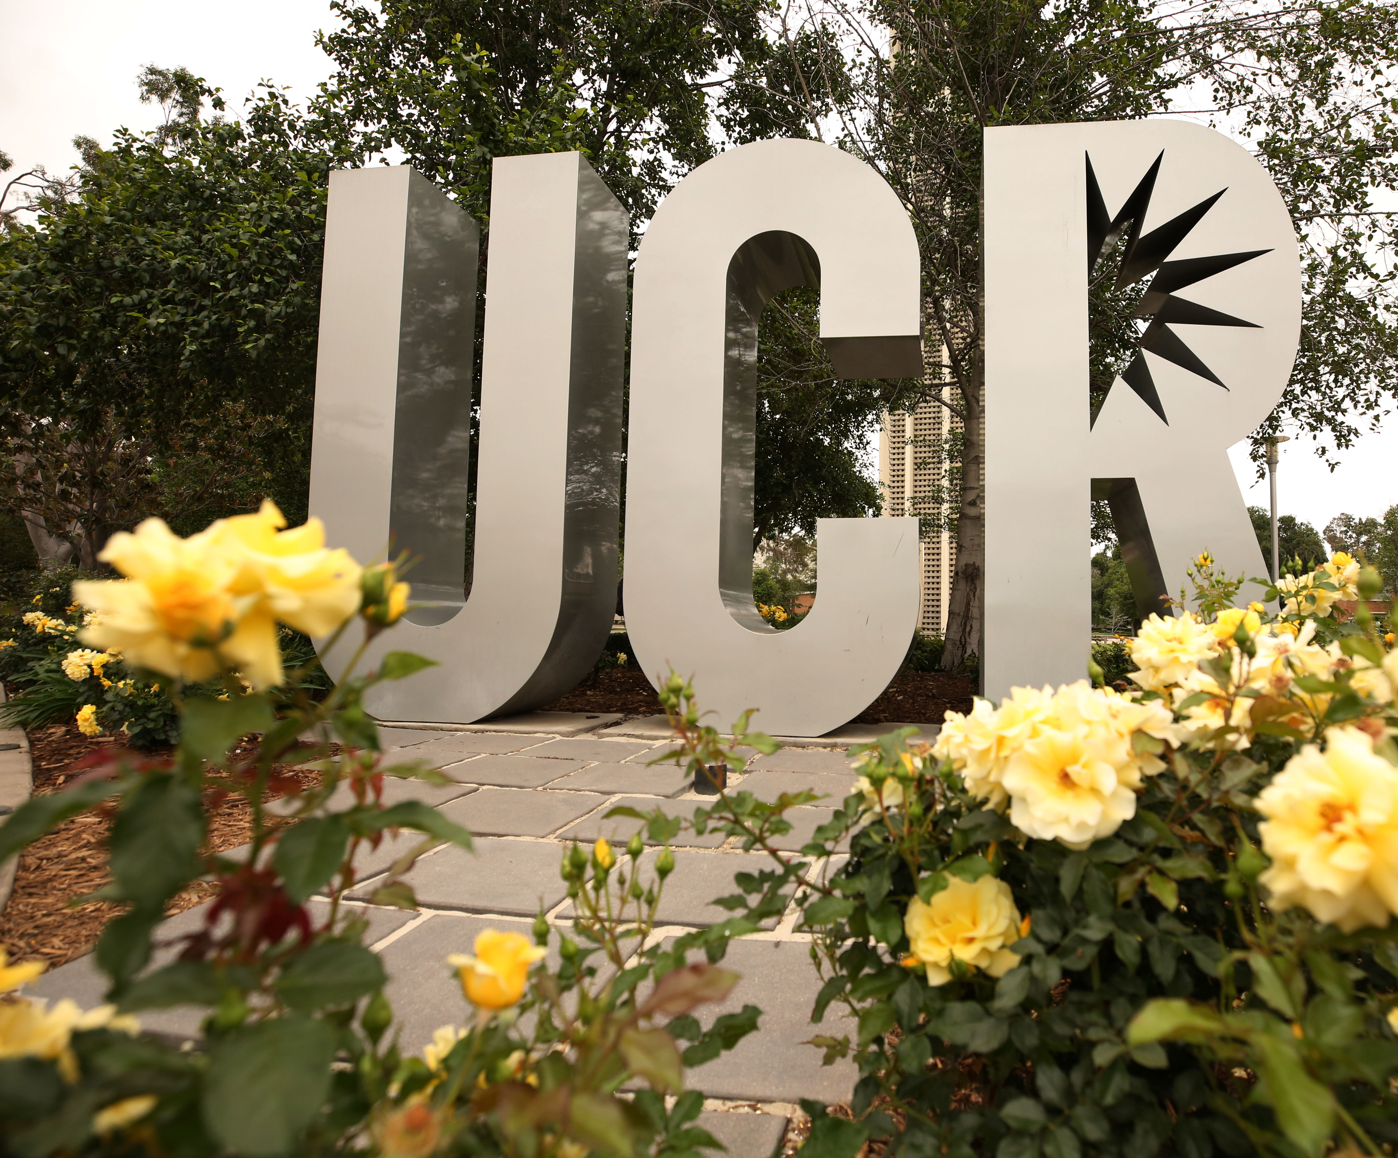

Join the Movement
rhealthycampus.ucr.edu
Questions?

