Slide 1
Bringing healthcare home.

Slide 2
Because Health Starts Here.
Video link | https://vimeo.com/975650044

Slide 3
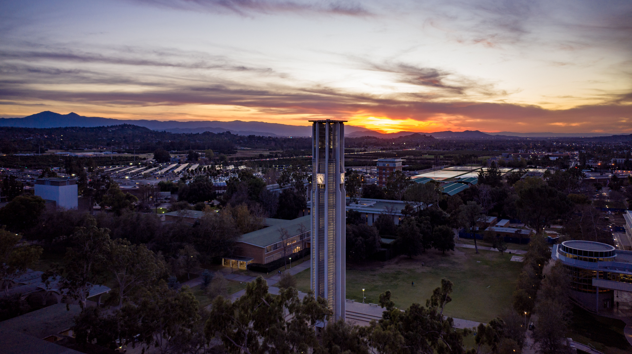
Our Mission
To deliver exceptional, compassionate, patient-centered care for the community.
Notes:
We will accomplish this by expanding primary care, specialty, ambulatory, inpatient, and procedural capabilities and research and developing the next generation of physicians serving the Inland Empire.
Improve the overall health of the community through community and population health initiatives.
Address at-risk patient populations.
Done in partnership with the community.

Slide 4
Healthcare access for Inland Empire patients
Quality and population health improvement
Clinical service and programmatic capabilities
Community partnerships
Clinical research
Care management and coordination
Clinical education of medical students and residents
Physician organization development/expansion
Reduction of healthcare disparity and inequity
Our Vision
To be the leading healthcare provider in the Inland Empire, improving health of individuals and families through mission-driven collaboration, outstanding education, and innovative care delivery.
Notes:
World–Class UC-Care Quality: Access to primary and specialty care and programs/services in the rapidly growing Inland Empire
Viability: Increasing the pipeline and retention from medical school to residency to faculty recruitment
Sustainability: Financial funds flow to support program growth and education/training
Regionally Integrated Clinical Network: Increased organization and integration of primary and specialty care and integration of health information
Long-Term Commitment: Investment in the economy of the Inland Empire

Slide 5
UCR Health Organization
CHIEF EXECUTIVE OFFICER
CHIEF OPERATING OFFICER
CHIEF MEDICAL OFFICER
Ambulatory Operations
Krystal Rivas
Marketing
Eileen Kwan
Physician Relations
Erin Ferencik
Performance Excellence
Linda Roney
Clinical
Finance
Anthony Simmons
Quality/
Grievance
Helen Lau
Epic/
Informatics
Team

Slide 6
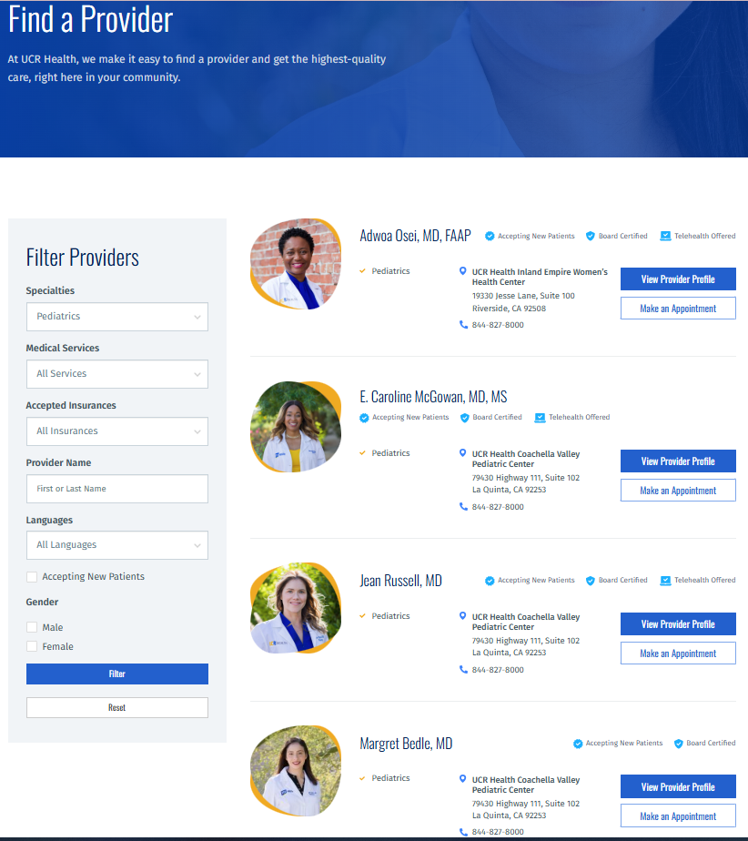
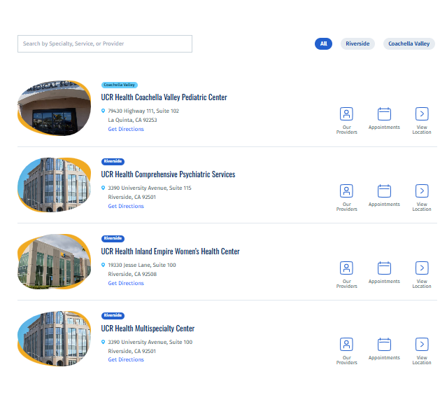
Visit UCRHEALTH.ORG Access full Physician Directory & Services

Slide 7
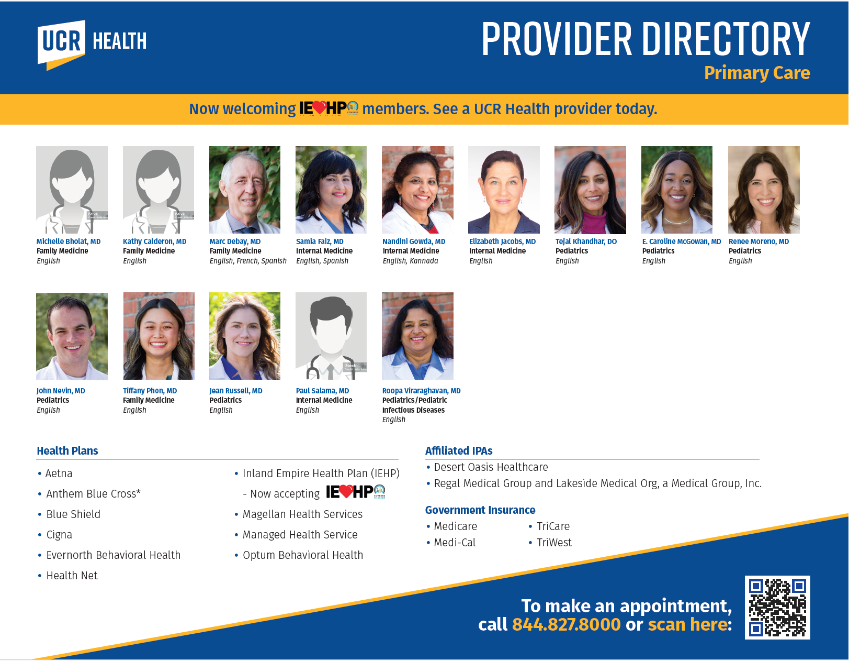
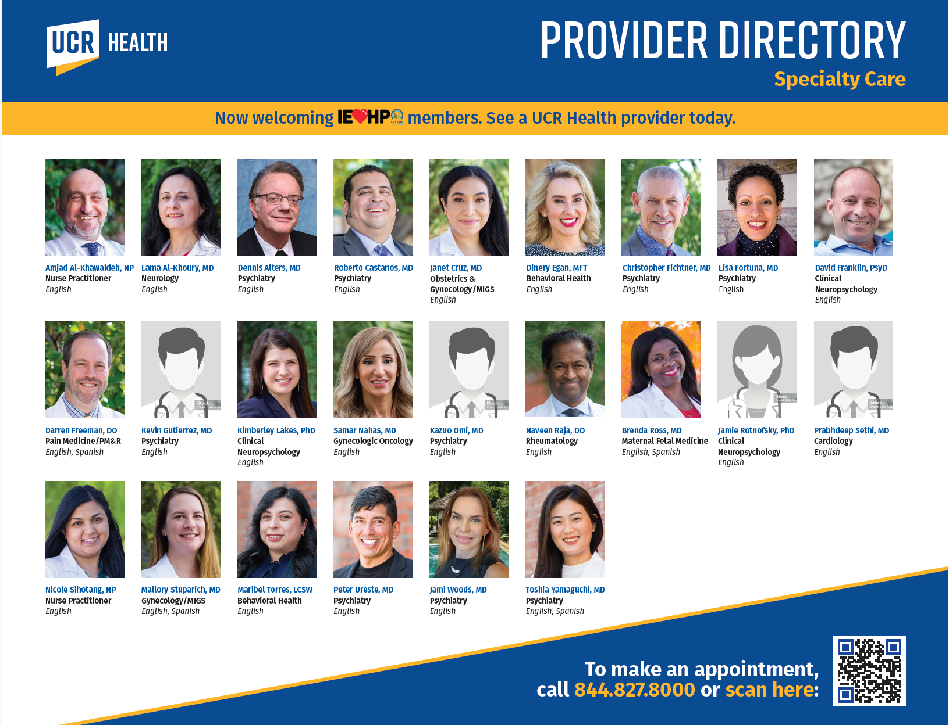
Our Providers
Notes:
Here are the populations we serve:
Geriatrics - Medicare
Pediatrics – Medi-Cal

Slide 8
Bringing Care to our Community
UCR Health physicians provide a wide range of routine, preventive, and specialty medical care:
Medical Services
Pain Medicine
Pediatrics
Primary Care
Psychiatry
Rheumatology
Sports Medicine
Urogynecology
Women’s Health
Cardiology
Clinical Neuropsychology
Family Medicine
Gynecologic Oncology
Hospitalist Services
Internal Medicine
Neurology
Obstetrics & Gynecology
Notes:
Offer distributed “Hub & Spoke” clinical network in the IE
Serve as Integrator of Care
Enhance Clinical Quality
Expand Clinical Education Programs
Collaborate with other UCs
Serve as a Community Partner

Slide 9
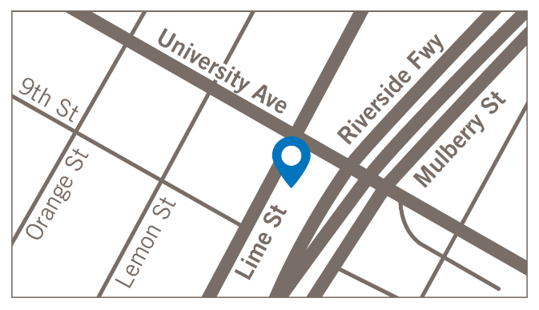
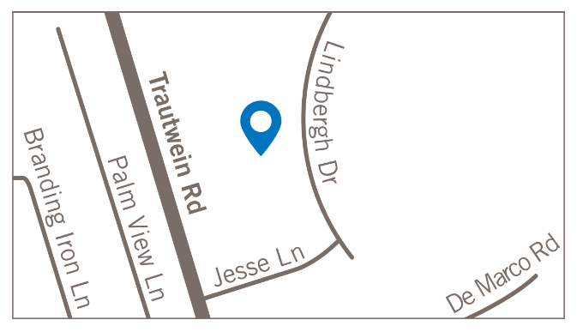
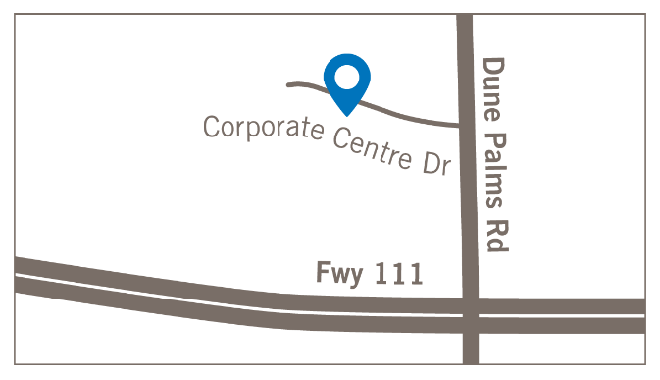
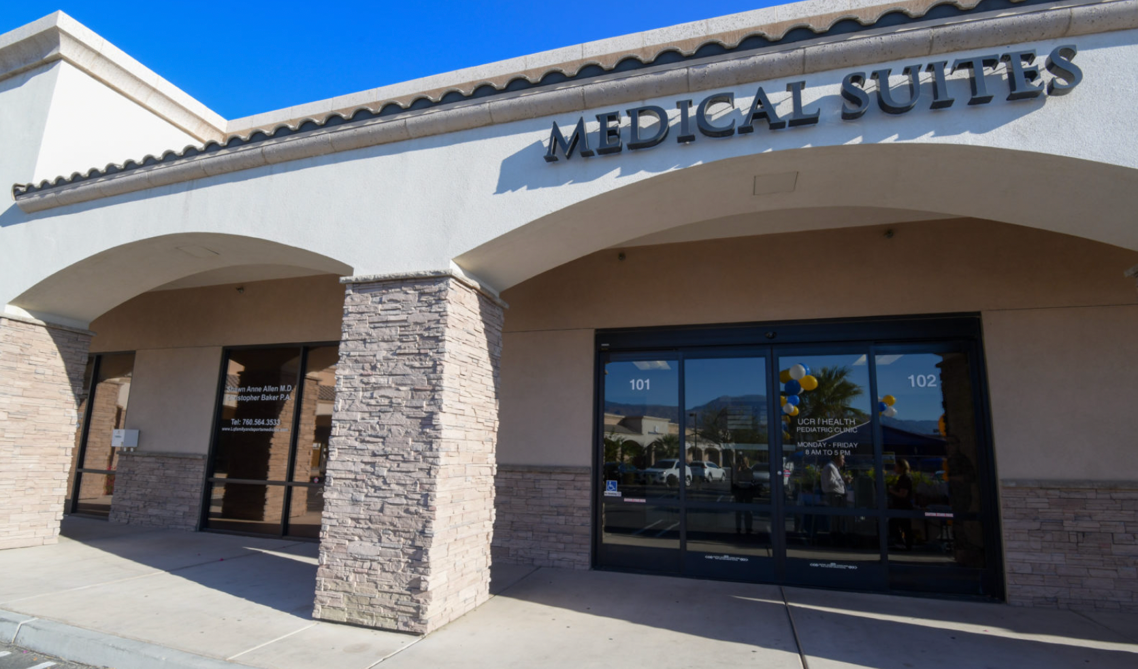
Accessible Locations Near You
UCR Health has four locations throughout Riverside County, serving individuals and families across Riverside and the Coachella Valley.
UCR Health | Multispecialty Clinic
3390 University Avenue, Suite 100
Riverside, CA 92501
UCR Health | Women’s Health
19330 Jesse Lane, Suite 100
Riverside, CA 92508
UCR Health | Pediatric Clinic
La Quinta Valley Plaza
79430 Highway 111, Suite 102
La Quinta, CA 92253
UCR Health | Psychiatry Clinic
3390 University Avenue, Suite 110
Riverside, CA 92501

Slide 10
Insurances Accepted
Health Plans
Aetna
Anthem Blue Cross*
Blue Shield
Cigna
Evernorth Behavioral Health
Health Net
Inland Empire Health Plan
Magellan Health Services
Managed Health Service
Optum Behavioral Health
Government Insurance
Medicare
Medi-Cal
TriCare
TriWest
Affiliated IPAs
Desert Oasis Healthcare
Regal Medical Group and Lakeside Medical Org, a Medical Group, Inc.
Notes:
Here are the populations we serve:
Geriatrics - Medicare
Pediatrics – Medi-Cal

Slide 11
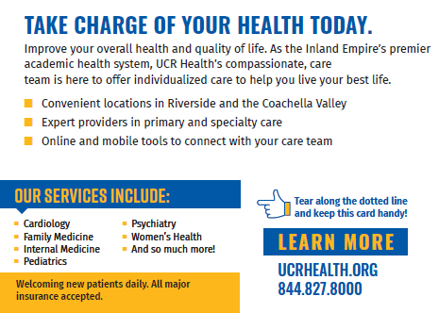
Specialized Programs
Notes:
Here are the populations we serve:
Geriatrics - Medicare
Pediatrics – Medi-Cal

Slide 12
Hospital Partners
Corona Regional Medical Center
Eisenhower Medical Center
Parkview Community Hospital Medical Center
Rancho Springs Hospital
Riverside Community Hospital
Riverside University Health System
St. Bernardine Medical Center
Notes:
Corona Regional Medical Center – Women’s Health and two Peds providers have hospital privileges. No written agreement.
Eisenhower Medical Center – UCR Pediatric Hospitalist Service agreement
Parkview Community Hospital – Dr. Sasi has hospital privileges and Dr. Roopa is going through the credentialing process. No written agreement.
Rancho Springs – some Women’s Health providers have hospital privileges to perform surgical procedures. No written agreement.
Riverside Community Hospital – Several providers have hospital privileges but I’m not aware of any current agreements with RCH.
St. Bernardine’s - A few providers have privileges in support of GME programs
Riverside University Health System Medical Center – we have providers with privileges to work in their community clinics. We don’t have providers covering any hospital services that I am aware of.

Slide 13
Vision 2030: UCR’s Role
Offer distributed “Hub and Spoke” clinical network in the IE | Serve as Integrator of Care | Enhance Clinical Quality | Expand Clinical Education Programs | Collaborate with other UCs | Serve as a Community Partner
307 physicians [Faculty ~15% / Clinical Track ~40% / CIN ~45%] Distributed primary care and office-based specialty clinic network Integrated ambulatory locations (~3 integrated centers and 1 HOPD site) Hospital | UCR Health will adopt an integrator role within the fragmented network of care of hospitals, clinics, and providers in the region UCR will drive alignment around population health, quality, equity, improved access, and service availability. | UCR Health will have top decile (>90%ile) quality performance UCR will be the second 4-star hospital in the region | Accommodates 500 medical school students Increased residencies to educate specialists and recruitment / retention strategy for increasing access | Physician organization development in the Inland Empire Integrated clinics in West, S/E and S/W Comprehensive cancer capability Infrastructure Quaternary & specialized care Care pathway standardization | Managed care (HMO) network by 2026-2027 Blue and Gold for employees and students Capitated network for employers Care coordination Foundations Tribal organizations FQHCs

Slide 14
Key Statistics
Fiscal Year: 2024
We completed 46,900+ visits
We accept 35+ different types of insurance
We treat 10 different specialties
We saw 7,134 new patients

Slide 15
Summary
UCR Health as the clinical enterprise for UCR School of Medicine, provides:
Clinical infrastructure
For employed UCR physician faculty to teach and care for patients
Generate revenue to reinvest and to support mission of SOM
Control quality and patient experience
Develop basis for future population health management

Slide 16
Thank you!
Questions?

