Slide 1
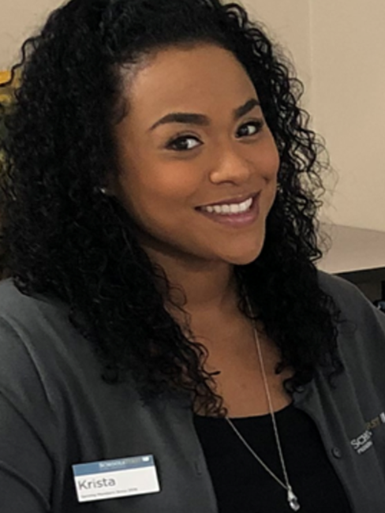
Krista Norwood
Membership Development Specialist
KNorwood@schoolsfirstfcu.org
Mobile: (714)380-9846

Slide 2
Notes:
Summer Saver offers an Annual Percentage Yield of 6.5% while most liquid savings only offer .5 and it can take you over 60 years to get what you get with us in 1 year!

Slide 3
Notes:
Competitive low interest rates on auto loans. Make 12 payments on time and we automatically lower your interest .5% until we get you to the lowest rate from the date you initially applied. Helps to save hundreds over the lifetime of your loan. skip payments on a SchoolsFirst FCU auto loan during June,July/July, August or August and September. Our products are tailored to school employees unique needs.

Slide 4
Notes:
A card tailored to your unique needs with a low everyday purchase rate and cash back which is deposited into Summer Saver if you it open. They partner together to get you compounded monthly interest on your cash back.

Slide 5
Notes:
0% Interest loans without a credit check, available within 3 minutes or less when you call.

Slide 6
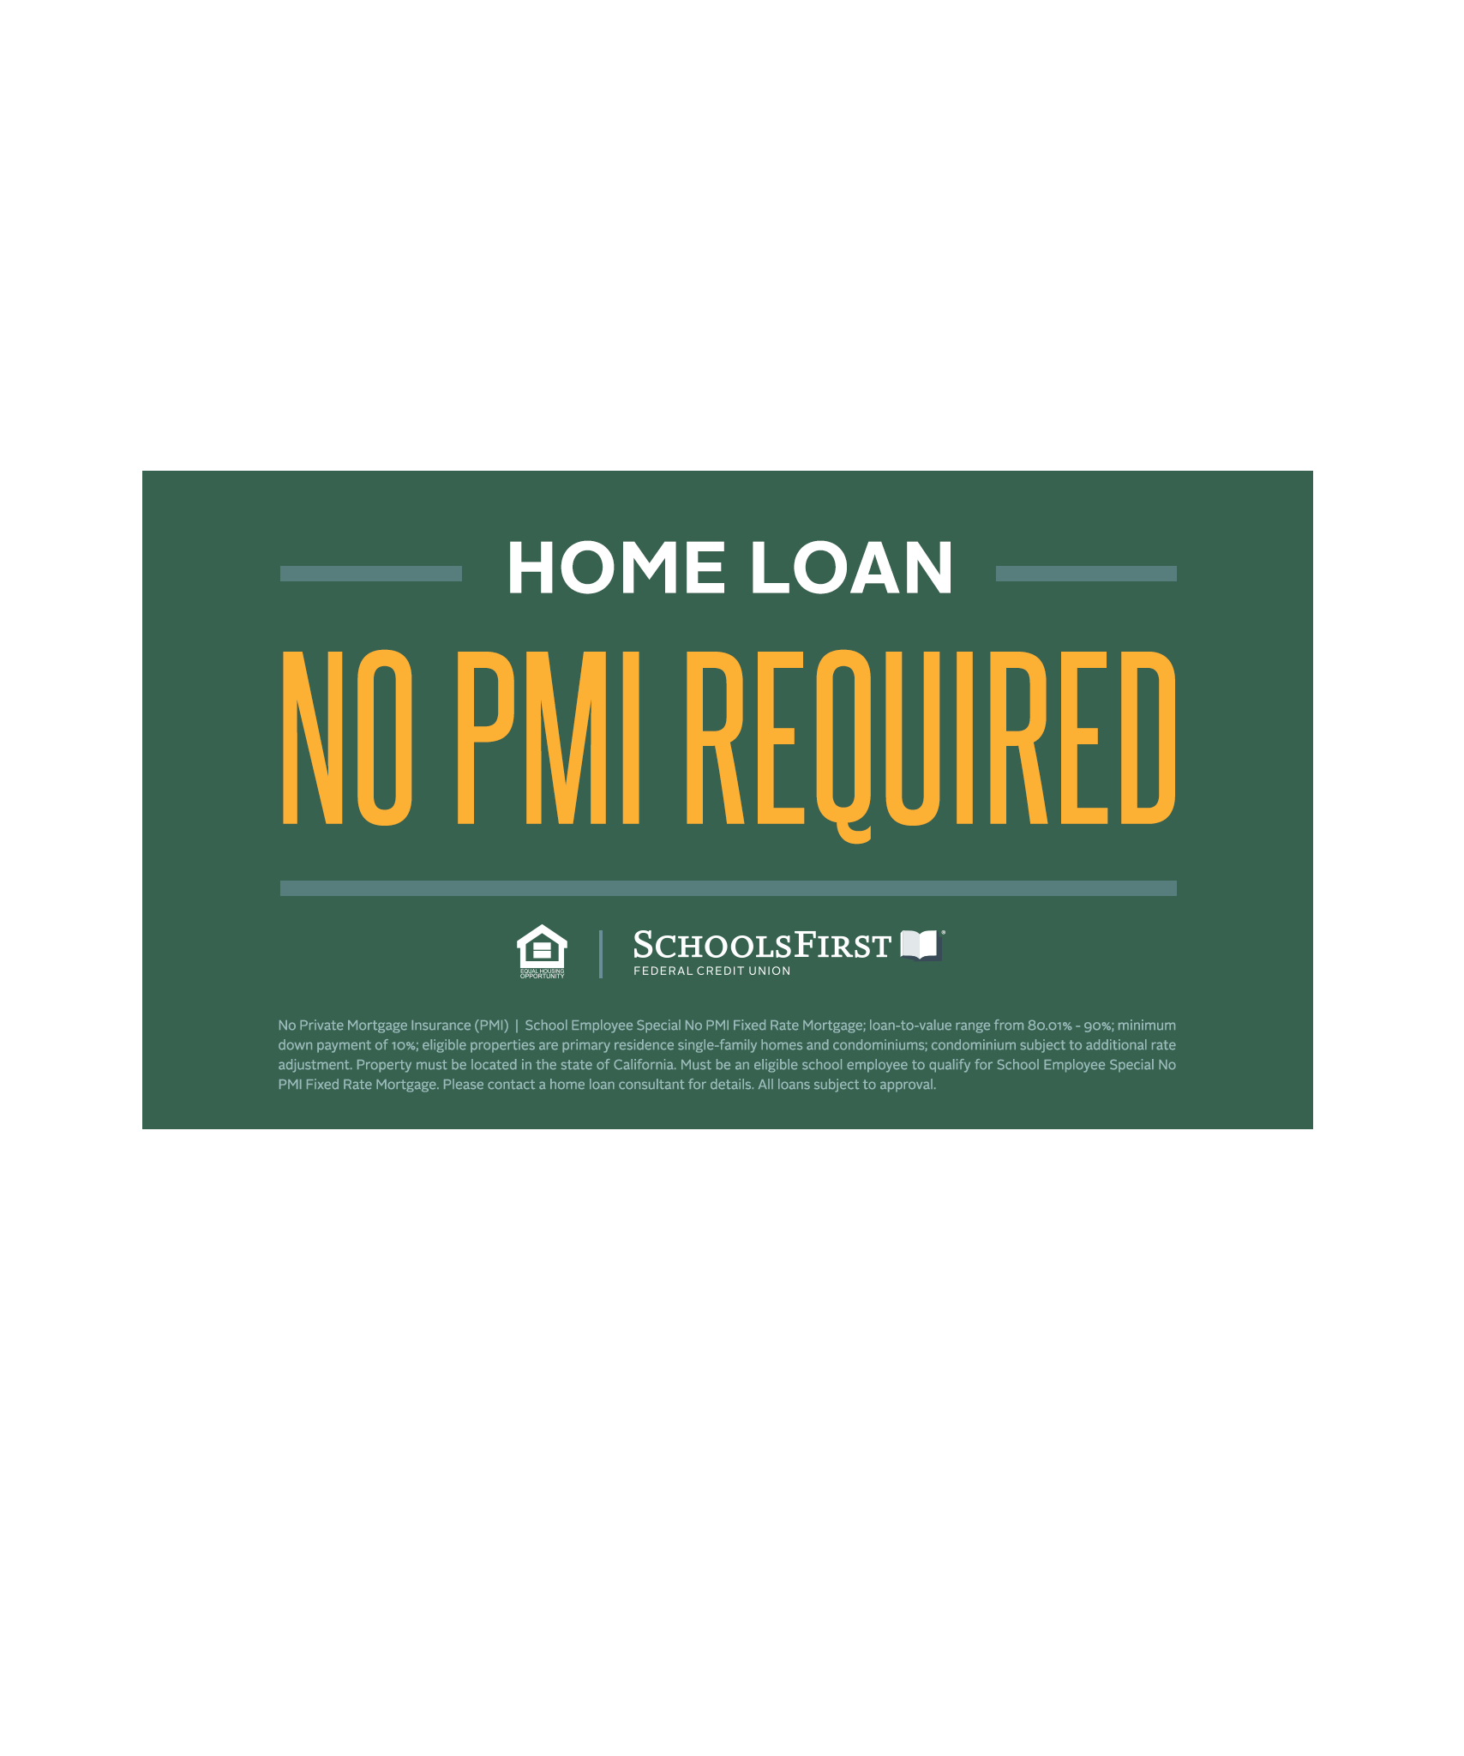
Notes:
5% Down No PMI for School Employees/ 3% down with discounted PMI instead of 20% required by most regular financial institutions.

Slide 7
Notes:
We work with other Credit Unions to ensure you have access to your money for free.

Slide 8
Notes:
Once you join you’re a Member for life and your immediate family can join because of you and save.

Slide 9
Notes:
This is the link that will take you to where you can sign up.

Slide 10
Notes:
Virtual attendees have access to join for free online.

