Slide 1
R’Card and
Highlander Service Station

Slide 2
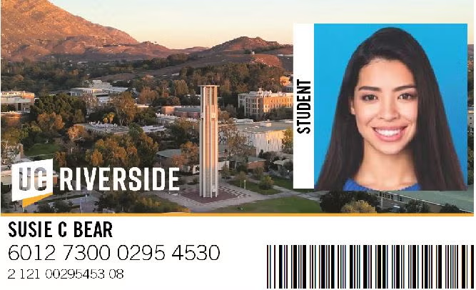
R’Card Benefits and Use
Door Access and Kronos
Your R’Card is equipped with technology to communicate with door readers and Kronos machines easily
RTA Free Rides
All staff and students with an R’Card are able to ride the RTA Bus for free, just swipe at the front and you’re set
Meal Plans
The Community Dining Plan offers 10 or 25 meal swipes loaded directly onto your R’Card for use at:
Glasgow & Lothian
The Barn
Noods Noodle Bar
Bear Bucks
Load funds directly onto your R’Card for use at any location on campus
Athletics Tickets
Your R’card is a free ticket into all UCR athletics games happening on campus
Library Access
Your R’Card is also your Library card for use at Rivera and Orbach

Slide 3
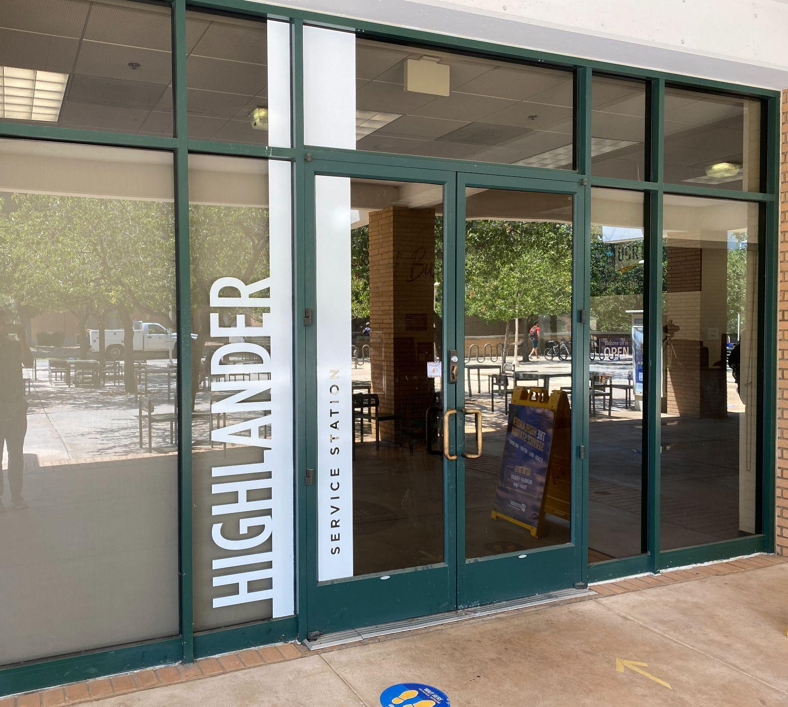
Highlander Service Station
R’Card Services
Take your picture and get your R’Card and/or badge printed in under 5 minutes
Mail Services
Ship out packages via USPS, UPS, and FedEx
On-Demand Printing
Print out up to 250 Flyers, brochures, or handbills
Passport Services
Get your first passport or renew your previous passport with us Tuesdays and Thursdays
Vendor Program
Come check out our vendors outside the Highlander Service Station or sign up for a date yourself with your own small business
Notary Services
Get documents notarized, payable via Card or COA

Slide 4
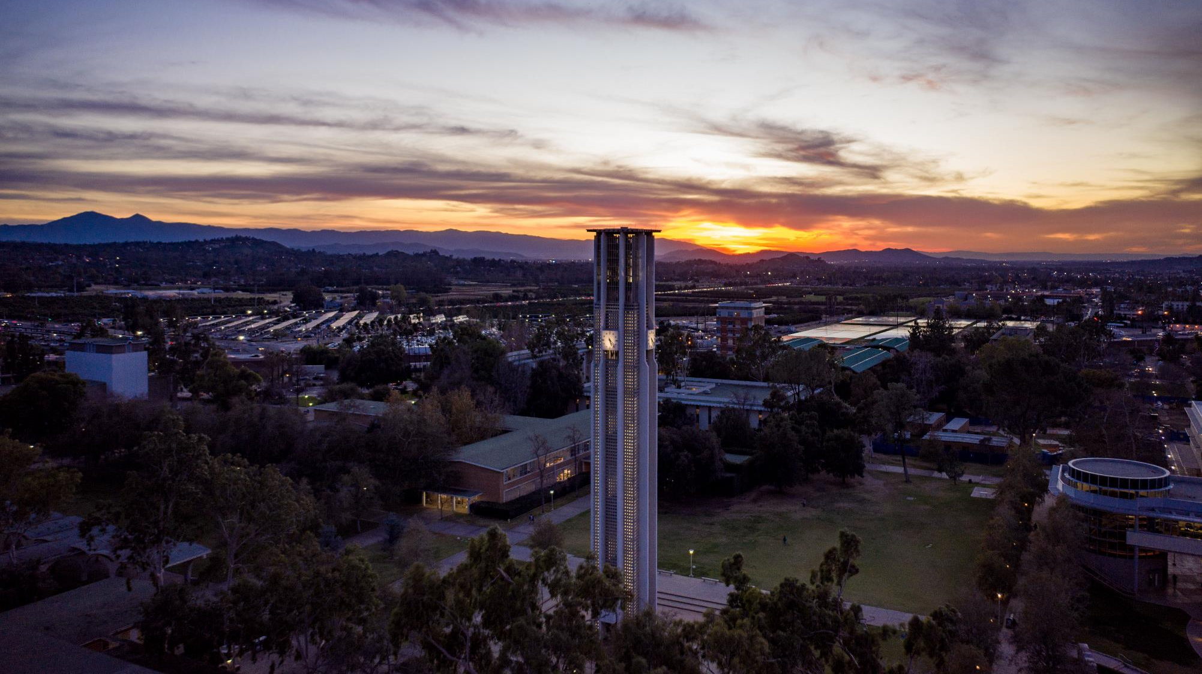
THANK YOU!
Evan McGuffin
Highlander Service Station Operations Coordinator
evan.mcguffin@ucr.edu
x2274

