Slide 1


Your UC
Retirement System
Prepare for your someday, today.
Expires 2.28.26
Notes:
Welcome, and thank you for coming! I’m [name] from Fidelity Investments®. We’re here to help you better understand the UC Retirement System, so you can make the most of it.
You might find the thought of retirement exciting, or scary, or both. How you feel probably has to do with your confidence in having a comfortable retirement.
Today, we want to help you feel more confident in your retirement planning and your ability to really retire.

Slide 2
What you’ll learn today
UC Retirement
Benefit Choices
RESOURCES AVAILABLE TO YOU
How AND WHERE to GET STARTED
Notes:
Here’s what we’ll cover today:
First, we’ll help you understand your retirement benefits at UC.
Then, we’ll talk about the resources available to help you with your retirement planning.
Finally, we’ll talk about where and how you can start saving for retirement.
Let’s get started.

Slide 3
Your UC Retirement System
PRIMARY
SUPPLEMENTAL
UC Retirement Choice Program
UC Retirement Savings Program
UC Retirement Plan
1976 Tier
2013 Tier
Option 1 — Pension Choice
Option 2 — Savings Choice
403(b)
457(b)
DCP (After-Tax)
Notes:
Let’s start by talking about the different components of the UC Retirement system.
Your retirement benefits are determined by your employment tier—1976 Tier, 2013 Tier, or 2016 Tier (aka Retirement Choice Program).
For Your Primary Retirement Benefits Options:
The investments are overseen by the Chief Investment Officer’s Office; and the recordkeeping is done at UC.
If you belong to the 1976 or 2013 Tiers (or a collective bargaining unit), you will automatically be enrolled in the UC Retirement Plan (UCRP).
If you belong to the 2016 Tier, you have two options – the Pension Choice or the Savings Choice. You have 90 days to make an election. If you do not make an election within your 90-day eligibility window, you will be defaulted into Pension Choice. Once an election is made, either by default or by choosing one, no further changes can be made. If election is made before 90 days, you can not go back into the system and change your election. All elections are always final.
For the Supplemental Retirement Benefits Option - which consist of the 403(b), 457(b), and DC Plans:
The investments are overseen by the Chief Investment Officer’s Office, like the UCRP; and
The recordkeeping is done by Fidelity Retirement Services, which provides recordkeeping services for a large number of organizations like UC. Fidelity has been providing this service to UC since July 2005.
As part of its contract, Fidelity also provides communication and financial education for UC employees. Fidelity’s Workplace Financial Consultants are registered investment professionals who provide help on a variety of topics. They have received specialized training on the Primary and Supplemental Retirement Benefits Options Fund Menu investment options—those funds which are chosen and monitored by the Chief Investment Officer’s Office. And if you call Fidelity, you’ll be talking with representatives who have also undergone this special training for UC.

Slide 4


Primary
Retirement
Benefits

Slide 5
Mandatory 1976 and 2013 Tiers
1976 and 2013 Tier UCRP enrollment is automatic
Contribution amounts:
UC contributes: 8%
UC employees contribute: 7 - 9%*
You become vested after 5 years of service credit
Minimum Retirement Age is 50 or 55, depending on Tier
* Subject to collective bargaining agreements and hire date
Notes:
If you were hired before July 1, 2016, (and have not had a “break in service), you likely fall into the 1976 Tier or the 2013 Tier. If so, then you will automatically be enrolled in the UC Retirement Plan (UCRP) The UCRP is a pension plan, record-kept by UC, and it’s designed to provide a predictable level of income in retirement. Both you and UC contribute to your pension plan, and UC directs investment of those contributions.
UC contributes 8%; You contribute 7-9%. These contributions are mandatory. Contributions to the UCRP are pre-tax.
To earn a monthly guaranteed income pension benefit, you have to meet both the vesting and minimum age requirements.
If you separate from UC you can always take a refund of accumulations, which is the 7-9% that you contribute to the pension. You would not take the 8% that UC contributes.
The minimum retirement age is 50 or 55, depending on tier.

Slide 6



2016 Tier – Retirement Choice Program
You have a choice of two Primary Retirement Options:
PENSION CHOICE
SAVINGS CHOICE
www.myUCretirement.com/choose
Notes:
For 2016 Tier employees, when it comes to choosing your primary (required) retirement benefits, you have two options – the Pension Choice or the Savings Choice. Both options offer a valuable retirement benefit and are designed to provide retirement income in addition to Social Security benefits and any other retirement savings you may have.
We will provide a brief overview for each of your choices. For additional details, visit www.myUCretirement.com/choose.

Slide 7
Retirement Choice Program - Who is eligible?
You are eligible for the UC Retirement Choice Program if you:
Are hired into an eligible faculty or staff appointment on or after July 1, 2016
Complete an hours requirement on or after July 1, 2016 (generally, 1,000 hours worked within a 12-month period.)
Are rehired into an eligible faculty or staff appointment on or after July 1, 2016, following a “tier” break in service^{1.}
Note: If you are represented by a union, your retirement benefits are governed by your union’s contract with UC and may be different than the benefits we’re discussing in this workshop. Please refer to your collective bargaining agreement for details.
¹In general, a “tier” break in service occurs if you do not return to UC employment before the end of the month following the month you separated from service.
Notes:
You are eligible for primary retirement benefits if you:
• Are hired into an eligible faculty or staff appointment on or after July 1, 2016; OR
• Complete an hours requirement on or after on or after July 1, 2016 – generally, 1,000 hours worked within a 12-month period; OR
• Are rehired into an eligible faculty or staff appointment on or after July 1, 2016, following a tier break in service¹. Generally, a tier break in service occurs if you do not return to UC employment before the end of the month following the month you separated from service.
Note: If you are represented by a union, your retirement benefits are governed by your union’s contract with UC and may be different than the benefits we’re discussing in this workshop. Please refer to your collective bargaining agreement for details.
Eligible employees will receive a Decision Guide in the mail within 2 weeks of hire/eligibility. A copy is in the UC Welcome Kit on UCnet.

Slide 8
Pension Choice
If you are new to UC¹
University of California Retirement Plan (UCRP) pension benefit Based on eligible pay up to $155,081 in 2025 Based on your age at retirement Based on UC service Supplemental 401(k)-style account For eligible employees
If you are a rehired former UC employee or newly eligible employee who is eligible for choice²
University of California Retirement Plan (UCRP) pension benefit Based on eligible pay up to annual IRS pay maximum* Based on your age at retirement Based on UC service
2013 California Public Employees’ Pension Reform Act (or PEPRA MAXIMUM)
Pensionable pay is limited to $155,081 in 2025. This limit applies to other California public pension plans, and is calculated and reviewed annually.
¹ New to UC on/after 7/1/2016
² Previously worked for UC before 7/1/2016
*Up to $350,000 in 2025
Notes:
Now let’s talk about Pension Choice.
The basic component of Pension Choice is a traditional pension benefit through the UC Retirement Plan (UCRP) based on your age at retirement, UC service and your eligible pay. Along with the UCRP pension benefit, Pension Choice provides eligible faculty and other eligible employees who have pay above the annual PEPRA maximum with a 401(k)-style supplemental retirement savings account.
If you are new to UC:
Pension Choice consists of two components:
1) A pension benefit from the University of California Retirement Plan (UCRP), based on your eligible pay up to $155,081 in 2025.
2) A supplemental 401(k)-style account eligible employees.
If you are a rehired former UC employee or newly eligible employee who is eligible for choice:
Pension Choice consists of one component:
A pension benefit from the University of California Retirement Plan (UCRP), based on your eligible pay up to the annual IRS pay maximum ($350,000 in 2025).
The amount of your salary that counts toward your pension benefits is limited, consistent with the cap on pensionable earnings under the 2013 California Public Employees’ Pension Reform Act (PEPRA). This limit applies to other California public pension plans and is reviewed annually. For 2025, the limit is the first $155,081 of annual pay.
Both you and UC contribute to Pension Choice.

Slide 9
Pension Choice
Contribution Amounts
UC contributes a portion of eligible pay*
UC Employees 7% of eligible pay*
UC manages the investment in the UCRP
You manage investments in the Supplemental Account
Vested after 5 years service credit
Minimum Retirement age 55
*Up to the $350,000 IRS pay maximum.
Target Date Funds are an asset mix of stocks, bonds and other investments that automatically becomes more conservative as the fund approaches its target retirement date and beyond. Principal invested is not guaranteed.
Notes:
If you are new to UC:
You contribute 7% of your eligible pay, up to the $350,000 IRS pay maximum. Your contributions on your salary up to the $155,081 PEPRA maximum will go toward your pension benefit. Your contributions on your earnings above the maximum will be invested in your supplemental account.
For the pension component, UC contributes a portion of eligible pay, up to the $155,081 PEPRA maximum, for all eligible employees.
For the supplemental account, UC’s contribution varies by job code:
Eligible faculty: UC contributes 5% on all pay up to the $350,000 IRS pay maximum.
Staff and other academic appointees: UC contributes 3% on pay above $155,081 up to the $350,000 IRS pay maximum.
There is a list of eligible faculty appointments in the Decision Guide.
If you are a rehired former UC employee or newly eligible employee who is eligible for choice:
You contribute 7% of your eligible pay, up to the $350,000 IRS pay maximum.
UC contributes 8% of your eligible annual pay, up to the $350,000 IRS pay maximum.
Under Pension Choice, UC controls the investments of the pension plan and assumes the investment risk.
If you are eligible for the supplemental account, you are responsible for investing any money in your account. By default, contributions to your supplement account will automatically be invested in the UC Pathway Fund with a retirement date closest to the year you turn 65. However, you may make changes to your investment elections at any time. You assume the investment risk for the money invested in your supplement account.
Visit www.myUCretirement.com and click on “UCRSP Fund Menu Details” for more information about the investment options available to you.
Vesting refers to the portion of your benefits that you own.
The UCRP pension benefit and any UC contributions to the supplemental account vest after five years of UCRP service credit.
Your contributions to the supplemental account, if any, vest immediately.
The minimum retirement age is 55.

Slide 10
2016 Savings Choice Program
Contribution amounts
UC 8% of eligible pay*
UC Employees 7% of eligible pay*
Investment defaults to Pathway Fund based on year you turn 65
You are responsible for managing your investments
Vesting
Your contribution vest immediately
UC’s contributions vest after 12 months of elapsed time
One-time opportunity on the fifth anniversary of your election to switch to Pension Choice.
2016 CHOICE MEMBERS: SERVICE CREDIT OR CONTRIBUTION AMOUNTS BEGIN PROSPECTIVELY FOLLOWING CHOICE ELECTION
*Up to the $350,000 IRS pay maximum.
Notes:
Okay, we’ve covered the Pension Choice option. Now let’s talk about the Savings Choice option.
Savings Choice is a stand-alone Retirement savings account based on your eligible annual pay, up to the annual IRS pay maximum ($350,000 in 2025).
One-time opportunity on the fifth anniversary of your election to switch to Pension Choice.
You are responsible for investing all the money in your Savings Choice account. By default, contributions to your Savings Choice account will automatically be invested in the UC Pathway Fund with a retirement date closest to the year you turn 65. However, you may make changes to your investment elections at any time. You assume the investment risk for the money invested in your Savings Choice account.
UC provides tools, resources, and one-on-one guidance to help you understand your investment choices.
Vesting in Savings Choice occurs faster than in Pension Choice.
UC contributions to Savings Choice vest after 12 months based on elapsed time vesting method.
Your contributions to Savings Choice vest immediately.
Vested UC contributions are eligible to rollover to another employer’s retirement plan or IRA.
Savings Choice will utilize the DCP Pre-Tax account.
Default investment is Pathway Fund based on the year you turn 65. You can change the default investment at anytime.
When you’re ready to make an election first create your Fidelity NetBenefit username and password, then go to myucretirement.com/choose to make an election. Service Credit or contributions begin prospectively after an election is made. No retro on either one.
The sooner you make your selection, the sooner you start receiving UC contributions (and service credit under Pension Choice). If you don’t make an election within your 90-day eligibility window, you’ll automatically be enrolled in Pension Choice—and you will not be able to change your enrollment.

Slide 11
Time is of the essence – make your choice now
Elections are made online only (www.myUCretirement.com/choose)
Choice must be made within 90 days from your date of hire (or qualifying eligibility date)
Once an election is made, the Choice window will close and no further changes are allowed
If you don’t make a choice within 90 days, you will be automatically enrolled in the Pension Choice
Aside from the one-time opportunity to switch from Savings Choice to Pension Choice, your election cannot be changed and will remain on record even if you leave UC and then return.
Contributions begin prospectively, following choice election, based on payroll processing cycles. Waiting to make choice could mean missing out on valuable contributions from UC and service credit under Pension Choice.
Notes:
You have 90 days from your date of hire, or your qualifying appointment eligibility date, to choose your primary retirement option. So it’s important to take the time to review your options, consider your financial and career situation, and make your choice before the end of your election period.
You also need to be certain of your choice before you make an election. Enrollment in the Pension Choice CANNOT be changed once an election is made. If you choose Savings Choice, you will have a one-time opportunity on the fifth anniversary of your election to switch to Pension Choice. It is VERY important that you review your options carefully, take advantage of the education and guidance resources available to you, and be certain of your choice BEFORE you make it.
If you don’t make a choice, you will automatically be enrolled in the Pension Choice when your 90-day selection window ends. You will NOT be able to make a change if you are automatically enrolled in the Pension Choice after your 90-day selection window ends.

Slide 12
Voluntary
Retirement
Benefits

Slide 13
UC Retirement Savings Program
Am I eligible?
Yes, unless you are a student working fewer than 20 hours per week
When can I enroll?
Any time while working at UC
What’s the difference between them?
How and when you can access your money
UC 403(b) Plan generally offers more flexibility
13
Notes:
Now let’s focus on the voluntary UC Retirement Savings Program, which allows employees contribute to three different plans: the 403(b) Plan, the 457(b) Plan, and the DC Plan. These plans give you the opportunity to build an account balance from which you can withdraw money in retirement.
You’re eligible to participate in these plans if you work more than 20 hours per week, and you may enroll at any time while working at UC.
So, what’s different about each of these plans? It pretty much boils down to when and how you can gain access to your money, either through a loan or a withdrawal. If you have an extreme financial need while you are working for UC and have to tap your retirement savings, the UC 403(b) Plan generally offers you more flexibility.

Slide 14
403(b) Plan and 457(b) Plan similarities
Voluntary 403(b) Plan
Voluntary 457(b) Plan
Defined Contribution (DC) 401(a) Plan
$23,500 pretax and/or Roth
$23,500 pretax and/or Roth
$47,000 combined pretax and/or Roth limit in 2025
$7,500 catch-up
$7,500 catch-up
$15,000 combined pretax and/or Roth catch-up limit, if 50 or older in 2025, for a total of $62,000
In-service distributions allowed at age 59½ or for financial hardship
In-service distributions allowed at age 59½ or for financial hardship
Notes:
Let’s take a closer look at the 403(b) Plan and the 457(b) Plan, which have a lot in common.
One of the greatest advantages of having these two plans available is that they allow you to double your contribution limits.
Through payroll deduction, you may contribute $23,500 in 2025 to both the 403(b) and 457(b) Plans. This is a per-plan limit, which means you may contribute a total of $47,000 combined. You do not have to max-out one to contribute to the other.
If you will reach age 50 or older during the calendar year and are already contributing the maximum pretax and/or Roth amount, you have the ability to make an additional pretax and/or Roth contribution, called a “catch-up contribution.” In 2025, the “catch-up contribution” limit is $7,500. Because this, too, is a per-plan limit, you may contribute a total of $15,000 in catch-up contributions if you’ll be age 50 or older during 2025. That brings your maximum to $62,000.
Another similarity is when you start making withdrawals from your plan(s) - In-service distributions allowed at age 59½ or for financial hardship
Let’s talk about how pretax contributions helps you save. Your pretax contributions come out of your paycheck before taxes, so it costs you less to save for your future.
For example, when you contribute $100 to the 403(b) Plan, it really only costs you $78 out of your paycheck (assuming a 22% tax bracket). Why? Because you pay $22 less in income taxes today. And that means more of your money goes to work for you now, and keeps working for you over time.
Any investment earnings on your contributions are reinvested, and you won’t pay taxes until you withdraw money from your account in retirement. The result: Your money has the potential to grow more than it might if you saved in a taxable account—like a bank savings account.
With Roth, your contributions come out of your paycheck after taxes.
For example, when you contribute $100 to the 403(b) Plan, the money would come out of your paycheck after taxes have been paid, reducing your take-home pay by $100
However, the Roth option provides the opportunity to take your earnings tax-free upon retirement - as long as the withdrawal is a qualified withdrawal. A qualified withdrawal, in this case, is one that is taken at least 5 tax years after the year of your first Roth contribution and after you have reached age 59½ or become disabled or deceased.

Slide 15
403(b) Plan and 457(b) Plan differences
Voluntary 403(b) Plan
Voluntary 457(b) Plan
Defined Contribution (DC) 401(a) Plan
Loans available
Hardship withdrawals are available
Loans not available
Hardship withdrawals are available
Notes:
We’re often asked, “Which plan is better: the 403(b) or 457(b)?” There is no “better” plan, but there is a key difference: how you can access your money if you need it before retirement.
As I mentioned earlier, the 403(b) Plan generally offers more flexibility than the 457(b) Plan.
Loans are available, and while you’re working at UC, you can generally take in-service distributions without penalty if you are at least age 59½.
Hardship withdrawals are available, if you meet the plan requirements.
Under the 457(b) Plan:
You cannot take a loan, and while you’re working at UC, you cannot withdraw your contributions until you reach age 59½. A small ($5,000 or less), one-time, in-service withdrawal is available under certain circumstances.
Hardship withdrawals are available, if you meet the plan requirements.
While loans and Hardship distributions are available, think twice before taking money from either plan, because you could miss out on valuable retirement savings.

Slide 16
Do you need to save on your own?
Current Age: 40
Current Salary: $40,000
Starting Balance $0
For illustrative purposes only. This hypothetical example assumes $40,000 annual salary, beginning balance of $0; 3% annual salary increase and a 7% annual rate of return compounded weekly. Your own plan account may earn more or less than this example and income taxes will be due when you withdraw from your account. Investing in this manner does not ensure a profit or guarantee against a loss in declining markets.
Notes:
As a UC employee, you already make mandatory contributions to either the UCRP or the DC Plan, so you might think you don’t need to save in the UC 403(b) or 457(b). Think again. Seven in 10 retired employees—including those who are receiving pension payments today—wish they had done more to save for retirement during their working years.¹
Now is the time to save, and here’s the difference it can make. Because your UC 403(b) and 457(b) contributions are made on a pretax basis, they—and any investments earnings—stay invested and have the potential to grow faster than an investment that is taxed annually. This is called compounding, and it can have a big impact on the growth of your balance.
Even a small amount can go a long way. In this graph, you can see the effect of only a 2% increase that has been compounded over 25 years.

Slide 17
DC Plan
Voluntary 403(b) Plan
Voluntary 457(b) Plan
Defined Contribution (DC) 401(a) Plan
Voluntary after-tax and/or mandatory pretax contributions
Loans not available
In-service distributions of after-tax and rollover money generally allowed
Option to withdraw after leaving UC, subject to penalty before age 59½
Notes:
Now let’s talk about the third of the three plans under the UC Retirement Savings Program: the DC Plan.
All UC employees can make after-tax contributions to the DC Plan, with the exception of most students who work less than 20 hours per week.
Although you don’t get the benefit of pretax contributions, your money does have the chance to grow tax-deferred. In addition, your contributions can be withdrawn tax-free, although any earnings on your contributions will be subject to income taxes.
Note that these after-tax contributions differ from Roth after-tax contributions, which aren’t available under the UC Retirement Savings Program.
The maximum amount you may contribute annually is determined by the IRS. Generally, this amount it’s the lesser of 100 percent of your adjusted gross UC salary, or $70,000 (in 2025). This limit applies to all annual additions, as defined by the IRS.
If you aren’t eligible for UCRP, you already make mandatory pretax contributions of 7.5% of pay to the DC Plan instead of paying into Social Security.
You cannot take a loan from the DC Plan. While you are working at UC, you can generally withdraw any after-tax contributions or rollover money (and related earnings) at any time. Finally, you can withdraw your pretax, after-tax, and rollover balances from the DC Plan after you leave UC. Remember that taxes will be due on any pretax amounts you withdraw, and you may pay a penalty if you withdraw your money before age 59½.

Slide 18
Safe Harbor Employees

Slide 19
Safe Harbor Employees
Part-time, seasonal, and temporary UC employees
Automatic 7.5% contribution to Pre-tax DCP
In lieu of Social Security
Default investment is Pathway fund based on year you turn 65
You can change investments at any time
Loans are NOT available
In-service distributions of after-tax and rollover money generally allowed; pretax in-service withdrawals available after you reach age 59.5
Option to withdraw after leaving UC, subject to penalty before age 59½
Notes:
Safe Harbor employees include part time, seasonal and temporary UC employees who are not eligible for primary retirement benefits and whose wages are not subject to social security taxes.
You make mandatory pretax contributions of 7.5% of your eligible pay, instead of paying into Social Security.
You’re also allowed to make voluntary after-tax contributions to the DC Plan, but you might want to consider maximizing the 403(b) and 457(b) Plans before you do.
You control how your contributions are invested. If you don’t elect investments, your contributions are automatically invested in the UC Pathway Fund closest to the year you turn 65.
There are a few things to note about taking money out of the DC Plan.
First, you cannot take a loan from the DC Plan.
While you are working at UC, you can generally withdraw any after-tax and rollover money (and related earnings) at any time. Pretax after-tax withdrawals are available after your reach age 59.5.
Finally, you can withdraw your balance from the DC Plan after you leave UC. Remember that taxes will be due on any pretax amounts you withdraw, and you may pay a penalty if you withdraw your money before age 59½.

Slide 20

Meet Taylor
Taylor
Age: 30
Annual pay: $47,000
Current years of UC service: 0
 | Retires at 55 | Retires at 60
Years of UC service at retirement | 25 years | 30 years
Potential income needed to retire (80% of annual pay) | $37,600 | $37,600
Potential annual income from UCRP (2013 Tier) | $12,930 (28%) | $25,380 (54%)
Taylor’s gap | $24,670 | $12,220
UC Retirement Savings Program contribution Taylor may need to make monthly to fill the gap | $470 (12%) | $150 (4%)
For illustrative purposes only. This hypothetical example is based on contributions to a tax-deferred workplace savings plan, earning a hypothetical 7% annual rate of return compounded monthly. We assume contributions are made monthly at the beginning of the month for 25 years and 30 years with no loans, withdrawals, or breaks in service. All earnings are reinvested and all current Plan and IRS limits are applied. Projected account balances have been converted to a hypothetical fixed income annuity to age 88 assuming a hypothetical discount rate of 6%.
Your own plan account may earn more or less than this example, and income taxes will be due when you withdraw from your account. Investing in this manner does not ensure a profit or guarantee against loss in declining markets.
Notes:
Taylor is 30 years old, relatively new to the workforce, and hopes to work most of Taylor’s career at UC. To replace 80% of Taylor’s income, Taylor will need $37,600 annually in retirement.
Now fast-forward 25 years. What happens if Taylor, after a great career at UC, decides to retire at 55?
The UCRP will replace 28% of Taylor’s annual income, which leaves a gap of almost $25,000—that’s the difference between Taylor’s retirement income goal and what Taylor will receive from the UCRP annually.
If Taylor starts contributing to the UC Retirement Savings Program now, Taylor will need to contribute approximately $470 per month for 25 years to make up the difference (assuming a hypothetical 7% rate of return).
But what happens if Taylor waits just five years and retires at 60? Remember, your benefit from UCRP is based on your age, your income, and your length of service—the longer your service and the later you retire, the higher your benefit.
If Taylor retires at age 60 with 30 years of service, the UCRP will replace 54% of Taylor’s income—about twice as much as if Taylor retires as age 55. By waiting just five years to retire, the difference between Taylor’s retirement income goal and what Taylor will receive from the UCRP drops to approximately $12,200.
If Taylor starts contributing to the UC Retirement Savings Program now, Taylor will only need to contribute approximately $150 per month for 30 years to close the gap (assuming a hypothetical 7% rate of return).
This hypothetical example is based on contributions to a tax-deferred workplace savings plan, earning a hypothetical a 7% annual rate of return compounded monthly. We assume contributions are made monthly at the beginning of the month for 25 years and 30 years with no loans, withdrawals, or breaks in service. All earnings are reinvested and all current Plan and IRS limits are applied. Forecast amounts are in today’s dollars, which means they have been adjusted for inflation. Account balances have been converted to a hypothetical fixed income annuity to age 88 assuming a hypothetical discount rate of 6%.
Your own plan account may earn more or less than this example, and income taxes will be due when you withdraw from your account. Investing in this manner does not ensure a profit or guarantee against loss in declining markets.

Slide 21

Meet Ridley
Ridley
Age: 47
Annual pay: $93,000
Rollover retirement account balance: $40,000
Current years of UC service: 5
 | Retires at 60 | Retires at 65
Years of UC service at retirement | 18 years | 23 years
Potential income needed to retire (80% of annual pay) | $74,400 | $74,400
Potential annual income from UCRP (1976 Tier) | $41,850 (45%) | $53,480 (58%)
Potential annual income from rollover | $6,780 (7%) | $10,370 (11%)
Ridley’s gap | $25,770 | $10,550
UC Retirement Savings Program contribution Ridley may need to make monthly to fill the gap | $1,460 (19%) | $345 (4%)
For illustrative purposes only. This hypothetical example is based on contributions to a tax-deferred workplace savings plan, earning a hypothetical 7% annual rate of return compounded monthly. We assume contributions are made monthly at the beginning of the month for 13 years and 18 years with no loans, withdrawals, or breaks in service. All earnings are reinvested and all current Plan and IRS limits are applied. Projected account balances have been converted to a hypothetical fixed income annuity to age 88 assuming a hypothetical discount rate of 6%.
Your own plan account may earn more or less than this example, and income taxes will be due when you withdraw from your account. Investing in this manner does not ensure a profit or guarantee against loss in declining markets.
Notes:
Let’s review one more example: Ridley. Ridley is 47 years old, and joined UC mid-career five years ago and hopes to spend the rest of their career here. To replace 80% of their income, Ridley will need $74,400 annually in retirement.
If Ridley decides to retire at 60:
The UCRP will replace 45% of their income, which leaves a gap of $32,550 annually.
Ridley already rolled over a $40,000 balance from a previous employer’s plan, which will replace another 7% of their income and bring their gap just below $26,000. With that head start, Ridley will need to contribute approximately $1,460 per month for 13 years to close the gap (assuming a hypothetical 7% rate of return).
What happens if Ridley waits five years and retires at 65? Remember, age and service matter.
If Ridley retires at age 65 with 23 years of service, The UCRP will replace 58% of their income. By waiting just five years to retire, the difference between their retirement income goal and what they’ll receive from the UCRP drops just below $21,000. And, Ridley’s rollover contribution will replace another 11% of their income, further closing the gap to approximately $10,500.
If Ridley starts contributing to the UC Retirement Savings Program now, they’ll only need to contribute approximately $345 per month for 18 years to close the gap (assuming a hypothetical 7% rate of return).
This hypothetical example is based on contributions to a tax-deferred workplace savings plan, earning a hypothetical a 7% annual rate of return compounded monthly. We assume contributions are made monthly at the beginning of the month for 13 years and 18 years with no loans, withdrawals, or breaks in service. All earnings are reinvested and all current Plan and IRS limits are applied. Forecast amounts are in today’s dollars, which means they have been adjusted for inflation. Account balances have been converted to a hypothetical fixed income annuity to age 88 assuming a hypothetical discount rate of 6%.
Your own plan account may earn more or less than this example, and income taxes will be due when you withdraw from your account. Investing in this manner does not ensure a profit or guarantee against loss in declining markets.

Slide 22
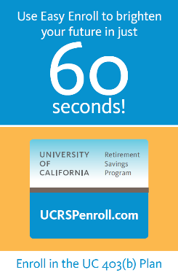
Enroll now
Notes:
If you want to start saving in the 403(b) Plan, you don’t need to wait: you can start right now if you have a tablet or smartphone with you. It’ll only take a minute. Just pull out your phone or tablet, and we’ll walk through the steps together.
Remember, you change your contribution and take a closer look at investments at any time. We just don’t want to miss this opportunity to help you take the first step today!
OK, here’s what to do:
Open your browser and go to UCRSPenroll.com.
Read the acknowledgment, and click “Yes” to proceed. Then enter the last four digits of your Social Security number, your first and last names, and your date of birth. These four pieces of information will help us identify you and verify your eligibility.
Next, select the percentage you want to contribute. Again, you can adjust your contribution at any time.
Lastly, click confirm. That’s it—you’re enrolled.

Slide 23
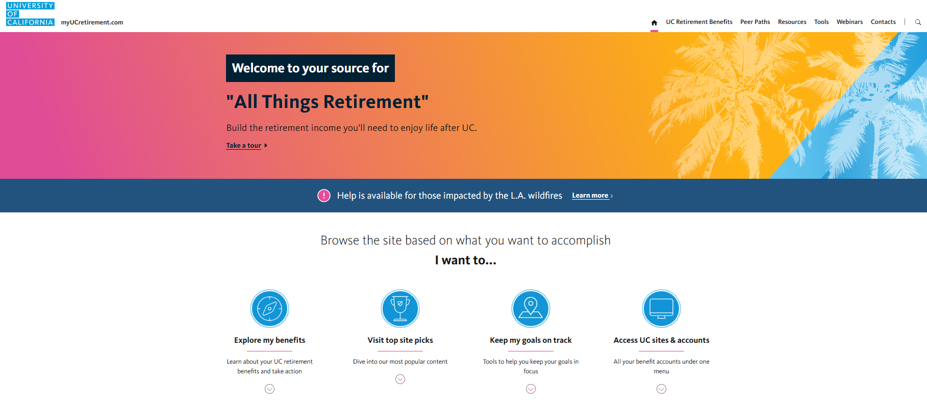
Enroll later
www.myUCretirement.com
1-866-682-7787
Notes:
If you don’t have a smartphone or tablet with you today, or if you simply want to enroll later, just log on to Fidelity NetBenefits® at www.myUCretirement.com.
Then click Peer Paths and then Newly Eligible. Or, you can call a Fidelity Retirement Representative at 1-866-682-7787.
If you’re already enrolled, this is also where you’ll go to change your contribution or investments, sign up for automatic annual increases, and designate a beneficiary. It’s also where you can go if you want to consolidate other workplace savings, like a 401(k) account from a past employer.
Earlier, I shared that you may need as much as 80% of your current estimated annual pay each year in retirement. If you’re wondering how much retirement income you potentially could have from the UC Retirement System, visit www.myUCretirement.com, click on Tools and then select the Retirement Review Tool.
The site will show your Retirement Readiness Score—the percentage of your current estimated annual income you’re currently on track to replace in retirement from UCRP and the UC Retirement Savings Program.

Slide 24
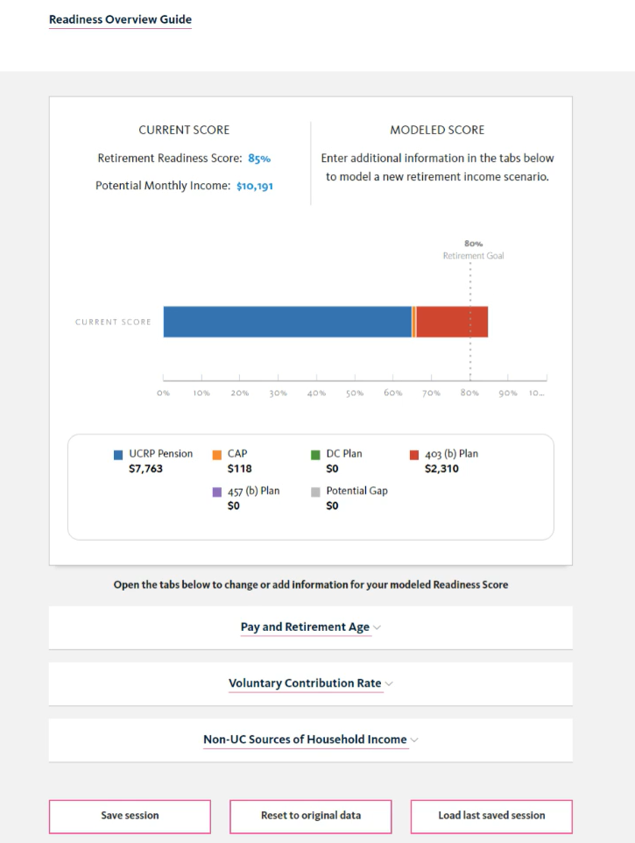
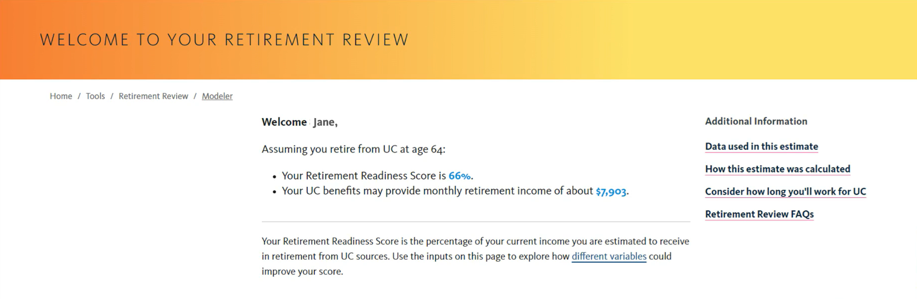
Create your personal retirement strategy
myUCretirement.com/tools/retirement-review/landing
For Illustrative purposes only.
Notes:
Here’s a look at YOUR Retirement Review. In addition to viewing your Retirement Readiness Score, you can also:
Use the modeler to explore ways to increase your score;
Get suggestions for learning about your financial fitness; and
Find answers to your planning and investing questions.
Let’s talk for a minute about your Retirement Readiness Score. It’s based on your UCRP pension benefit and your annual pay, and your UC Retirement Savings Program data as of the most recent month.
If you are eligible for UCRP and you were paid by UC, you’ll see your Retirement Readiness Score when you log in to the site.
If you did not receive pay from UC, you won’t automatically have a Retirement Readiness Score, because the site doesn’t have your annual pay on file. If you enter your annual pay, the site will calculate your Retirement Readiness Score for you. When the pension data is updated again, the site should automatically show your Retirement Readiness Score when you log in.
In addition to the wealth of online resources available, including articles, tools, and tutorials, there are group, phone, and in-person resources to help you, too. Let’s take a look.

Slide 25
Put all you’ve just learned to work for your future
Call 800-558-9182 for help
Text UCPLANNER to 343898
myUCretirement.com®
When you text UCPLANNER to 343898, you will receive a text message from Fidelity. Message and data rates may apply. Text HELP for help and STOP to opt out. Visit https://digital.fidelityinvestments.com/smsee for additional information.
Notes:
Put all you’ve just learned to work for your future. Talking through big questions about your UC Retirement Benefits and financial future can make it all feel a bit more manageable.
Call 800-558-9182 and talk one on one with an experienced Workplace Financial Consultant; or text UCPLANNER to 343898 to schedule an in-person consultation. Together, you can discuss your situation and the best options for reaching your goals.
And don’t forget to visit myUCretirement.com for additional information on the UC Retirement Savings Program.

Slide 26
Important information
Fidelity does not provide legal or tax advice and the information provided above is general in nature and should not be considered legal or tax advice. Consult with an attorney or tax professional regarding your specific legal or tax situation.
Over time, the value of your account will vary and you may have more or less than the original amount invested.
©2015-2025 FMR LLC. All rights reserved.
Fidelity Brokerage Services LLC, Member NYSE, SIPC, 900 Salem Street, Smithfield, RI 02917
702890.16.0

