Slide 1
Presentation by: Joshua Smith
Welcome!
Enriching Lives and Empowering Dreams

Slide 2
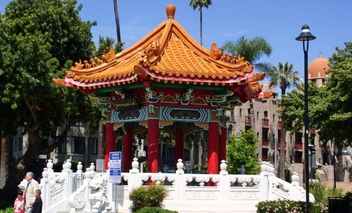
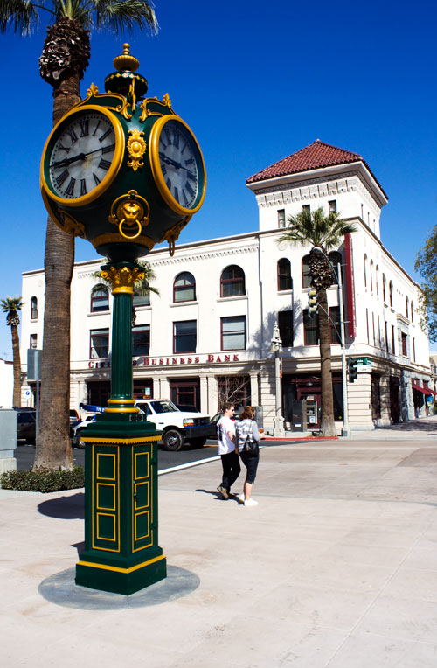
Introduction
Altura Founded in 1957 by two Riverside USD Employees
Grown to be one of the largest credit union in the Inland Empire with more than 205,000 members and growing
23 Current Branches
Notes:
As we look back to Altura’s origin we continue to adapt to the needs of our Community. For example, we continue supporting academics through partnerships, sponsorships and special events throughout the school year to help the education community achieve excellence. This includes, support of the Arts, classroom makeovers, appreciation lunches, internships, job shadowing, financial workshops and funding over 52 $1000.00 scholarships for Seniors throughout Riverside County. Again, This is just one example of our legacy of supporting those in our Community and We are proud of and plan to continue providing resources to Enrich Lives and Empower the Dreams of the Community we serve.

Slide 3
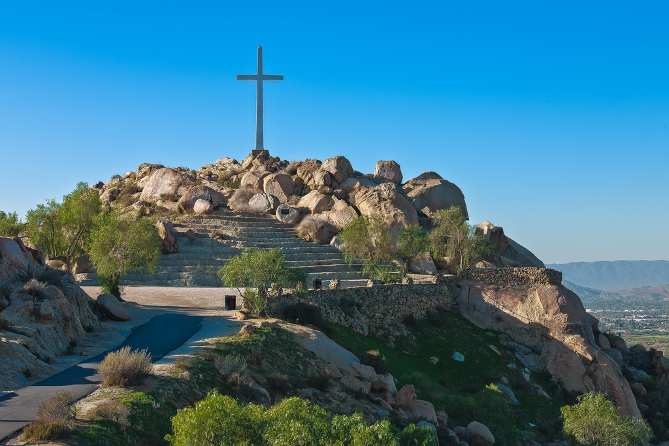
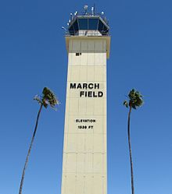
Credit Unions vs. Banks
Credit Union vs. Banks
Credit Union vs. Banks
Credit Union Banks
Not-for-Profit - Profit Driven (owned by stockholders)
Free Accounts - High Fees
Low loan rates - Higher interest rates
Flexible - Strick rules and regulations
Credit building and Balance
Member Service
We are committed to provide accuracy, consistency, and personalized service.
Every member every time

Slide 4
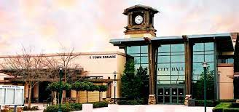
Products and Services
VIP Checking
Free Checking with direct deposit (min. $500 per month)
No fee for non Altura ATM usage
Get paid early with direct deposit
Free Cashiers Checks and Money Orders
Dividend earning account on balances over $100
Free Credit monitoring & I.D. theft protection
Free access to CO-OP Share Branching Network
Free access to 30,000 Plus ATM’s
5,600 Shared Branching locations

Slide 5
Products and Services
Summer Savings
6% Interest Earning Summer Savings Account
Contribute up to $2,500 a month
Funds disperse during Summer Months
Education Supply Card
0% Interest Revolving Credit Card
Build positive payment history
Approval not based on credit – Limit based off credit

Slide 6
Products and Services Cont.
Ascend Checking – A truly free Checking
No Monthly Fees & No Minimum Balance Requirement
No Direct Deposit Required
Credit Builder – Great way to enhance or repair credit
Create positive payment history
Structured Savings Account
No Credit Check
Balance – Free financial resources
Money Management Counseling
Credit Report Review
Debt Management Plan

Slide 7
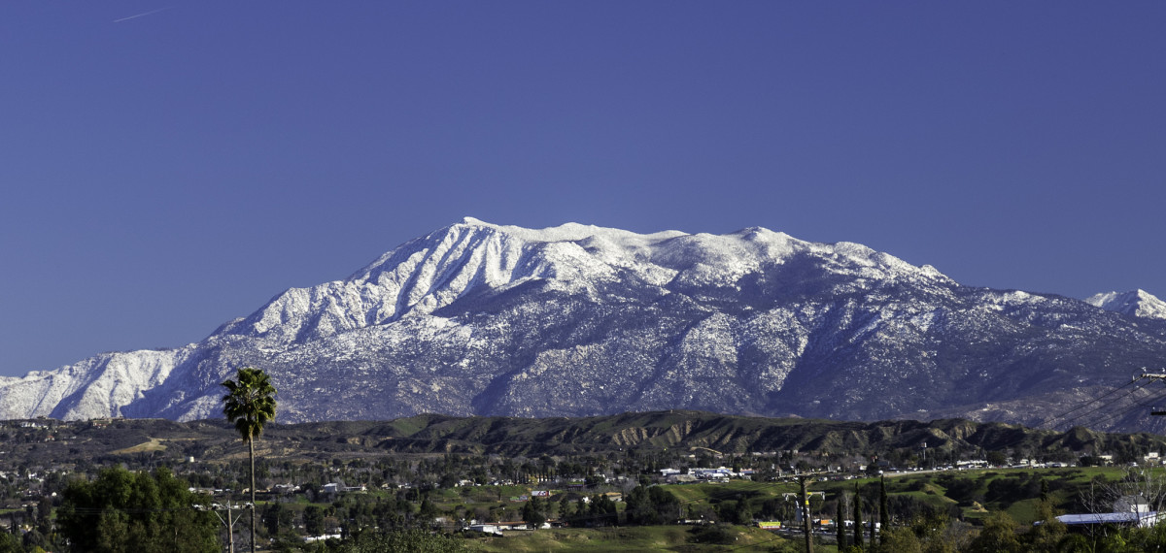
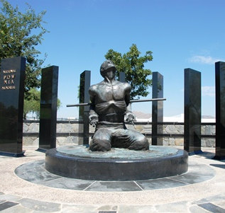
Lending
Auto Loans
Homes Loans
Personal Loans
Credit Cards, Share Secured Credit Card
Auto Expert:
• .25% rate discount on loan for using Auto Expert
• Average savings of $1,500 - $3,000 off MSRP
• 97% Member Satisfaction Score
• Most convenient way to buy a car

Slide 8
Questions?
Contact Information:
Joshua Smith – Business Development Officer
Phone: (951)565-7951
Email: jsmith@alturacu.com
Education Website: https://www.alturacu.com/js-ed/
Thank you!

