Slide 1


Presentation by: Joshua Smith
Welcome!
Enriching Lives and Empowering Dreams
September 2025

Slide 2

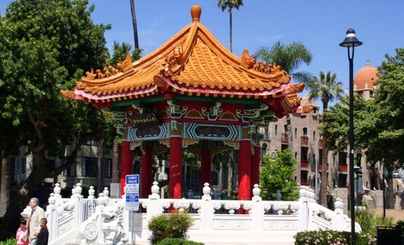
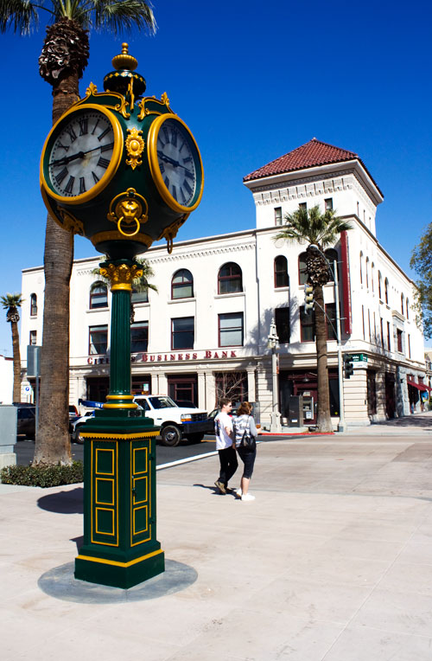

Introduction
Altura Founded in 1957 by two Riverside USD Employees
Grown to be one of the largest credit union in the Inland Empire with more than 209,000 members and growing
23 Current Branches
Notes:
As we look back to Altura’s origin we continue to adapt to the needs of our Community. For example, we continue supporting academics through partnerships, sponsorships and special events throughout the school year to help the education community achieve excellence. This includes, support of the Arts, classroom makeovers, appreciation lunches, internships, job shadowing, financial workshops and funding over 52 $1000.00 scholarships for Seniors throughout Riverside County. Again, This is just one example of our legacy of supporting those in our Community and We are proud of and plan to continue providing resources to Enrich Lives and Empower the Dreams of the Community we serve.

Slide 3

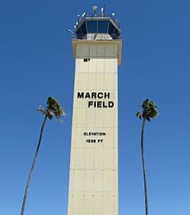
Credit Unions vs. Banks
Credit Union vs. Banks
Credit Union vs. Banks
  Credit Union Banks
    Not-for-Profit - Profit Driven (owned by stockholders)
    Free Accounts - High Fees
    Low loan rates - Higher interest rates
    Flexible - Strick rules and regulations
    Credit building and Balance
Member Service
  We are committed to provide accuracy, consistency, and personalized service.
  Every member every time

Slide 4
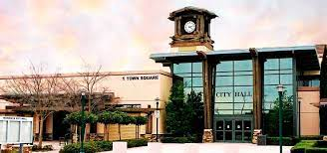

Products and Services
VIP Checking
    Free Checking with direct deposit (min. $500 per month)
    No fee for non Altura ATM usage
    Get paid early with direct deposit
    Free Cashiers Checks and Money Orders
    Dividend earning account on balances over $100
    Free Credit monitoring & I.D. theft protection
    Free access to CO-OP Share Branching Network
      Free access to 30,000 Plus ATM’s
      5,600 Shared Branching locations

Slide 5
Products and Services
Summer Savings
  6% Interest Earning Summer Savings Account
  Contribute up to $2,500 a month
  Funds disperse during Summer Months
Education Supply Card
  0% Interest Revolving Credit Card
  Build positive payment history
  Approval not based on credit – Limit based off credit

Slide 6
Products and Services Cont.
Ascend Checking – A truly free Checking
  No Monthly Fees & No Minimum Balance Requirement
  No Direct Deposit Required
Credit Builder – Great way to enhance or repair credit
  Create positive payment history
  Structured Savings Account
  No Credit Check
Balance – Free financial resources
  Money Management Counseling
  Credit Report Review
  Debt Management Plan

Slide 7

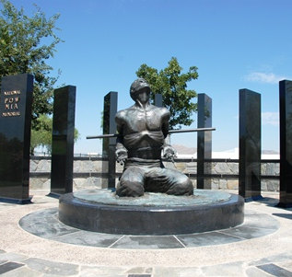
Lending
Auto Loans
Homes Loans
Personal Loans
Credit Cards, Share Secured Credit Card
Auto Expert:
• .25% rate discount on loan for using Auto Expert
• Average savings of $1,500 - $3,000 off MSRP
• 97% Member Satisfaction Score
• Most convenient way to buy a car

Slide 8

Building a Better Budget
If you are one of the many people for whom the word “budget” is the same as the word “denial,” you may be surprised
to learn that the opposite is true. A well-designed budget is the best way for you to reach goals and achieve financial independence – without having to sacrifice all of life’s pleasures.

Slide 9

Why Budget?
Achieve goals
Use money efficiently
Become financially secure
One rule: expenses < income

Slide 10
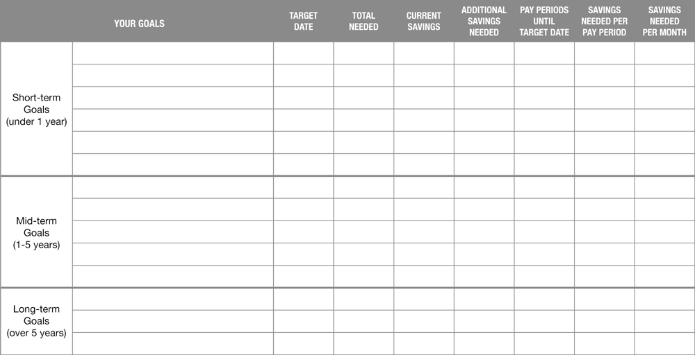
Financial Goal Chart

Slide 11
Sample Goals
Goal type | Goal | Target date | Total needed | Monthly deposit
Short-term | Emergency savings account | 1 Year | $1,800 | $150
Mid-term | Repay debt | 3 Years | $5,000 | $140
Long-term | Fund retirement With high rate of return | 30 Years | $1,000,000 | $350
Total monthly savings for all goals |  |  |  | $640

Slide 12

Establish an Emergency Account
3-6 months of essential living expenses
Liquid account
Create fund while working toward other goals

Slide 13

Start Saving Now
We spend what we make
Automate it!
Don’t wait until after bills are paid
“You” are an essential expense

Slide 14

Constructing a Budget
Calculate Income
  Be Conservative with non-guaranteed income such as; overtime, bonuses, commissions, seasonal work
Two columns
  Essential Spending
  Budget Busters
Subtract total Expenses from income
Make changes if needed

Slide 15
Action Items
1
2
3
Increase income
Decrease spending
Don’t forget goals!
Overtime, part-time, better pay, sell things
Reduce, substitute, postpone, forego

Slide 16

Your Credit Report
Three major credit bureaus
- Equifax, Experian & TransUnion
Bureau's compile and report information
- Payment history, public records, personal information, inquiries
Information is used for credit and other
business decisions

Slide 17
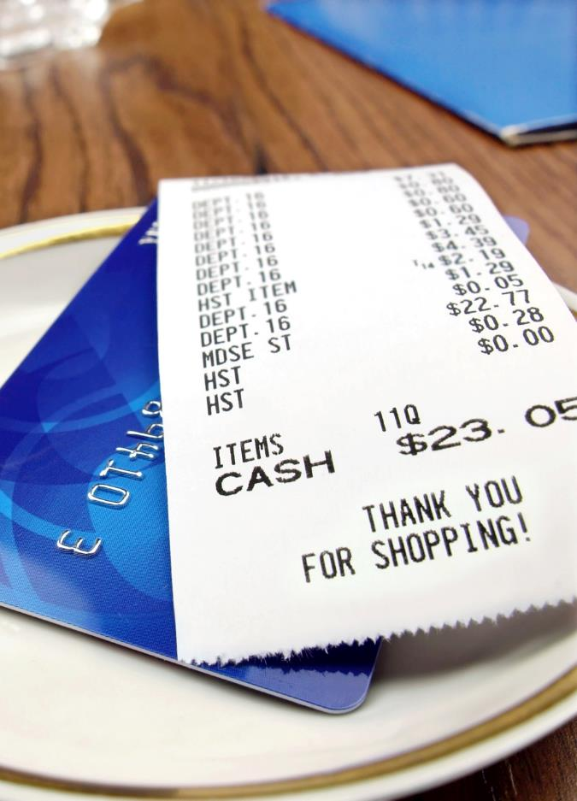
Why Does Good Credit Matter?
Money: where is it going now;
where do you want it to go?
Cost of credit
- Car loans
- Mortgages
- Credit cards
- Personal loans
Insurance costs
Employment opportunities
Housing options

Slide 18
Credit Scoring
FICO scores range from 300-850
Score is based on several factors

Slide 19


BALANCE is a financial education and counseling service. Services include money management counseling, debt repayment options, credit report review, and more.
Call toll-free 888.456.2227 or visit alturacu.balancepro.org
FOLLOW US!
/BALANCEPro
@BAL_Pro

Slide 20

Questions?
Contact Information:
Joshua Smith – Business Development Officer
Phone: (951)565-7951
Email: jsmith@alturacu.com
Education Website: https://www.alturacu.com/js-ed/
Thank you!

