Slide 1



UCR Shared Service Centers
COBRA Training
Employee Offboarding and
Qualifying Life Event Procedures

Slide 2


The Consolidated Omnibus Budget Reconciliation Act of 1985 (COBRA)
COBRA – What is it?
The Consolidated Omnibus Budget Reconciliation Act of 1985 (COBRA) is an amendment to the Health Public Service Act, the IRS Code and the Employee Retirement Income Security Act (ERISA). It is a Federal law enacted to provide employees the option to continue identical, existing coverage if the employee, spouse or domestic partner, or dependents lose group medical, dental, vision or Health FSA coverage due to:
Termination of employment (for reasons other than gross misconduct);
Reduction in work hours below the eligible status;
Death, divorce, legal separation; or
Child ceases to be an eligible dependent (reaches age 26 per ACA).

Slide 3
COBRA Coverage Continuation and Limits
Medical, dental, vision and the Health FSA plans are the only eligible plans to be continued under COBRA.
COBRA allows continued coverage for up to 18 months if employment terminates or working hours are reduced to less than 43.75 percent (17.5 hours per week).
If dependent(s) lose coverage due to divorce, legal separation, annulment, end of domestic partnership, death, or reaching age 26, dependent generally may continue coverage for up to 36 months.

Slide 4
Notification and Enrollment Requirements
Medical, dental, vision and the Health FSA plans are the only eligible plans to be continued under COBRA.
COBRA allows continued coverage for up to 18 months if employment terminates or working hours are reduced to less than 43.75 percent (17.5 hours per week).
If dependent(s) lose coverage due to divorce, legal separation, annulment, end of domestic partnership, death, or reaching age 26, dependent generally may continue coverage for up to 36 months.

Slide 5
Qualifying Life Event Notice Requirement
Employees are required to advise the UCPath Center of qualifying events such as divorce or end of domestic partnership which require the dependent losing coverage to be extended the option of COBRA.
If parties have separate addresses, the affected non-employee dependent may submit the Notice of Qualifying Life event form directly to the UCPath Center to ensure the COBRA packet is received.
The Qualifying Life Event Notification form is found on UCNet and available to be shared: https://ucnet.universityofcalifornia.edu/forms/pdf/uben-109.pdfn

Slide 6
Information about other benefits
Provide terminating employees with the Termination of Employment Benefits booklet containing information about what happens to benefits and UC Retirement plan funds upon separation. https://ucnet.universityofcalifornia.edu/forms/pdf/termination-of-employment.pdf
The What to do if you’re Leaving UC Employment web page found on UCNet contains additional information, things to consider, and guidance. https://ucnet.universityofcalifornia.edu/compensation-and-benefits/roadmaps/leaving-uc-employment.html

Slide 7
COBRA Costs
Former employees pay the full cost of coverage (the employer and employee portion); there is no UC contribution.
  In addition, the employer is allowed to charge an administrative fee to cover additional costs of managing the COBRA program. UC adds a 2% COBRA administration fee.
  COBRA participants pay 102% of the cost for coverage.
The COBRA rates for all plans (medical, dental, vision, Health FSA) are available on UCNet: https://ucnet.universityofcalifornia.edu/forms/pdf/cobra-rates-tip-sheet.pdf

Slide 8
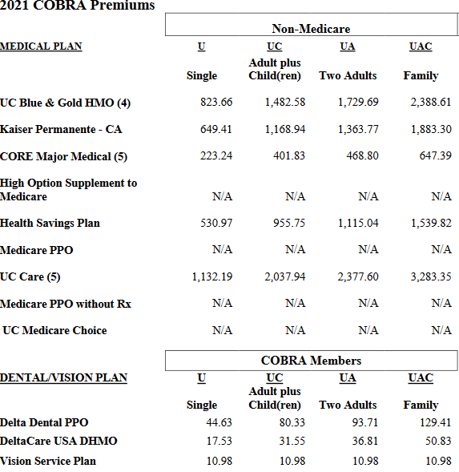
2021 COBRA Premiums

Slide 9
WEX COBRA Third Party Administrator
How to enroll for COBRA coverage
WEX Health is UC’s COBRA plan administrator.
Once notified by the UCPath Center of the employee qualifying event, WEX Health will send a COBRA election packet to eligible beneficiaries.
Former employees must enroll online or send enrollment forms and premiums directly to WEX Health; WEX Health will then report eligibility and premiums to the individual health plans.
COBRA participants are eligible to participate in the Annual Open Enrollment event. All communications, Open Enrollment information, and options are submitted by WEX and plan changes are performed on the WEX system or via mail in election forms.

Slide 10
Notification Contents
A notice of COBRA rights generally includes the following information:
A written explanation of the procedures for electing COBRA.
The date by which the election must be made.
How to notify the plan administrator of the election.
The date COBRA coverage will begin.
The maximum period of continuation coverage.
The monthly premium amount.
The due date for the monthly payments.
Any applicable premium amount due for a retroactive period of coverage.
The address to which to send premium payments.
A qualified beneficiary’s rights and obligations with respect to extensions of COBRA coverage.
The bases for early termination of the period of COBRA coverage.

Slide 11

Contacts
UCPath Center – (855) 982-7284
WEX COBRA Administrator – (844) 561-1338

Slide 12
Questions?

Slide 13
Thank you!

